Slide 1
Chemical Waste Management

Slide 2
ÇM344 Hazardous Waste Management – Chemical Waste Management
Introduction
As a result of our daily facilities we may exposed to a wide variety of chemicals that are used for treatment procedures, cleaning instruments and surfaces, disinfection and sterilization, laboratory procedures, and x-ray processing.
The heart, kidney, liver, and lung tissues can be damaged by the chemicals.
The result could range from short-term discomfort (e.g., burns or rashes) to life-threatening conditions (e.g., cancer, sterility, organ failure).

Slide 3
ÇM344 Hazardous Waste Management – Chemical Waste Management
For all of the chemicals used in domestic or industrial applications, it is important to understand their correct management:
The proper use
The proper storage
The proper handling
The proper spill cleanup
The proper disposal method

Slide 4
ÇM344 Hazardous Waste Management – Chemical Waste Management
Hazardous Chemicals
A hazardous chemical is defined as any chemical that has been shown to cause either a physical or health hazard.
A hazardous chemical is any substance that can:
catch fire
can react or explode when mixed with other substances
is corrosive
is toxic

Slide 5
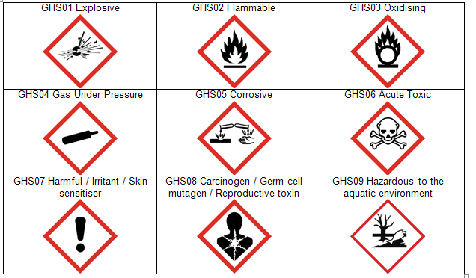
ÇM344 Hazardous Waste Management – Chemical Waste Management
Fig. 1. Chemical Hazard Warning Labels

Slide 6
ÇM344 Hazardous Waste Management – Chemical Waste Management
Primary Methods of Chemical Exposure
Inhalation of gases, vapors, or dusts of chemicals can cause direct damage to the lungs.
Skin: Some chemicals are absorbed through the skin.
Ingestion (swallowing): Eating in an area in which chemicals are used or eating with hands that are contaminated with chemicals is a common way of ingesting harmful chemicals.

Slide 7
ÇM344 Hazardous Waste Management – Chemical Waste Management
Types of Chemical Toxicity
Acute chemical toxicity results from high levels of exposure over a short period of time. This frequently is caused by a chemical spill, in which the exposure is sudden, and often involves a large amount of the chemical.
Chronic chemical toxicity results from many repeated exposures, generally to lower levels, over a much longer time-months or even years.

Slide 8
ÇM344 Hazardous Waste Management – Chemical Waste Management
Personal Chemical Protection
Hand protection: When using chemical disinfectants, wear a utility-type glove made from a chemical-resistant material, such as natural rubber, neoprene, or industrial-grade nitrile.
Eye protection: Protect the eyes from fumes and splashes while pouring chemicals such as x-ray processing solutions, ultrasonic solutions, disinfectants, and sterilants.
Protective clothing: Wear a rubber or neoprene apron when mixing or pouring the chemical.
Inhalation protection: Facemasks should be fluid-repellent and provide respiratory protection.

Slide 9
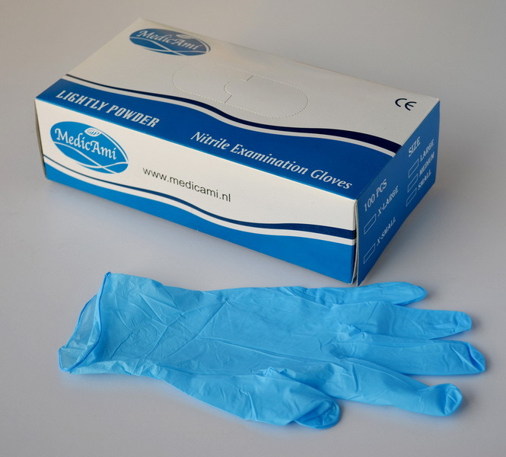
ÇM344 Hazardous Waste Management – Chemical Waste Management
Fig. 2. Nitrile Gloves for Hand Protection

Slide 10
ÇM344 Hazardous Waste Management – Chemical Waste Management
Fig. 3. Chemical resistant polyvinyl chloride (PVC) goggles for eye protection

Slide 11
ÇM344 Hazardous Waste Management – Chemical Waste Management
Fig. 4. Disposable respirator with tapered angle to fit facial contours around nose and chin (Protection for inhalation).

Slide 12
ÇM344 Hazardous Waste Management – Chemical Waste Management
Control of Chemical Spills
Accidents and spills should not be common occurrences.
Planning and practice of dealing with such spills should minimize employee exposure to harmful chemicals.
Refer to the material safety data sheet (MSDS) for the specific product for accurate information on how to manage spills.

Slide 13
ÇM344 Hazardous Waste Management – Chemical Waste Management
Mercury Spill Kits
Mercury spill kits should be available in all dental offices in which amalgam is used.
Exposure to even small amounts of mercury is very hazardous to the health of dental personnel.
Mercury can be absorbed through the skin or through the inhalation of mercury vapors.

Slide 14
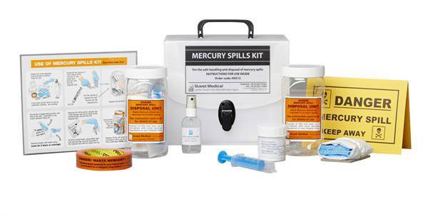
ÇM344 Hazardous Waste Management – Chemical Waste Management
Fig. 5. Mercury Spill Kit

Slide 15
ÇM344 Hazardous Waste Management – Chemical Waste Management
Eye Wash Stations
OSHA regulations require an eye wash unit to be installed in every place of employment in which chemicals are used.
There are a wide variety of styles available.
When turned on, the eye wash unit will irrigate the eyes with a soft, wide flow of water necessary to bathe away contaminants without causing additional damage.
Employees must be trained in the proper use of the eye wash station, and the unit should be inspected every 3 months to make certain it is functional.

Slide 16
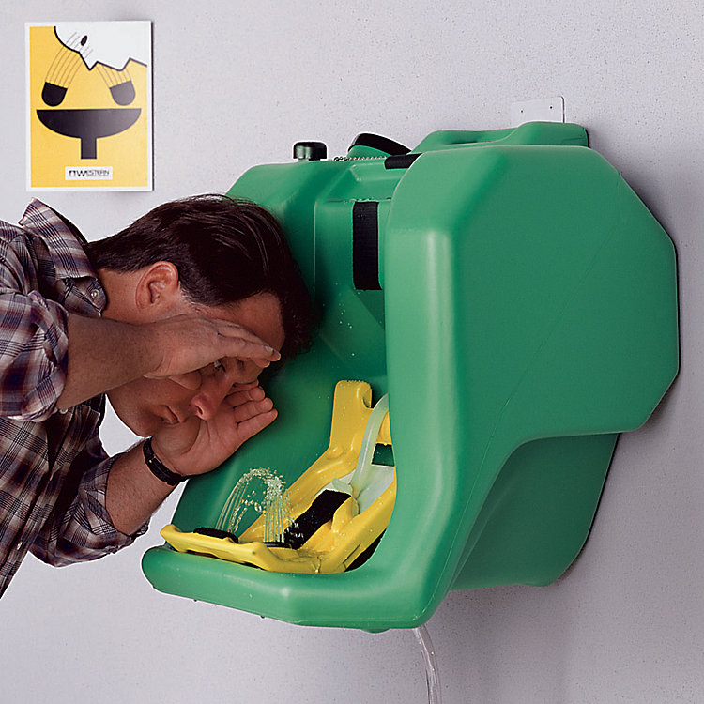
ÇM344 Hazardous Waste Management – Chemical Waste Management
Fig. 6. How to use eye wash station

Slide 17
ÇM344 Hazardous Waste Management – Chemical Waste Management
Ventilation
Good ventilation is a necessity when dealing with any type of chemical.
Many industrial places are equipped with special exhaust systems in the laboratory and sterilization and darkroom areas for fumes and dust.
Radiographic processing chemicals can cause contact dermatitis and irritation of the eyes, nose, throat, and respiratory system due to the vapors and fine particles of chemicals.

Slide 18
ÇM344 Hazardous Waste Management – Chemical Waste Management
Storing Chemicals
All detrimental materials contain chemicals, and the chemical components in some are more hazardous than others.
When changes in the chemical composition of materials occurs, the product may no longer retain its effectiveness.
A basic “safe” policy is to store first aid materials and chemicals in a dry, cool, dark place where they are not exposed to direct sunlight.
The manufacturer’s instructions for storage can be found on the MSDS and should be followed.

Slide 19
ÇM344 Hazardous Waste Management – Chemical Waste Management
Disposal of Chemicals
Empty containers can hold residues that can burn or explode.
Never fill an empty container with another substance because a dangerous chemical reaction could occur.
Follow the label and the MSDS on how to dispose of empty containers.

Slide 20
ÇM344 Hazardous Waste Management – Chemical Waste Management
OSHA Hazard Communication Standard
OSHA issued the Hazard Communication Standard because employees have the right to know the identity and hazards of chemicals that they use in the workplace.
The Hazard Communication Standard is also known as the “Employee Right-to-Know Law.”
It requires employers to implement a Hazard Communication Program.

Slide 21
ÇM344 Hazardous Waste Management – Chemical Waste Management
Hazard Communication Program
Written program
Chemical inventory
Material safety data sheets (MSDS)
Labeling containers
Employee training

Slide 22
ÇM344 Hazardous Waste Management – Chemical Waste Management
Requirements of the Written Program
Identify the individual who is responsible for the program.
It must also describe staff training.
Describe how chemicals are handled in the office.
Provide a description of all labeling and safety measures.
Describe how to respond to chemical emergencies such as spills or exposures.

Slide 23
ÇM344 Hazardous Waste Management – Chemical Waste Management
Requirements for the Chemical Inventory
A comprehensive list of every product used in the office is required.
When a new product containing a hazardous chemical is added to the office, it must be added to the chemical list, and the MSDS for that product is placed in the MSDS file.
The manufacturer or distributor must provide an updated MSDS when appropriate.

Slide 24
ÇM344 Hazardous Waste Management – Chemical Waste Management
Material Safety Data Sheet (MSDS)
MSDSs contain health and safety information about every chemical in the office.
They provide comprehensive technical information and are a resource for employees working with chemicals.
They describe the physical and chemical properties of a chemical, health hazards, routes of exposure, precautions for safe handling and use, emergency and first aid procedures, and spill control measures.
The manufacturers of products that contain hazardous chemicals are required to provide MSDSs.
The MSDSs should be organized in binders.

Slide 25
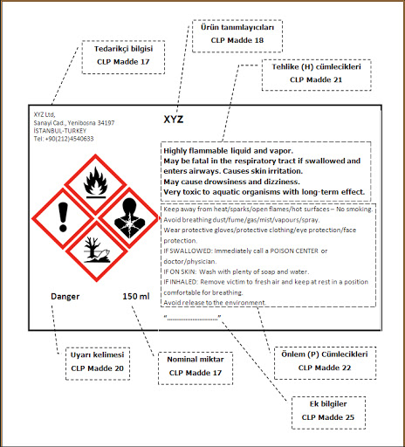
ÇM344 Hazardous Waste Management – Chemical Waste Management
Fig. 7. The common symbols and their meaning in MSDS

Slide 26
ÇM344 Hazardous Waste Management – Chemical Waste Management
Requirements for Employee Training
Staff training is required:
When a new employee is hired
When a new chemical product is added to the office
Once a year for all continuing employees
Records of each training session must be kept on file.
Training records are to be retained for at least 5 years.

Slide 27
ÇM344 Hazardous Waste Management – Chemical Waste Management
Labelling of Chemical Containers
The label must contain
Identity of the hazardous chemical (s)
Name and address of the manufacturer or responsible party
Appropriate warnings

Slide 28
SON

