Slide 1
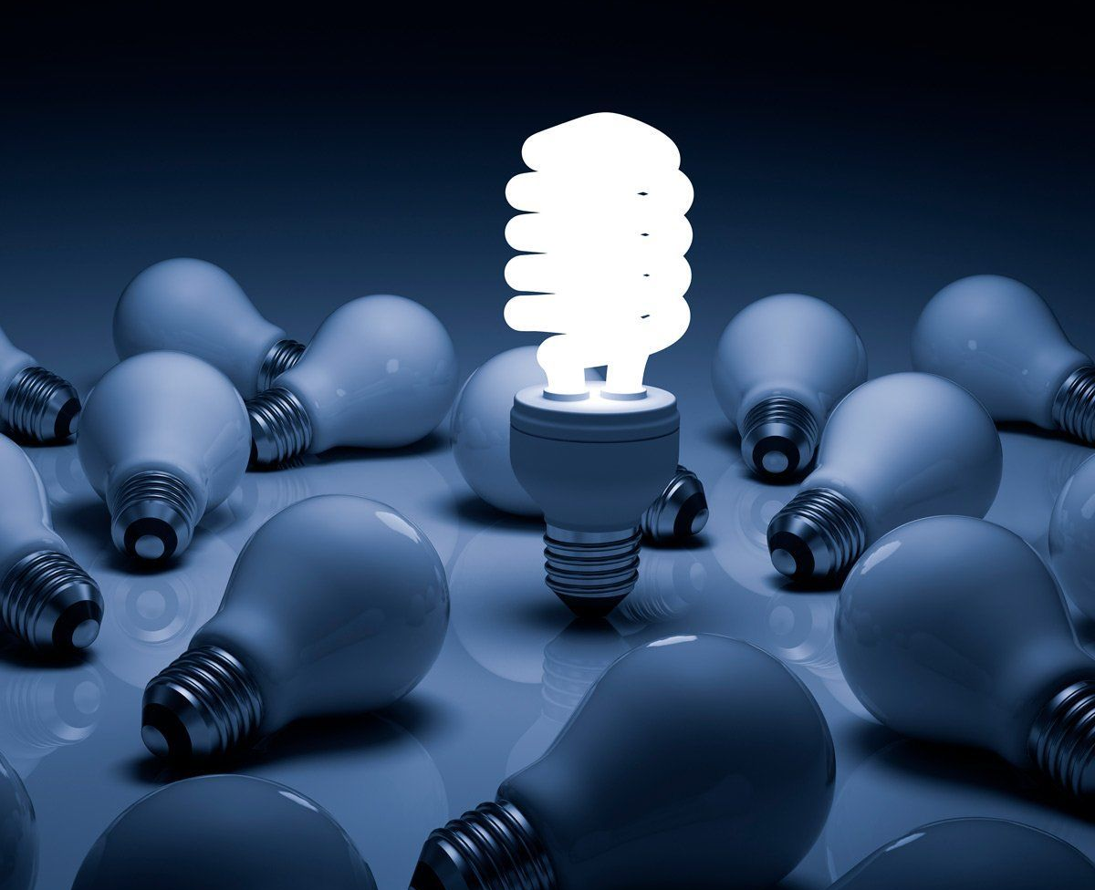
DISPOSAL OF FLUORESCENT WASTES
Merve TAŞCIOĞLU
February,2020

Slide 2
WHAT IS FLUORESCENT?
Fluorescent lamps are lighting systems that contain high vacuum, a small amount of liquid mercury, mercury vapor, some phosphorus dust in the glass frame and are complemented by aluminum heads.

Slide 3
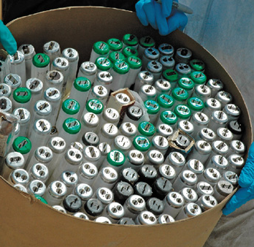
WHAT IS FLUORESCENT?
Fluorescent lamps cause significant damage to the environment due to the mercury they contain. Fluorescent lamps are defined as hazardous wastes in Annex 7, Article 20 Municipal Waste 200121, in the "Regulation on Control of Hazardous Wastes" published in the Official Gazette dated 27 August 1995 and numbered 22387.

Slide 4
MERCURY AND ENVIRONMENTAL EFFECTS IN FLUORESCENT LAMPS
Mercury is a highly toxic inorganic pollutant. Even in the case of a very small amount of inhalation and exposure, it can lead to immediate damage to the body. Fluorescent lamps in the hazardous waste class have started to be disposed in solid waste storage and incineration plants, as they are included in the Hazardous Waste Control Regulation. However, sufficient efficiency cannot be obtained with these disposal methods, but these methods also bring high costs.

Slide 5
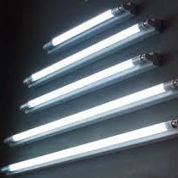
MERCURY AND ENVIRONMENTAL EFFECTS IN FLUORESCENT LAMPS
Fluorescent lamps are safely disposed of with the Bulb Eater Fluorescent Lamp Disposal System developed by the American Aircycle company. Turkey distributorship ENVIROCHEM Environmental Technologies Aircycle use of the new system made by a company that is very easy. By eliminating storage difficulties, the system reduces storage space by 80% and reduces recycling costs. The system collects the glass and aluminum parts in a 200 lt barrel, while keeping the emissions released and mercury vapor with a 3-stage filter system. This system has OSHA and ACGIH standards.

Slide 6
WORKING PRINCIPLE
The fluorescent lamp, which is left in the vacuum system by selecting the appropriate head, is shattered and glass skeleton and aluminum heads are collected in a 200 lt barrel. Dust emissions released and mercury vapor pass through a 3-stage filter system.

Slide 7
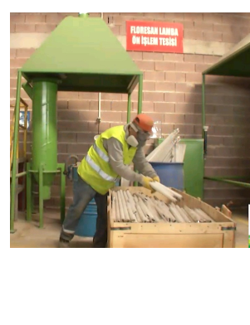
1. Bulb Eater filtration system draws the dirty air formed inside the barrel out of the barrel, mercury vapor is filtered as the dust is released and turned into the barrel. At this point, the air has been cleaned, but mercury vapor may still be present in it.

Slide 8
WORKING PRINCIPLE
2. Mercury vapor comes to the third and final filtration system, the activated carbon filter, after the filtration process in the blue case.

Slide 9
WORKING PRINCIPLE
3. The carbon filter doesn't just hold mercury vapor. At the same time, by neutralizing it, it converts steam into mercury sulfide. Mercury sulfide is also a non-hazardous substance. The fresh air is thrown out of the Bulb Eater through the exhaust vent.

Slide 10
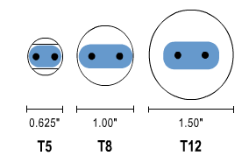
The Bulb Eater Fluorescent Lamp Disposal System
With the Bulb Eater Fluorescent Lamp Disposal System, approximately 1 inch diameter fluorescent lamps can be broken in 1 second. Approximate lamp collection capacity of 200 lt barrel; 1350 flat T8 lamps 875 flat T12 lamps 475 flat long T12 lamps 40 U-shaped T12 lamps

Slide 12
REFERENCES
www.envirochemtr.com
http://www.sureko.com/detaylar/1/haberler/1164/floresan_lambalarin_insan_sagligina_ve_cevreye_etkileri.aspx
https://www.youtube.com/watch?v=QOQU5w2YILE&t=29s

Slide 13
THANK YOU

