Slide 1
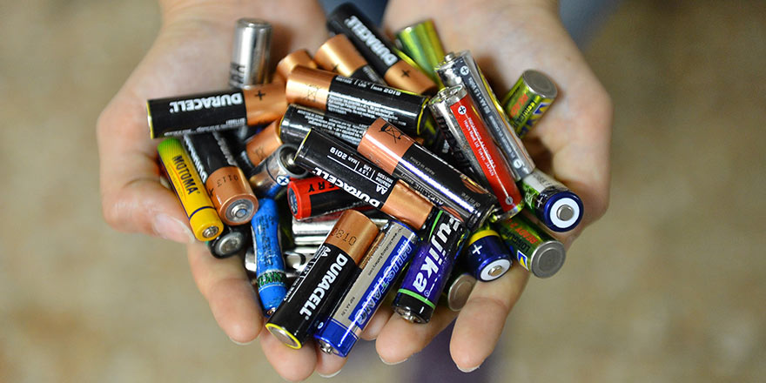
T.C
ERCİYES UNIVERSTY
ENVIRONMENTAL ENGINEERING
HAZARDOUS WASTE MANAGEMENT
COLLECTION OF WASTE BATTERIES AND DISPOSAL
ÇETİN ÖZALTIN
1030920129

Slide 2
CONTENTS
WHAT IS A BATTERY? WHERE TO USE ?
WHAT ARE THE TYPES OF BATTERIES AND WHAT ARE THEIR CONTENTS?
SIGNS ON BATTERY PACKAGING
BATTERY INDUSTRY IN TURKEY
WHAT IS A WASTE BATTERY? WHAT SHOULD WE DO?
COLLECTİON ACTİVİTİES
WASTE BATTERY COLLECTION MATERIALS
SEPARATION BY TYPES
RECYCLING AND DISPOSAL
WASTE BATTERY RECYCLING CYCLE
THE IMPORTANCE OF RECYCLING OF WASTE BATTERIES

Slide 3
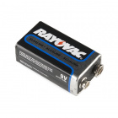
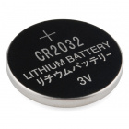
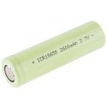
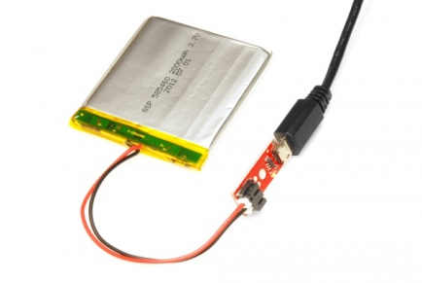
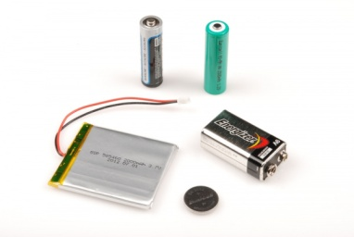
WHAT IS A BATTERY? WHERE TO USE ?
Batteries are a collection of one or more cells whose chemical reactions create a flow of electrons in a circuit. All batteries are made up of three basic components: an anode (the '-' side), a cathode (the '+' side), and some kind of electrolyte (a substance that chemically reacts with the anode and cathode).

Slide 4
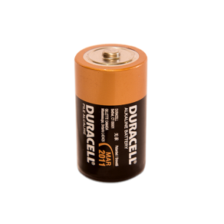
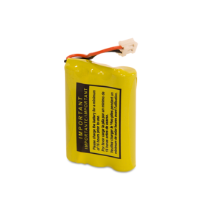
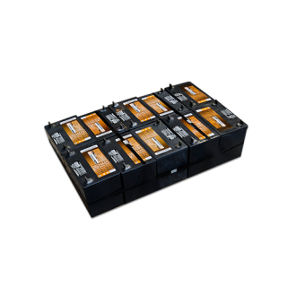
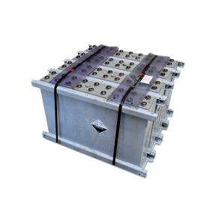
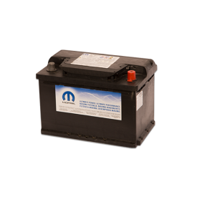
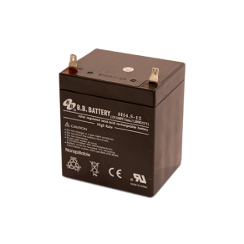
WHAT ARE THE TYPES OF BATTERIES AND WHAT ARE THEIR CONTENTS?
Categorized the batteries into three different sectors:
household (rechargeable and non-rechargeable),
aklanine nickel metal hydride
Industrial batteries.
absolyte ups
Vehicle batteries.
lead acid vrla

Slide 5
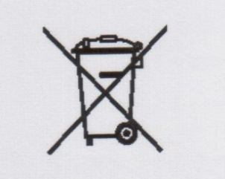
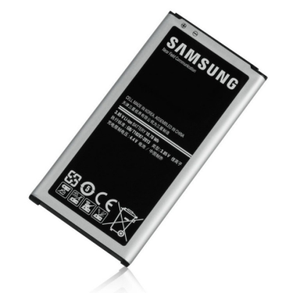
SIGNS ON BATTERY PACKAGING
Indicates that batteries should not be disposed of.
It shows that the amount of mercury in the batteries is greater than 0.0005% (5 mg / kg).
Hg
Indicates that the cadmium content in the batteries is greater than 0.025% (250mg / kg).
Cd

Slide 6
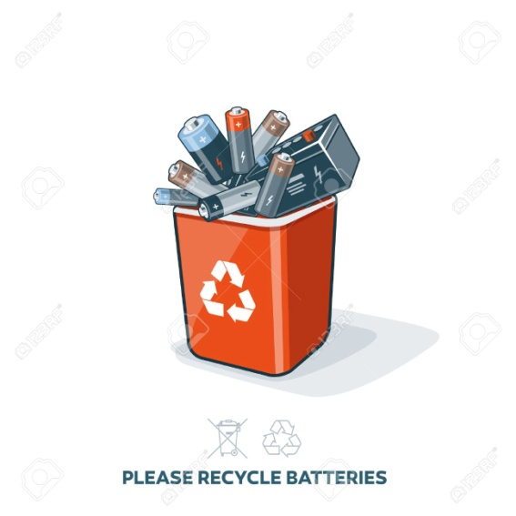
BATTERY INDUSTRY IN TURKEY
Production of batteries in portable types are not made in Turkey. All of the demand is met by imports.
Approximately 85% of the imported batteries are non-rechargeable type (zinc-carbon, alkali manganese and button) and the remainder are nickel-cadmium, nickel-metal hydride or lithium-ion batteries that can be charged.
The consumption of primary batteries varies from rural to urban. The main reason for the change is price difference.
In parallel with the increase in demand on mobile phones and laptops, there has been a large increase in the amount of imported Li-ion batteries.

Slide 7
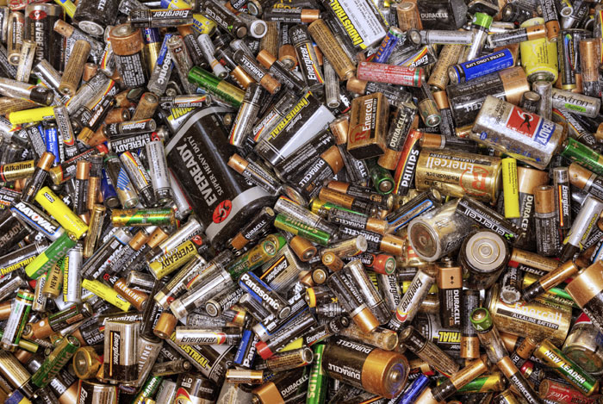
WHAT IS A WASTE BATTERY? WHAT SHOULD WE DO?
We call the batteries that have become unusable due to physical damage and / or have been expired. Recovered batteries cannot be repaired and reused.
Waste batteries should not be mixed with household waste and should never be disposed of in waste.
Waste batteries should not be thrown into the fire, water sources and buried in the ground. Otherwise, the outer container of the battery can be drilled over time and the metals and chemicals in it can be mixed with soil and water.
Waste batteries should be stored separately in your homes and disposed of in waste battery collection boxes.

Slide 8
COLLECTİON ACTİVİTİES
Various chemical substances in waste batteries can be mixed with irrigation water and soil from wild landfills, creating environmental pollution.
In order to increase the efficient use of natural resources through the recovery of waste batteries, we should either dispose of the waste batteries in nylon bags, cardboard boxes or jars, or put them in the waste battery boxes
Located in the collecting centers determined by the municipalities.

Slide 9
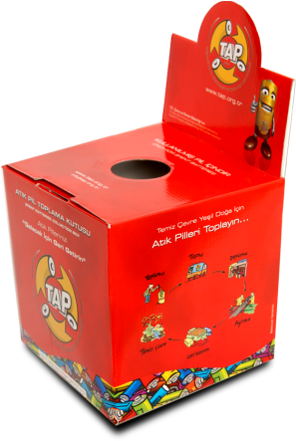
WASTE BATTERY COLLECTION MATERIALS

Slide 10
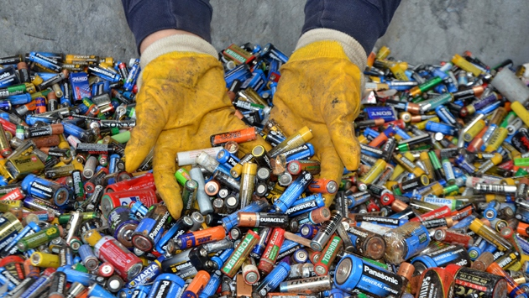
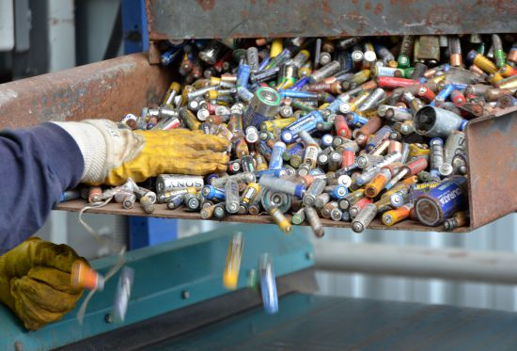
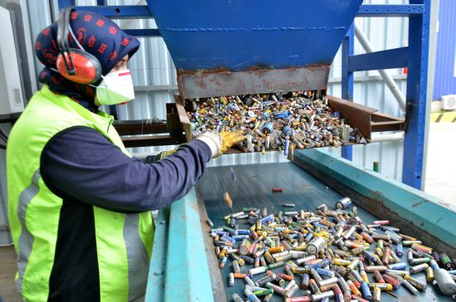
SEPARATION BY TYPES
Turkey's first "Waste Battery Recycling Plant" in Kocaeli.
The waste batteries are disposed in such a way that they do not cause environmental pollution, and the metals are supplied to the industry.
Thanks to the integrated plant, where the separation, recovery and recovery of waste batteries are carried out together, the precious metals inside the batteries are recycled and the potential harm to the environment is prevented.

Slide 11
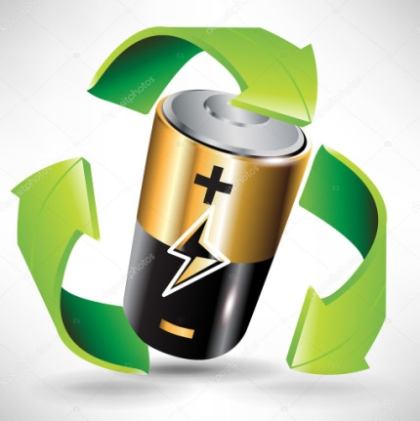
RECYCLING AND DISPOSAL
Most of the batteries include heavy metals like cobalt, manganese, mercury, lead, nickel, cadmium and lithium. Car batteries contain lead, various acids and chemicals. Improper disposal of batteries can contaminate our soil and underground waters.
For this reason, all kinds of batteries need to be recycled or disposed in a proper recycling facility.
Authorized by the Ministry of Environment and Urban Planning and also as a member of both TAP (Turkish Battery Importers and Manufacturers Association) and AKUDER (Association of Accumulator and Recycling Industrialists), GCL collects and provides safe storage for waste batteries.

Slide 12
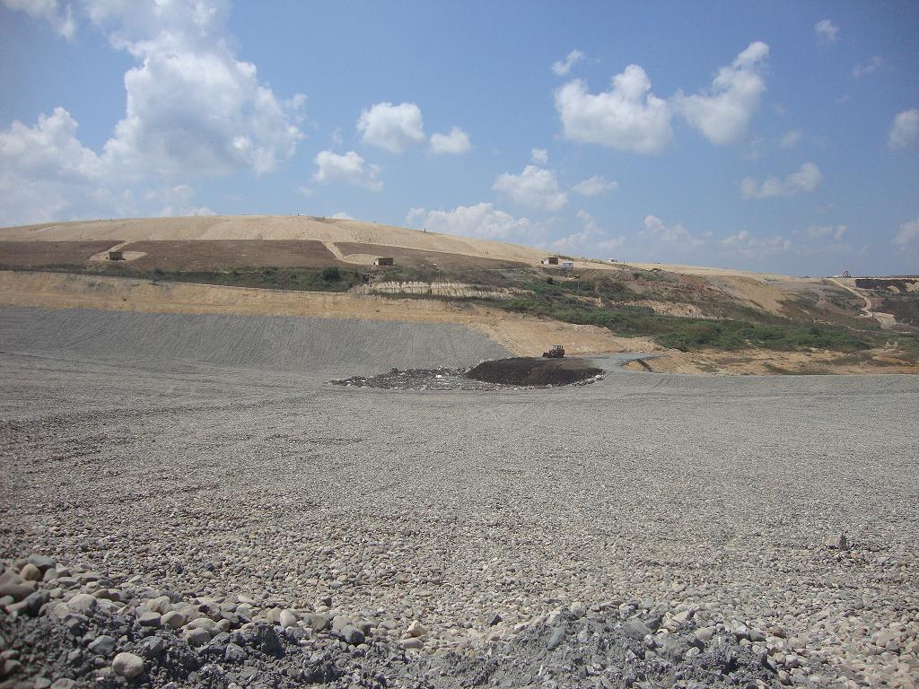

Slide 13
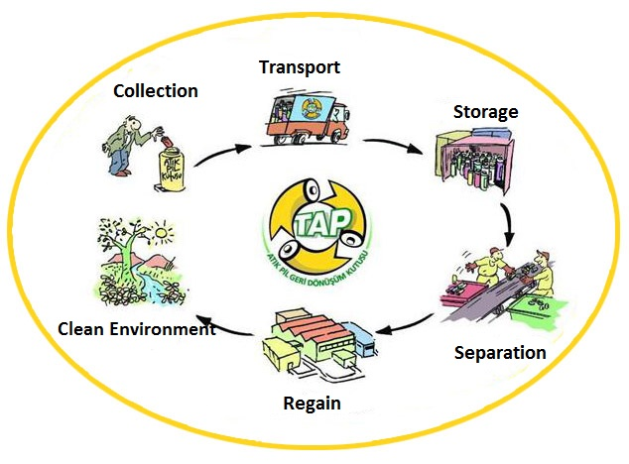
WASTE BATTERY RECYCLING CYCLE

Slide 14
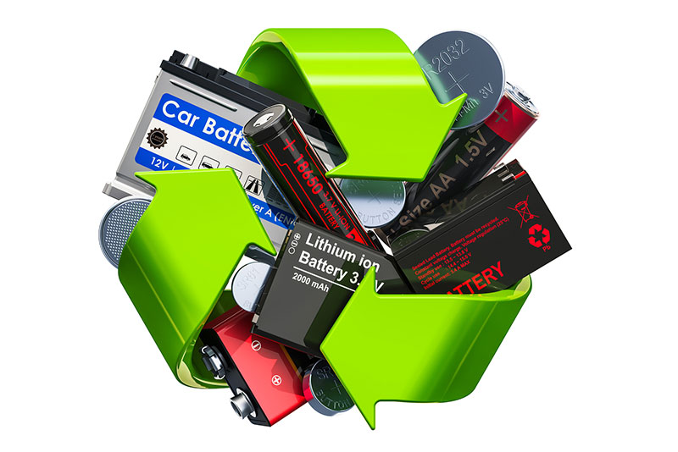
THE IMPORTANCE OF RECYCLING OF WASTE BATTERIES
As waste batteries do not biodegrade, they cannot be disposed of by composting methods. Likewise, since waste batteries do not burn well due to their structure and consequently do not show sufficient shrinkage in their masses, their disposal is not preferred.
The storage of waste batteries under or above ground in a controlled manner is still applied in many countries. However, following the classification of waste batteries according to their chemical structures, it is most convenient to dispose them through recycling processes.

Slide 15
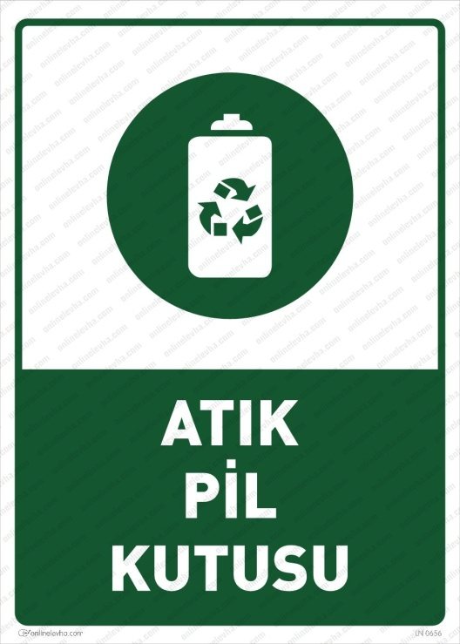
REFERENCES
https://www.omurgokkus.com/ders-sunumlari-waste-management
http://www.gclcevre.com/en/e-waste-recycling/waste-battery-recycling
http://www.jieas.com/volumes/vol191-3/abs19-v14-i3-8.pdf
https://tap.org.tr/pil-atik-pil/sss/atik-pil-nedir-ve-neden-toplanmalidir/

Slide 16
Thank you for listening

