Slide 1
Biomedical Waste Management

Slide 2
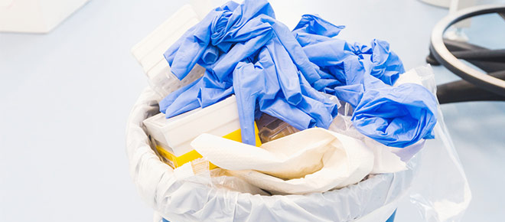
ÇM344 Hazardous Waste Management – Biomedical Waste Management
WHAT IS BIOMEDICAL WASTE?
Biomedical waste is all waste material generated in health care facilities, such as hospitals, clinics, physician’s offices, dental practices, blood banks, and veterinary hospitals/clinics, as well as medical research facilities and laboratories .
Poor management of health care waste potentially exposes health care workers, waste handlers, patients and the community at large to infection, toxic effects and injuries, and risks polluting the environment. It is essential that all medical waste materials have to be segregated at the point of generation, appropriately treated and disposed of safety.

Slide 3
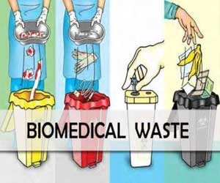
ÇM344 Hazardous Waste Management – Biomedical Waste Management
In the process of health care, waste is generated which usually includes sharps, human tissue or body parts and other materials referred to as "Hospital Solid Waste" and "Bio-medical Solid Waste"
According to the law of waste management in many countries in Europe, USA and India and in the Republic Macedonia regulated by Law of medical waste management (Official Gazette of Republic Macedonia Nº68/2004 and correction in Nº71/2004) medical and clinical waste is waste generated in medical and health institutions (dispensaries, hospitals, polyclinics and outpatient clinics, dental clinics, veterinary stations etc.), originated as a product of used items and materials during diagnosis, convalescence, treatment and prevention in humans and animals.

Slide 4
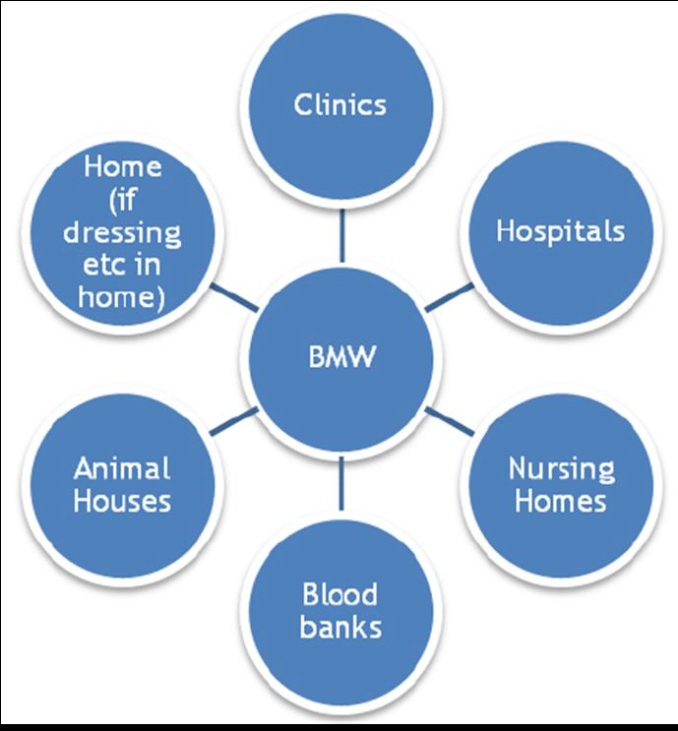
ÇM344 Hazardous Waste Management – Biomedical Waste Management
The major sources of healthcare waste are:
hospitals and other health facilities,
laboratories and research centers,
mortuary and autopsy centers,
animal research and testing laboratories,
blood banks and collection services,
nursing homes for the elderly.

Slide 5
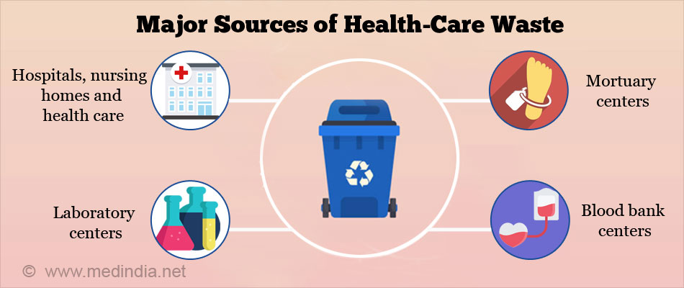
ÇM344 Hazardous Waste Management – Biomedical Waste Management
Medical waste that is a result of the provision of health care can be divided into two groups-municipal and hazardous medical waste. The municipal medical waste includes: paper, carton, glass, food and other common debris arising in the administration, kitchen and laundries.
On the other hand, hazardous medical waste contains elements of chemical and biological threat, in solid, liquid or gaseous form. The properties of hazardous medical waste are virulence, ability for infection, toxicity, carcinogenicity , and so on. According to these properties hazardous medical waste differs from the municipal medical waste.

Slide 6
ÇM344 Hazardous Waste Management – Biomedical Waste Management
Definitions and type of medical waste
Medical (clinical) waste is defined as waste consisting of:
Needle, syringe with needle, surgical instrument of other article that is discarded in the course of medical, dental or veterinary practice or research and has a sharp edge or point capable of inflicting a penetrating injury on a person who comes into contact with it, or
Human tissue, bone, organ, body part or fetus, or
A vessel, bag or tube containing a liquid body substance, or
An animal carcass discarded in the course of veterinary research or medical practice or research, or
A specimen or culture discarded in the course of medical, dental or veterinary practice or research and any material that has come into contact with such a specimen or culture, or
Any other article or matter that is discarded in the course of medical, dental or veterinary practice or research and that poses a significant risk to the health of a person who comes into contact with it.

Slide 7
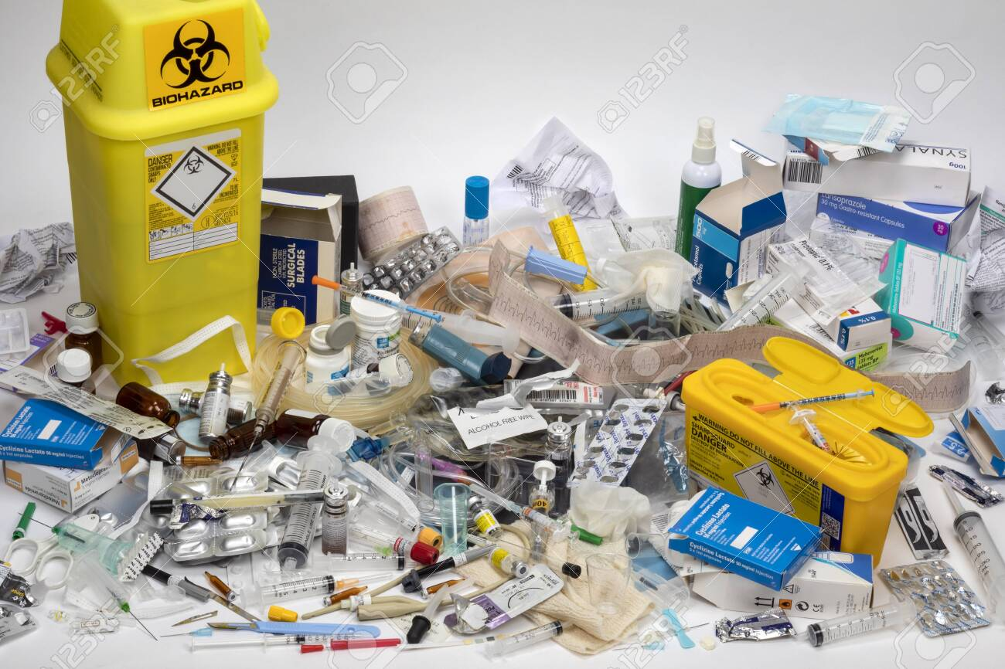
ÇM344 Hazardous Waste Management – Biomedical Waste Management
Although there is no universally accepted definition for medical waste, the definitions offered by most regulatory agencies are similar. Most federal and state agencies differentiate between common medical waste and those wastes with the potential for causing infection and for which special precautions are prudent. Depending on the state, these wastes are referred to as: regulated medical waste, infectious waste, biomedical waste. Some state regulations use a general definition, while others list specific wastes and categories of waste that are considered infectious.

Slide 8
ÇM344 Hazardous Waste Management – Biomedical Waste Management
The following six medical wastes are commonly regulated:
Pathological waste. Tissues, organs, body parts, and body fluids removed during surgery and autopsy.
Human blood and blood products. Waste blood, serum, plasma and blood products.
Cultures and stocks of infectious agents (microbiological waste). Specimens from medical and pathology laboratories. Includes culture dishes and devices used to transfer, inoculate, and mix. Also includes discarded live and attenuated vaccines.
Contaminated sharps. Contaminated hypodermic needles, syringes, scalpel blades, Pasteur pipettes, and broken glass.
Isolation waste. Generated by hospitalized patients isolated to protect others from communicable disease.
Contaminated animal carcasses, body parts and bedding. From animals intentionally exposed to pathogens in research, biologicals production, or in vivo pharmaceuticals testing.

Slide 9
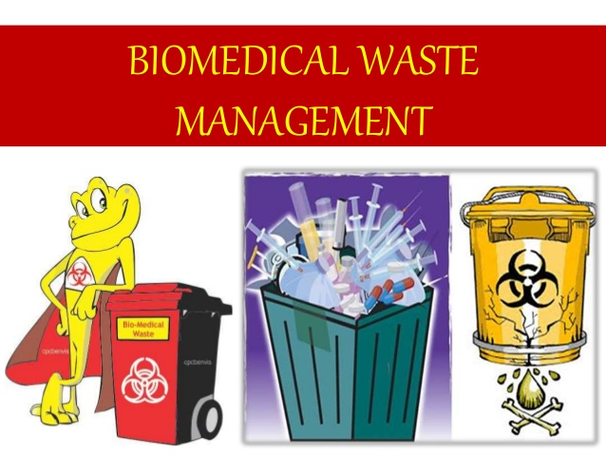
ÇM344 Hazardous Waste Management – Biomedical Waste Management
Definition of biomedical waste
"Any solid, fluid or liquid waste, including its container and any intermediate product, which is generated during the diagnosis, treatment or immunization of human beings or animals, in research pertaining there to, or in the production or testing of biological and the animal waste from slaughter houses or any other like establishments”. Namely, the term clinical waste is associated with waste originating from medical, dental and veterinary sources and has been defined as "waste that is contaminated with blood, saliva or any other bodily hazardous fluids and which may prove hazardous to any person coming into contact with it".

Slide 10
ÇM344 Hazardous Waste Management – Biomedical Waste Management
The World Health Organization (WHO) has defined healthcare waste as "all waste produced by healthcare establishment, research facilities and laboratories including the waste originating from "minor" or "scattered" sources such as that produced in the courses of healthcare undertaken in the home (such as dialysis and insulin injections) (WHO1999 p.6) [13]. 85% of the waste produced by health-care providers is non-risk or "general" health-care waste, comparable to domestic waste. This type of waste usually comes from the administrative and housekeeping functions of health-care establishments and may also include waste generated during maintenance of health- care premises. The remaining 10-15% of healthcare waste as shown in Figure 1 is regarded as hazardous and may create a variety of health risks (WHO, 1999)

Slide 11
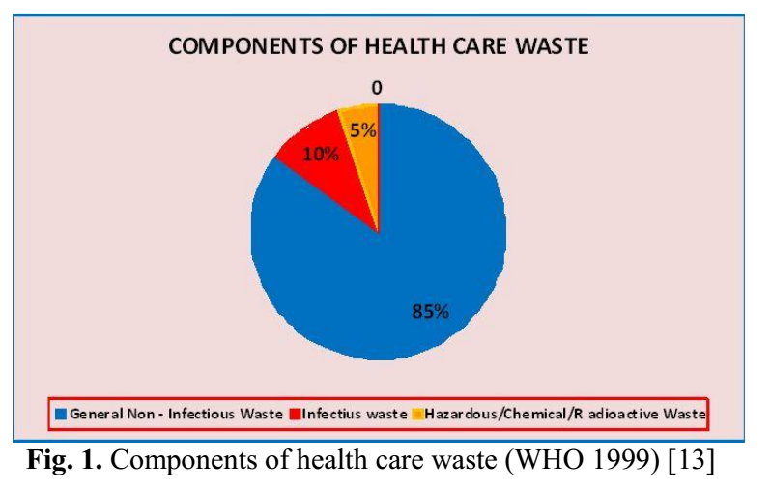
ÇM344 Hazardous Waste Management – Biomedical Waste Management

Slide 12
ÇM344 Hazardous Waste Management – Biomedical Waste Management
Waste and by-products cover a diverse range of materials, as the following list illustrates:
infectious waste: waste contaminated with blood and other bodily fluids (e.g. from discarded diagnostic samples), cultures and stocks of infectious agents from laboratory work (e.g. waste from autopsies and infected animals from laboratories), or waste from patients in isolation wards and equipment (e.g. swabs, bandages and disposable medical devices);
pathological waste: human tissues, organs or fluids, body parts and contaminated animal carcasses;
sharps: syringes, needles, disposable scalpels and blades, etc.;
chemicals: for example, solvents used for laboratory preparations, disinfectants, and heavy metals contained in medical devices (e.g. mercury in broken thermometers) and batteries;
pharmaceuticals: expired, unused and contaminated drugs and vaccines;
genotoxic waste: highly hazardous, mutagenic, teratogenic or carcinogenic, such as cytotoxic drugs used in cancer treatment and their metabolites;
radioactive waste: such as products contaminated by radionuclides including radioactive diagnostic material or radiotherapeutics materials; and
non-hazardous or general waste: waste that does not pose any particular biological, chemical, radioactive or physical hazard.

Slide 13
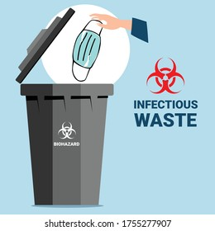
ÇM344 Hazardous Waste Management – Biomedical Waste Management
Infectious waste
Potentially infectious wastes from patients care include: Dressings and swabs, contaminated with blood/body fluids; Laboratory waste including laboratory samples, cultures stocks of infectious agent, laboratory glassware; Instruments used in patient care: those range from diagnostic equipment such as endoscopes, ultrasound probes, syringes and needles, sharps and other instruments, tubings and bags; Potentially infected materials: Placenta, tumors, organs or limbs, which are removed during surgery; Potentially infected animals used in diagnostic or research studies. In all these wastes the major concern is to prevent potential accidental transmission of infection.

Slide 14
ÇM344 Hazardous Waste Management – Biomedical Waste Management
Toxic wastes:
Potentially toxic wastes include: Radioactive waste: these may be solids, liquids and gases used for analytical procedures, body organ imaging and tumor localization and treatment; Chemical waste: these may be hazardous, toxic, corrosive, flammable, reactive or genotoxic; Pharmaceutical agents: these may enter hospital because there was surplus stock, spillage or contamination was detected or the expiry date was over.

Slide 15
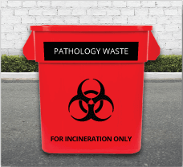
ÇM344 Hazardous Waste Management – Biomedical Waste Management
Categories of medical waste
Pathological & Anatomical Waste: All human anatomical wastes and all wastes that are human tissues, organs, or body parts removed by trauma, during surgery, autopsy , birth, research studies, or another hospital procedure, and which are intended for disposal. Pathological waste differs from anatomical waste in that these are typically samples of tissues that are examined in a laboratory setting to understand the nature of the disease or make a diagnosis. For the most part, pathological waste refers to very small tissue sections and body material derived from biopsies or surgical procedures that are then examined in the lab. Anatomical wastes are typically distinguished as recognizable human organs, tissue and body
parts, and may require special treatment under some state regulations. Some states do not consider hair, teeth and nails to be pathological/anatomical waste

Slide 16
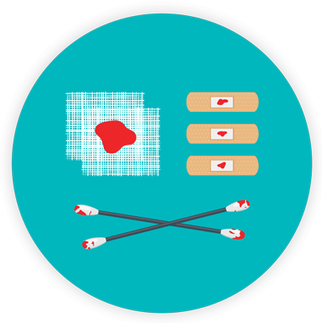
ÇM344 Hazardous Waste Management – Biomedical Waste Management
Bulk human blood, blood products, bulk body fluids or other potentially infectious material (OPIM): This waste category typically includes bulk waste human blood, human blood components or products derived from blood including serum, plasma and other blood
components, or bulk human body fluids as defined as other potentially infectious materials (OPIM), includingthe following human body fluids: semen, vaginal secretions, cerebrospinal fluid, synovial fluid, pleural fluid, pericardial fluid, peritoneal fluid, amniotic fluid, saliva in dental procedures, anybody fluid that is visually contaminated with blood, and all body fluids in situations where it is difficult or impossible to differentiate between body fluids. This category includes sample of these fluids taken in hematology labs, as well as drainage from
surgery, and urine or feces when visibly contaminated by blood.

Slide 17
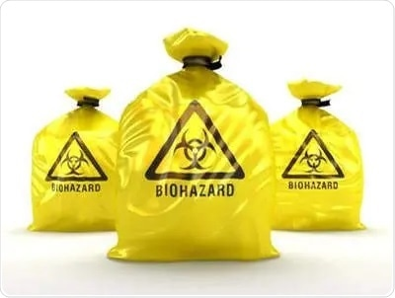
ÇM344 Hazardous Waste Management – Biomedical Waste Management
Microbiological Waste: Microbiological waste is made up of cultures and stocks of infectious agents, and associated microorganisms and biologicals. This waste stream is primarily generated by the healthcare organization’s labs. Discarded cultures, culture dishes and devices used to transfer, inoculate and mix cultures, stocks, specimens, live and attenuated vaccines and associated items are considered microbiological waste, if they contain organisms likely to have been contaminated by organisms that may be pathogenic to healthy humans. Also typically included in this category are discarded etiologic agents and wastes from the production of biologicals and antibiotics likely to have been contaminated by organisms likely to be pathogenic to healthy humans, as well as waste that originates from clinical or research laboratory procedures involving communicable infectious agents

Slide 18
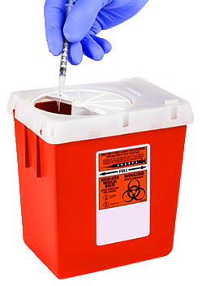
ÇM344 Hazardous Waste Management – Biomedical Waste Management
Sharps: "Sharps" is a term applied to objects such as needles and scalpel blades-anything that can cut or puncture the skin. Their special hazard lies in the fact that, having been designed to pierce the skin, they are very efficient delivery mechanisms for putting infectious
agents directly into the bloodstream. Wastes containing both infectious material and sharp objects create particular hazards for anyone handling them, or coming into contact with them.

Slide 19
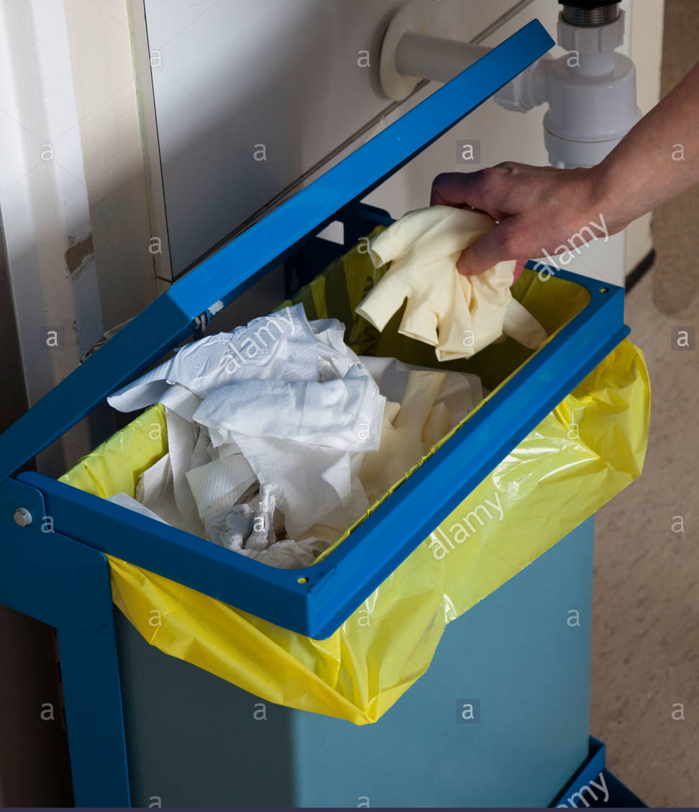
ÇM344 Hazardous Waste Management – Biomedical Waste Management
Isolation Wastes (Wastes from Highly Communicable Diseases): This waste category includes biological waste and discarded materials contaminated with blood, excretion, exudates or secretion from humans or animals who are isolated to protect others from highly communicable diseases (Lassa fever virus, Marburg virus, monkey pox virus, Ebola virus and others).

Slide 20
ÇM344 Hazardous Waste Management – Biomedical Waste Management
Animal Waste: Many facilities have affiliated animal research laboratories as part of their organizational footprint. This waste category includes animal carcasses, body parts, bedding and related wastes that may have been exposed to infectious agents during research, production of biologicals, or testing of pharmaceuticals.
As a special heterogeneous mixture of municipal, infectious, pathological, pharmaceutical, laboratory waste, disinfection agents and packaging, as well as radioactive and chemical waste, hazardous medical waste can be divided into several subgroups for easier and more accurate identification and, therefore, is divided to:
- Infectious (laboratory cultures, fluids, materials and equipment that have been in contact with infected patients);
- Pathological (blood, other body fluids, body parts, fetuses);
- Sharp (objects of needles, scalpels, knives, broken glass);
- Pharmaceutical (drugs, residues of drugs);
- Genotoxic (cytostatic, genotoxic chemicals);
- Chemical (solvents, laboratory reagents, disinfectants);
- Heavy metal (batteries, thermometers);
- Pressure vessels (gas cylinders, metal vessels) and
- Radioactive waste (scrap used in radiation therapy, urine and fluids of patients treated with radio- nuclides).

Slide 21
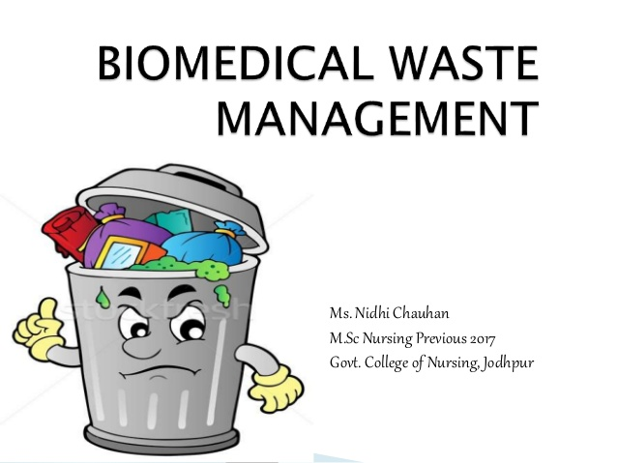
ÇM344 Hazardous Waste Management – Biomedical Waste Management
Management of medical waste
The Hospital Waste Management is part of hospital hygiene and maintenance activities and it involves range of activities, which are mainly engineering functions, such as collection, transport, treatment/processing and disposal waste. Initial segregation and storage activities
are direct responsibility of nursing personal who are engaged in the hospital.
The actual management of medical waste is an organized process that consists of five elements: separation, identification, handling, treatment and disposal.

Slide 22
ÇM344 Hazardous Waste Management – Biomedical Waste Management
Collection of Medical Waste
Medical waste must be collected and stored prior to treatment in a way that reduces the possibility of interaction with humans, animals, or the environment.
Medical waste containers are generally red, contain the word "biohazard" and are imprinted with the universal three- sided biohazard symbol (Table 1, Figure 2- 4). This standardization immediately identifies these containers as medical waste. General storage guidelines include
the following:

Slide 23
ÇM344 Hazardous Waste Management – Biomedical Waste Management
Contaminated reusable sharps must be placed in containers that are puncture resistant, closeable, leak-proof on sides and bottoms, and labeled or color coded,
Reusable sharps that are contaminated with blood or other potentially infectious materials must not be stored or processed in a manner that requires employees to reach by hand into the containers,
Specimens of blood or other potentially infectious material are required to be placed in a container that is labeled and color coded and closed prior to being stored, transported or shipped,
Regulated wastes (liquid or semi-liquid) must be placed in containers that are constructed to contain all contents and prevent leakage of fluids, labeled or color coded, and closed prior to removal,
All bins, pails, cans, and similar receptacles intended for reuse are required to be inspected and decontaminated on a regularly scheduled basis,
Labels must include the biohazard symbol, be fluorescent orange or orange-red or predominantly so, with lettering and symbols in contrasting color, and affixed as closely as possible to the container by adhesive or wire to prevent loss or removal.

Slide 24
ÇM344 Hazardous Waste Management – Biomedical Waste Management
The most visible form of medical waste collection is the sharps container. Sharps containers are found in every medical office, and often in public places, for medical personnel and the general public to safely dispose of hypodermic needles. These containers are designed so the user is never exposed to any of the sharps already in the container, eliminating the possibility of contact or puncture by any of the used needles.
Sharps containers are generally made of thick plastic, and have a door that opens and the user can insert the sharp into the container. When the door is closed, the sharp is dropped down into the main chamber of the container. The container functions much like a standard post office mailbox, in that the user cannot reach the sharps inside the container via the door. Sharps containers are also used for other categories of sharps, including scalpels and lancets.

Slide 25
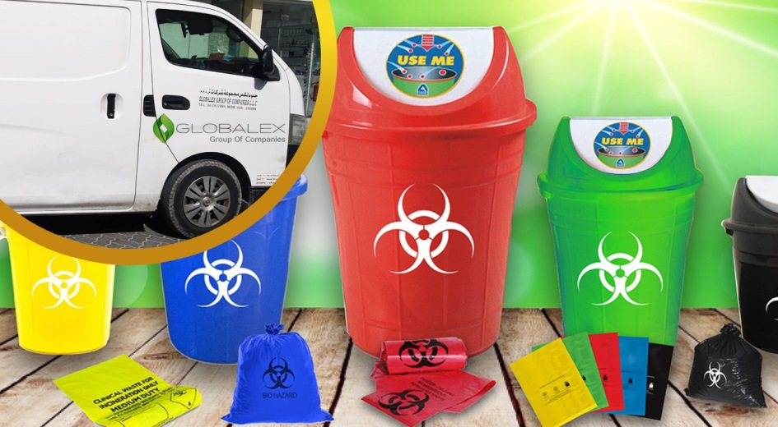
ÇM344 Hazardous Waste Management – Biomedical Waste Management
Community Hazardous Waste Collection
Many municipalities have occasional household hazardous waste collection days when authorities designate a place where residents bring waste from their homes.
These are intended to be strictly for residential/household waste, not from commercial facilities. Different authorities have different rules, but usually these collection days explicitly prohibit infectious waste.

Slide 26
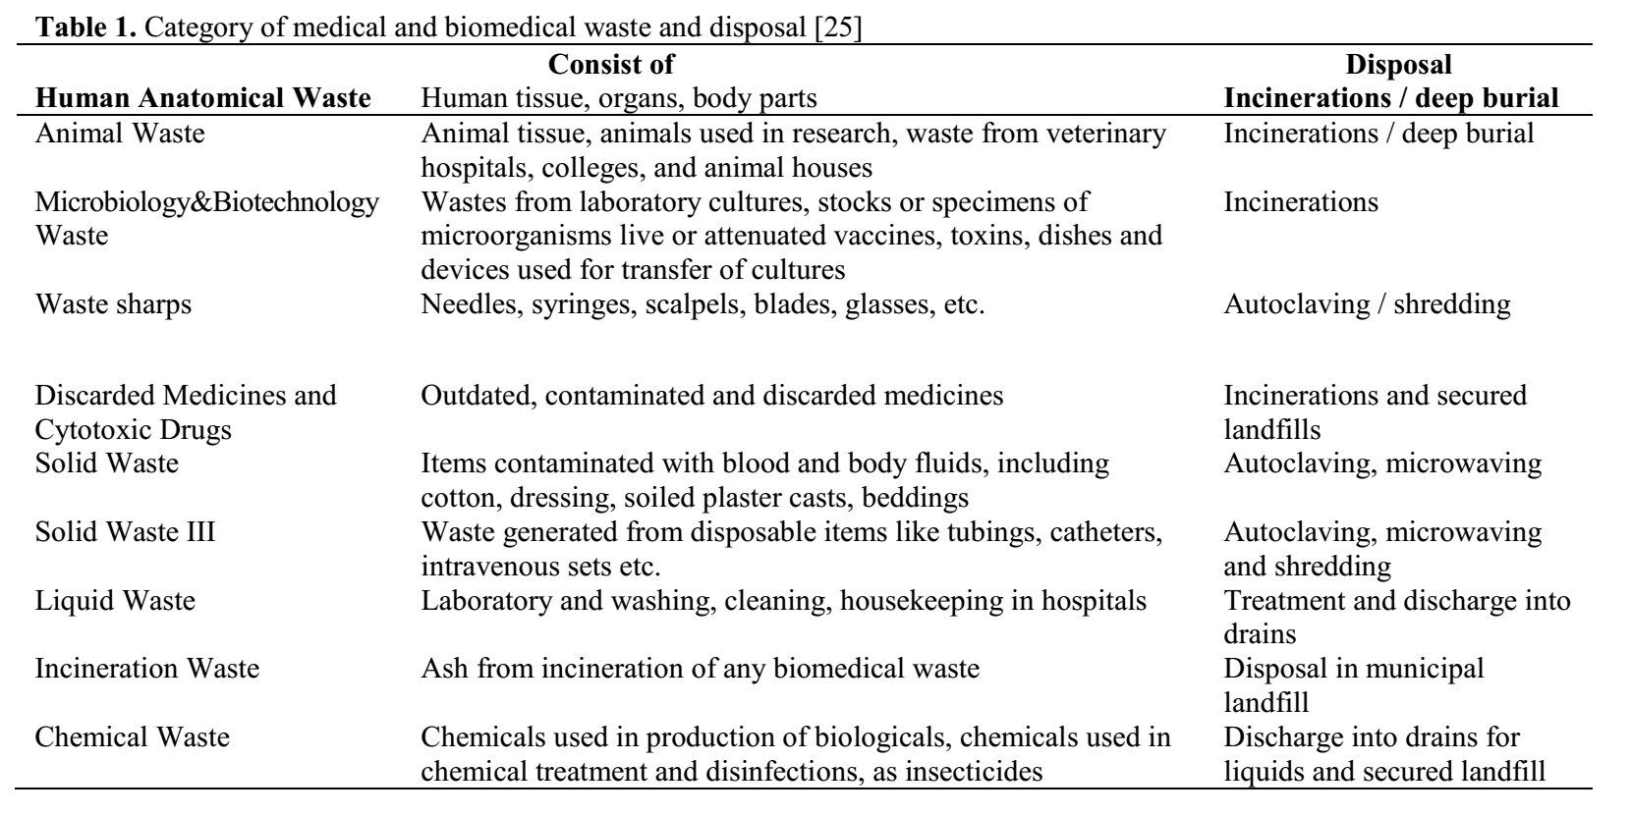
ÇM344 Hazardous Waste Management – Biomedical Waste Management

Slide 27
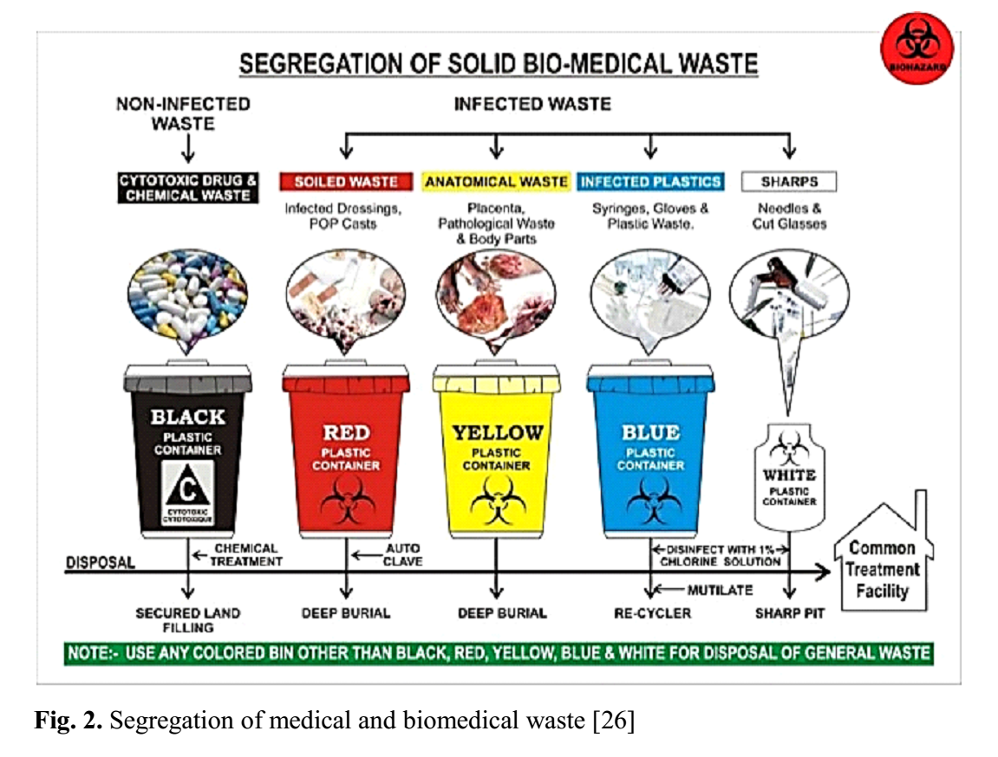
ÇM344 Hazardous Waste Management – Biomedical Waste Management

Slide 28
ÇM344 Hazardous Waste Management – Biomedical Waste Management

Slide 29
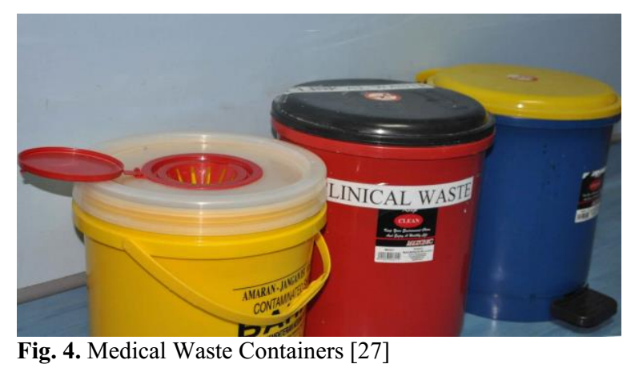
ÇM344 Hazardous Waste Management – Biomedical Waste Management

Slide 30
ÇM344 Hazardous Waste Management – Biomedical Waste Management
Treatment of Medical Waste
The primary methods of treatment and disposal of medical waste are:
Incineration
Autoclaves
Mechanical/Chemical Disinfection
Microwave
Irradiation

Slide 31
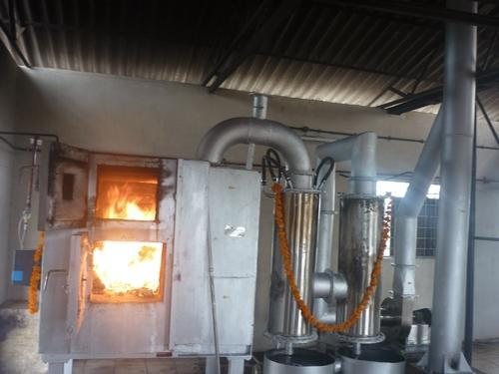
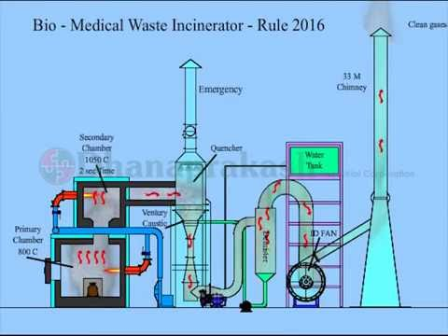
ÇM344 Hazardous Waste Management – Biomedical Waste Management
Incineration
According to the EPA, 90% of medical waste is incinerated. Incineration is the controlled burning of the medical waste in a dedicated medical waste incinerator. Among industry folks, these units are often referred to as hospital/medical/infectious waste incinerators (HMIWIs).

Slide 32
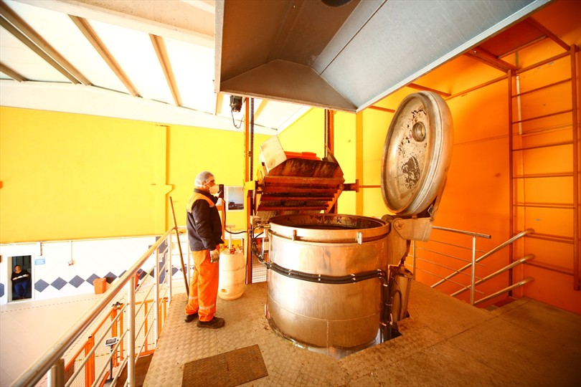
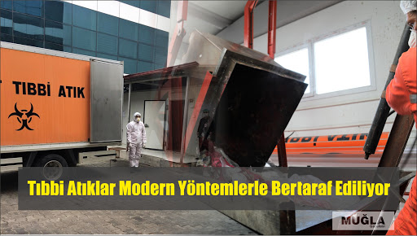
ÇM344 Hazardous Waste Management – Biomedical Waste Management
Autoclaves
Autoclaves are closed chambers that apply both heat and pressure, and sometimes steam, over a period of time to sterilize medical equipment. Autoclaves have been used for nearly a century to sterilize medical instruments for re-use. Autoclaves are used to destroy microorganisms that may be present in medical waste before disposal in a traditional landfill

Slide 33
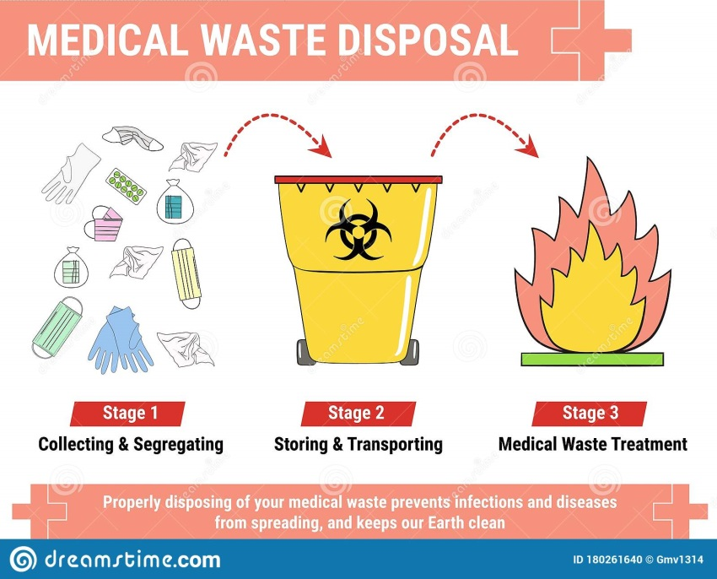
ÇM344 Hazardous Waste Management – Biomedical Waste Management
Disposal
Mechanical/Chemical Disinfection
Chemical disinfection, primarily through the use of chlorine compounds, is another method to treat medical waste. The use of chlorine bleach for cleaning and disinfecting is well known and this method has been in use for many years. The mechanical/chemical disinfection process provides control and consistency to the disinfection process. The EPA identifies chemical disinfection as the most appropriate method to treat liquid medical waste. Chemical disinfection processes are often combined with a mechanical process, such as shredding or maceration, to ensure sufficient exposure of the chemicals to all portions of the waste

Slide 34
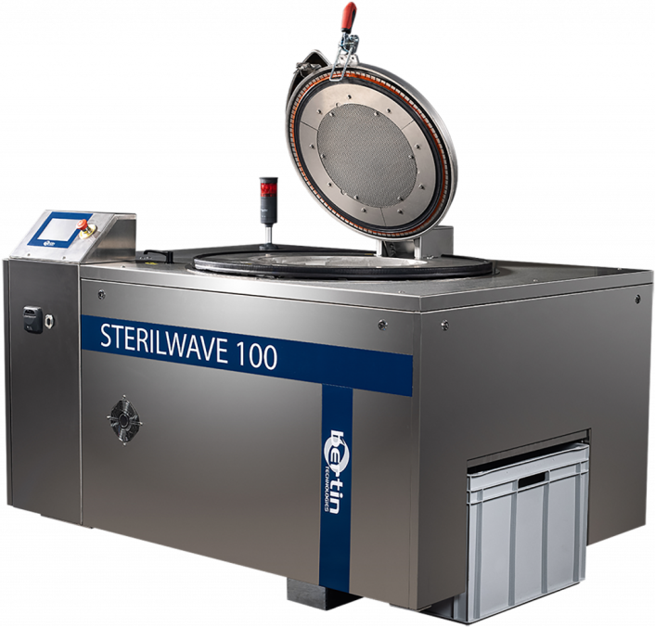
ÇM344 Hazardous Waste Management – Biomedical Waste Management
Microwave
The use of microwaves to disinfect medical waste has only recently been introduced in the United States. Microwave treatment units can be either on-site installations or mobile treatment vehicles. In this type of disinfection process, the waste is first shredded. The shredded waste is then mixed with water and subjected to microwaves. The microwaves internally heat the waste, rather than applying heat externally, as in an autoclave

Slide 35
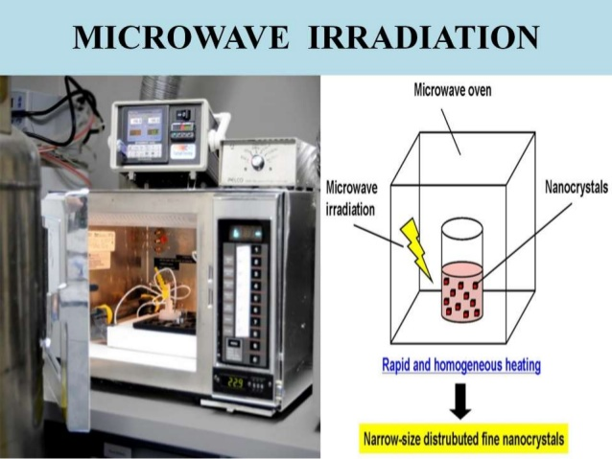
ÇM344 Hazardous Waste Management – Biomedical Waste Management
Irradiation
Another method used to sterilize medical equipment or waste is irradiation, generally through exposure of the waste to a cobalt source. The gamma radiation generated by the cobalt inactivates microbes. Dedicated sites are required for this form of treatment, while mobile versions are available for other non- incineration methods.
The World Health Organization recommends as protective gear for anyone who comes into contact with medical waste to wear: helmet; protective face mask; goggles; special jumpsuits; industrial aprons; feet guards; boots etc.

Slide 36
ÇM344 Hazardous Waste Management – Biomedical Waste Management
Proposals
In each health institution, actions should be organized and controlled with regards to the occurrence of the medical waste stream and reduce the amount of hazardous materials medical waste, as well as on- site waste collection.
It's important to clearly define the responsibility for proper waste management, to the process of its final processing. It is necessary to develop a comprehensive and planned management system that beside responsibility should provide funds for safe implementation of waste. This is a long process that despite organizational structure requires individual and professional commitment.

Slide 37
ÇM344 Hazardous Waste Management – Biomedical Waste Management
THANK YOU!

