Slide 1
HAZARDOUS WASTE MANAGEMENT
Hazardous Characteristics

Slide 2
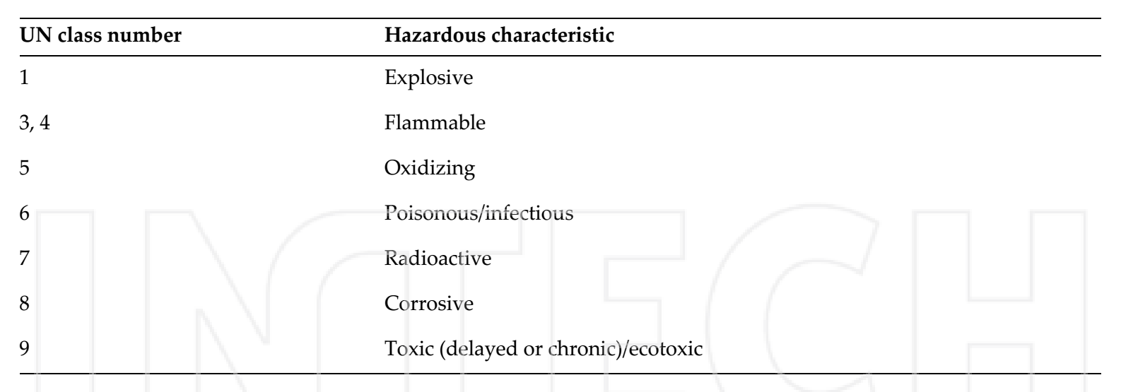
ÇM344 Hazardous Waste Management – Hazardous Characteristics
A useful listing of hazardous characteristics is that provided by the United Nations as part of recommendations relating to the transport of dangerous goods as illustrated in Table 1.
Table 1. Hazardous characteristics: extracted from UN listing

Slide 3
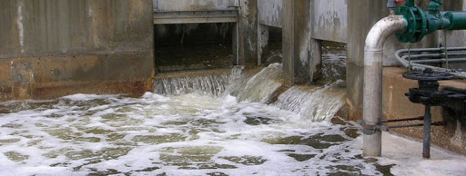
ÇM344 Hazardous Waste Management – Hazardous Characteristics
1. Industrial wastes
Waste generated from industrial sources can have non‐hazardous and hazardous components, with non‐hazardous waste usually representing the greater part of the volume. The hazardous component of this waste is relatively small in volume.
This type of waste was identified as hazardous waste when proceeds toxicity test, corrosively test, ignitability test, and some special character test. As a hazardous pollutant, it may impose serious impacts on surrounding environment and such impacts should be quantitatively examined to assess the influence on human health.

Slide 4
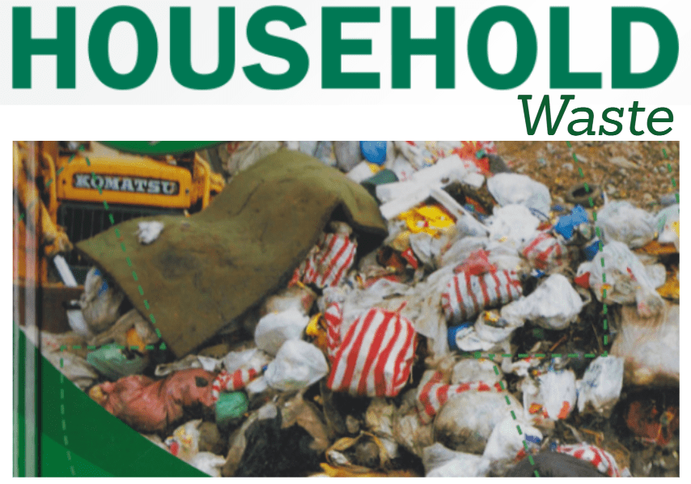
ÇM344 Hazardous Waste Management – Hazardous Characteristics
2. Household waste
Households generate small quantities of hazardous wastes such as oil‐based paints, paint thinners, wood preservatives, pesticides, insecticides, household cleaners, used motor oil, antifreeze, and batteries. It has been estimated that household hazardous waste in industrialized countries such as the United States accounts for a total of about 0.5% (by weight) of all waste generated at home, while in most developing countries, the percentage probably is even lower [3].

Slide 5
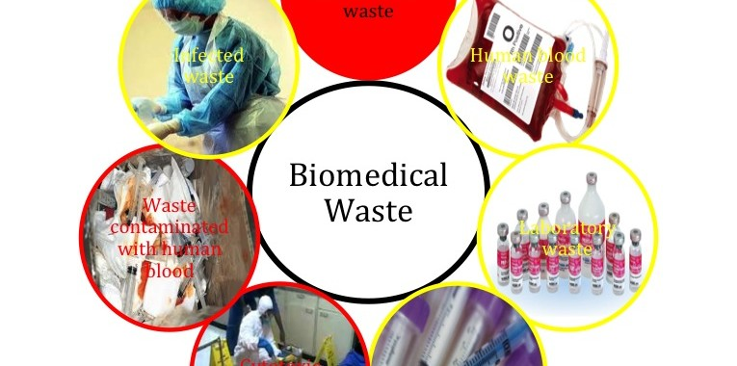
ÇM344 Hazardous Waste Management – Hazardous Characteristics
3. Biomedical waste
There are some of hazardous medical and dental wastes that, when disposed improperly, could cause harm to the environment. It also presents an occupational health hazards to the health‐care personnel who handle these wastes at the point of generation and those involved with their management, that is, segregation, storage, transport, treatment, and disposal.
Healthcare waste that is capable of producing injury or disease including many sorts of
hazardous wastes such as:
Infectious waste: Which contain pathogens namely bacteria, viruses, fungi, or parasites in
concentrations sufficient to cause disease in susceptible hosts. Cultures and stocks of
infectious agents from laboratory work; tissues and dressing generated from autopsies,
Introductory Chapter: Introduction to Hazardous Waste Management surgeries, and treatment of infected patients and animals; materials or equipment in contact
with blood and infected body fluids.

Slide 6
ÇM344 Hazardous Waste Management – Hazardous Characteristics
Pathological waste: Including tissue, organs, body parts, human fetuses, and animal
carcasses, blood and body fluids.
Sharps: It comprise syringes, needles, scalpels, saws, infusion sets, knives, blades, broken
glass, or other items that can cause cut or puncture wounds.
Pharmaceutical waste: It covers expired, unused, spilt, and contaminated pharmaceutical
products, drugs, vaccines, and sera that are no longer required and need to be disposed of
in appropriate manner.
Genotoxic waste: This type combines cytostatic drugs, vomit, urine, or feces from the
patients treated with cytotoxic drugs, chemicals, and radioactive materials. Genotoxic waste has mutagenic, teratogenic, and carcinogenic properties.
Chemical waste: Discarded solid, liquid, or gaseous chemicals should be considered as
hazardous if it is toxic, corrosive, inflammable, or reactive.
Waste with high content of heavy metals: Mercury (thermometers, blood pressure gauges,
amalgam), cadmium (discarded batteries), and lead (reinforced wood panels for radiation
proofing in radiology department) generated from hospitals could be represented as a
subcategory of hazardous chemical waste.

Slide 7
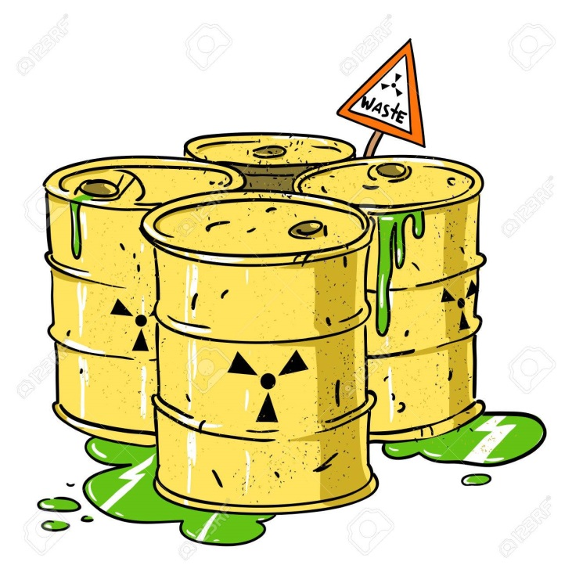
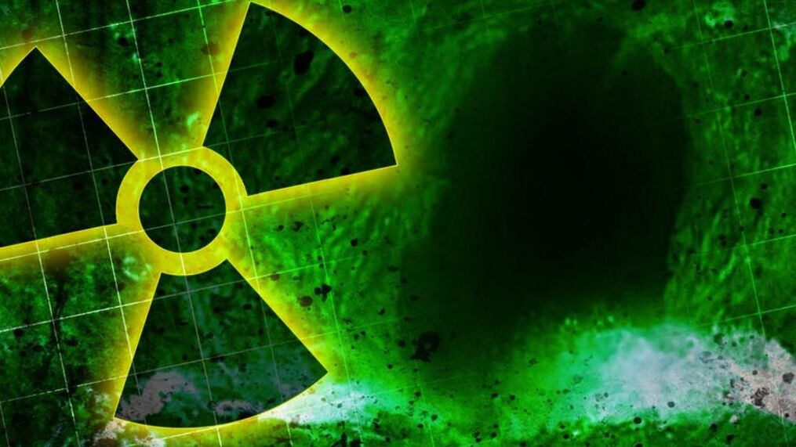
ÇM344 Hazardous Waste Management – Hazardous Characteristics
Radioactive waste: The use of radioisotopes in vitro analysis of body tissues and fluids, in
vivo organ imaging, tumor localization, and treatment and various clinical studies involving certain radionuclides need to be specially managed in a centralized treatment facility for radioactive wastes.

Slide 8
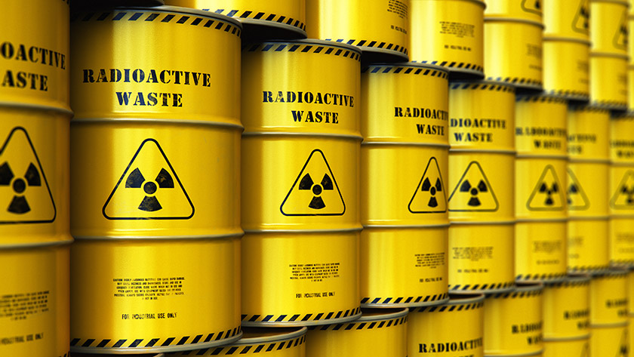
ÇM344 Hazardous Waste Management – Hazardous Characteristics
Radioactive waste
Nuclear applications have been rapidly developed recently, and several nuclear power plants
started to work throughout the world. The potential impact of released radioactive contaminants into the environment has received growing attention due to nuclear accidents. Contamination of soil and water by radionuclides due to natural processes, global fallout from nuclear weapon testing, discharges from nuclear installations, disposal of nuclear waste, and occasional nuclear accidents (i.e., Chernobyl in 1986 and Fukushima in 2011) poses serious problems to biological systems. Radioactive waste includes a variety of radionuclides and occurs in a variety of physical and chemical forms. It can be generally classified as low‐/intermediate‐level radioactive waste and high‐level radioactive waste.

Slide 9
ÇM344 Hazardous Waste Management – Hazardous Characteristics
Radioactive waste, arising from civilian nuclear activities as well as from weapon activities, poses a potential problem for handling and saving the environment for coming generations.
Radioactive waste includes a variety of radionuclides and occurs in a variety of physical
and chemical forms. It can be generally classified as low‐/intermediate‐level radioactive
waste and high‐level radioactive waste. Nuclear research establishments include, for example, waste containing different organic components, toxic or chemically aggressive constituents, radionuclides with specific properties (high mobility, high chemical activity, volatile elements, etc.), waste difficult for treatment and not appropriate for direct immobilization (e.g., spent organic ion exchange resins and spent liquid scintillation cocktails). For such waste, application of conventional treatment and conditioning options may not be efficient and appropriate in terms of economy, safety, and performance characteristics. In many cases, such wastes are stored awaiting an appropriate treatment and conditioning solution.
The primary sources of radioactive wastes in a country without nuclear fuel cycle activities
are nuclear research, production of radioisotopes, application of radioisotopes, and decontamination and decommission of nuclear installations.

Slide 10
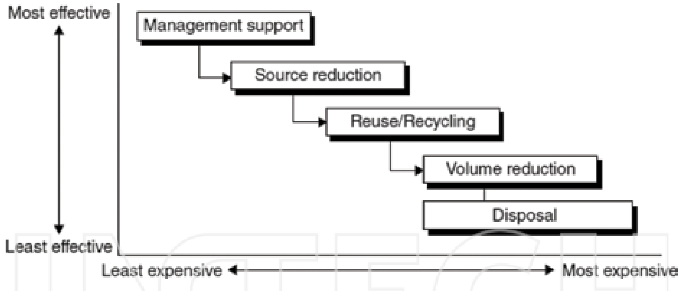
ÇM344 Hazardous Waste Management – Hazardous Characteristics
Hazardous and radioactive wastes management
Waste management is an important component of environmental policy all over the world.
Priority of hazardous solid waste for environmental protection is formulated on source
reduction and reuse, recycling, treatment, and landfilling .
Figure 1. Minimization program for low‐ and intermediate‐level radioactive wastes

Slide 11
ÇM344 Hazardous Waste Management – Hazardous Characteristics
The objective of radioactive waste management is to deal with those wastes that in a manner that protects human health and the environment now and in the future without imposing undue burden on future generations. Radioactive waste management involves many steps keeping the position of radioactivity clean. As nuclear power and arsenal grow, continuous monitoring and immobilization of waste over several decades and centuries and deposition in safe repositories assume great relevance and importance. The overall waste management generally includes the following steps: segregation and sorting of the radioactive wastes, treatment, conditioning, storage, transport, and final disposal. To achieve a satisfactory overall waste management strategy, component steps must be complementary and compatible with each other. Consequently, for every nuclear activity, there should be a waste minimization program that aims to reduce the amount of generated wastes. Such programs should cover the organizational, technological, and economic aspects of the performed waste minimization processes. The key considerations of the minimization program for low‐ and intermediate level radioactive wastes are illustrated in Figure 1, based on the effectiveness and cost of processing.

Slide 12
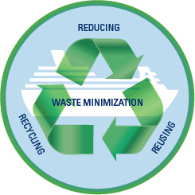
ÇM344 Hazardous Waste Management – Hazardous Characteristics
Waste minimization
Waste minimization is a process aimed to reduce the amount and activity of waste to a level
as low as reasonably achievable. This process is now applied at all stages of nuclear processing from power plant design through operation to decommissioning. It consists of reducing waste generation as well as recycling, reuse, and treatment, with due consideration for both primary wastes from the original nuclear cycle and secondary wastes generated by reprocessing and clean‐up operations

Slide 13
ÇM344 Hazardous Waste Management – Hazardous Characteristics
Some wastes may require treatment for safety, handling, or stability for interim storage
reasons. Treatment methods can be generally classified as chemical, physical, and/or biological. For new wastes, there is an opportunity to influence the process design so that wastes generated will require little or no treatment. If treatment is required, it is usually easier to obtain most of the characterization, while the waste is in raw form and characterization requirements may be directed toward treatment process control. For historic wastes, many situations are possible. Wastes may have already undergone some degree of treatment with little or no precharacterization. In such a case, further characterization will be required both before and during treatment to obtain a sufficient degree of detailed information. Waste streams may have been inadvertently combined, leading to a much larger volume of material that must be checked for certain properties. Previously treated wastes need to be examined to determine the compatibility of the prior treatment process with the waste acceptance criteria for the conditioning and disposal phases

Slide 14
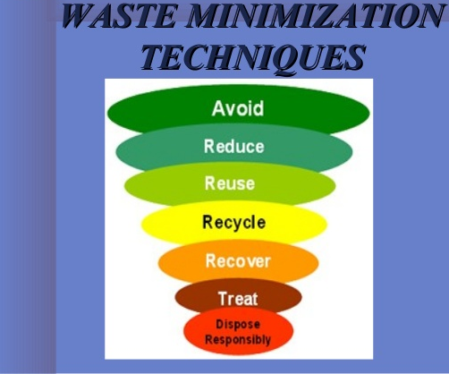
ÇM344 Hazardous Waste Management – Hazardous Characteristics
However, the seeking of inexpensive methods has led to develop new technologies based on the utilization of plant in biosorption of hazardous elements such as radioisotopes. Phytoremediation is the using of plants to remove hazardous contaminants from the environment. This trend is a growing application in remediation studies due to its numerous advantages, such as environmental friendliness, cost‐effectiveness, and high abundance. Phytoremediation like other traditional treatment processes has to follow the subsequent step called immobilization process, and it could be done to solidify and stabilize the resulting secondary solid waste in an inert matrix. The efficiency of contamination removal by phytoremediation can be greatly enhanced by a proper selection of the species suitable for the nature of pollutant and according to its geographic location, the microclimate, hydrological conditions, soil properties, and accumulation capacity of the plant species.

Slide 15
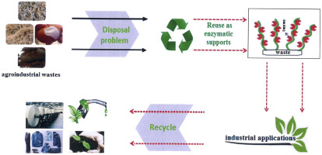
ÇM344 Hazardous Waste Management – Hazardous Characteristics
Processing and immobilization
Processing of radioactive waste includes any operation that changes its characteristics such as pretreatment, treatment, and conditioning. Solidification/stabilization (s/s) of hazardous and radioactive wastes is an attractive technology to reduce their risks and facilitate their handling prior to disposal. The long‐term safe landing of the solidified hazardous waste is an important request for keeping the surrounding environment more secure for the coming generations. Immobilization reduces the potential for migration or dispersion of contaminants including radionuclides. The International Atomic Energy Agency (IAEA) defines immobilization as the conversion of a waste into a waste form by solidification, embedding, or encapsulation.
It facilitates handling, transportation, storage, and disposal of radioactive wastes. Conditioning means those operations that produce a waste package suitable for handling, transportation, storage, and disposal. Conditioning may include the conversion of waste to a solid waste form and enclosure of waste in containers

Slide 16
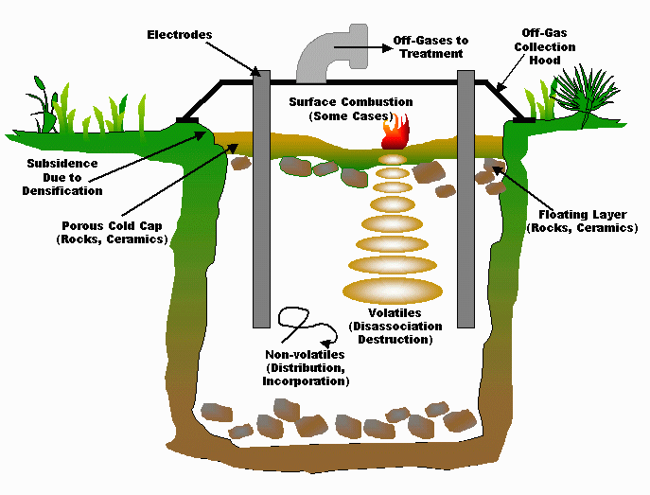
ÇM344 Hazardous Waste Management – Hazardous Characteristics
Solidification/stabilization is typically a process that involves the mixing of a waste with a binder to reduce the contaminant leachability by both physical and chemical means and to convert the hazardous waste into an environmentally acceptable waste form for land disposal. Moreover, it provides the waste form acceptable mechanical performance to withstand transport and handling. Inorganic binders such as cement are effective in immobilizing heavy metals through chemical and physical containment mechanisms, but are not as effective in immobilizing most organic contaminants. Many substances in the wastes significantly affect the setting and hardening characteristics of binders, especially cement‐based cementing systems

Slide 17
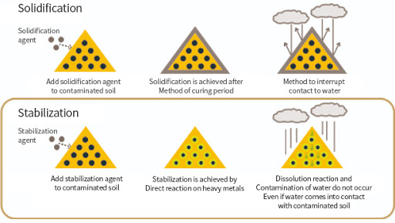
ÇM344 Hazardous Waste Management – Hazardous Characteristics
The requirements for the waste form are to provide physical, chemical, and thermal stabilities of the solidified radioactive materials. Moreover, the immobilized final waste forms resist leaching, powdering, cracking, and other modes of degradation. Portland cement is the most widely inorganic‐based system used for solidification/stabilization of hazardous, low‐ and intermediate‐level radioactive wastes

Slide 18
ÇM344 Hazardous Waste Management – Hazardous Characteristics
Disposal of hazardous and radioactive wastes
Waste disposal is the final step of waste management and ideally comprises placing hazardous waste in a dedicated disposal facility, although discharging of effluents into the environment within permitted limits is also a disposal option. Concepts for radioactive waste disposal have, however, developed considerably since that time and great consideration is now given to the necessary retention times and retention capacities for different types of waste, resulting in much‐improved repositories and planned disposal facilities.
According to IAEA, the disposal of radioactive waste is defined as the emplacement of waste in an approved specific facility that is intended to isolate the waste from human and environment and to prevent or limit a release of potentially harmful substances such that human health and the environment are protected. However, the safe disposal of radioactive wastes is one of the main concerns for those who oppose the nuclear technology. Therefore, disposal plays an important role in public acceptance of civilian applications of nuclear technology in different nations.

Slide 19
ÇM344 Hazardous Waste Management – Hazardous Characteristics
The effect of climatic conditions, for example, flooding and freezing/thaw accidents on the solidified wastes, is one of the most issues taken into consideration to evaluate the performance of this immobilized hazardous and radioactive wastes under the worst climatic conditions during the disposal process. Flooding accidents, one of the main dangerous problems that could face the solidified waste at the disposal site, should deserve special attention. Water is the primary agent of both creation and destruction of many natural materials, happens to be central of most durability problems in solidified waste materials. The rate of chemical deterioration is dependent on whether the chemical attack is confined on the surface of solidified waste material or also happening inside the material. The rate of deterioration is affected by the type and the concentration of ions present in water and by the chemical composition of the solid matrix.

Slide 20
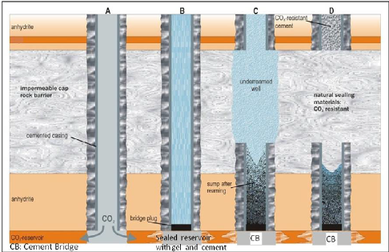
ÇM344 Hazardous Waste Management – Hazardous Characteristics
Multi‐barrier concept
Safety strategy for radioactive waste containment and isolation for the proposed storage and transportation focuses on two objectives: (1) to provide stabilization of the radioactive waste within the including package and (2) to limit the radiation exposure dose of the public during the transportation or other handling processes.

Slide 21
ÇM344 Hazardous Waste Management – Hazardous Characteristics
References
[1] Pichtel J., Waste management practices: municipal, hazardous, and industrial, 2nd
edition. Taylor & Francis Group, USA. (2014).
[2] United Nations, Recommendations of the UN Committee of experts on the transport
of dangerous goods. United Nations, New York, (1989)
[3] Solid Waste Management (Vol. I) United Nations Environment Programme, CalRe‐
covery, Inc. USA (2005). ISBN: 92‐807‐2676‐5.
[4] Li W., Huang Q., Lu S., Wu H., Li X., Yan J., Life cycle assessment of the environmental
impacts of typical industrial hazardous waste incineration in Eastern China. Aerosol
and Air Quality Research, 15: 242–251, (2015).
[5] Thareja P., Singh B., Singh S., Agrawal D., Kaur P., Biomedical waste management:
need for human civilization. Indian Journal of Clinical Anatomy and Physiology, 2(2):
66–73, (2015).
[6] Saleh H.M., Water hyacinth for phytoremediation of radioactive wastes simulate
contaminated with cesium and cobalt radionuclides. Nuclear Engineering and Design,
242, 425–432, (2012).
[7] International Atomic Energy Agency, IAEA‐TECDOC‐1579: New developments and
iimprovements in processing of ‘problematic’ radioactive waste, IAEA, Vienna, (2007).
[8] EPA (2013) Municipal solid waste in the United States: facts and figures, United States
Environmental Protection Agency, Office of Solid Waste (5306P) EPA530‐R‐13‐001 May
2013. www.epa.gov.

Slide 22
ÇM344 Hazardous Waste Management – Hazardous Characteristics
[9] International Atomic Energy Agency, TECDOC‐851, Radioactive waste management
practices and issues in developing countries, IAEA, Vienna, (1996).
[10] Saleh H.M., Treatment and solidification of hazardous organic wastes: radioactive
cellulose‐based wastes. LAP Lambert Academic, Germany. ISBN 978‐3‐659‐18564‐9,
(2012).
[11] Abdel Rahman R.O., Rakhimov R.Z., Rakhimova N.R. and Ojovan M.I., Cementitious
materials for nuclear waste immobilization, 1st edition, John Wiley & Sons, UK, (2015)
ISBN: 9781118512005.
[12] Ojovan M.I., Lee W.E., An introduction to nuclear waste immobilisation, 2nd edition,
Elsevier, Amsterdam, (2014).
[13] International Atomic Energy Agency, IAEA‐TECDOC‐1537: strategy and methodology
for radioactive waste characterization, IAEA, Vienna (2007).
[14] Eskander, S.B. and Saleh, H.M., Cement mortar-degraded spinney waste composite as
a matrix for immobilizing some low and intermediate level radioactive wastes:
consistency under frost attack. Journal of Nuclear Materials, 420(1–3): 491–496, (2012).
[15] Saleh H.M., Stability of cemented dried water hyacinth used for biosorption of
radionuclides under various circumstances. Journal of Nuclear Materials, 446(1–3),
124–133, (2014).

Slide 23
ÇM344 Hazardous Waste Management – Hazardous Characteristics
[16] Saleh H.M., Tawfik M.E. and Bayoumi T.A., Chemical stability of seven years aged
cement–PET composite waste form containing radioactive borate waste simulates.
Journal of Nuclear Materials, 411(1–3), 185–192, (2011).
[17] Bayoumi T.A., Saleh H.M. and Eskander S.B., Solidification of hot real radioactive
liquid scintillator waste using cement‐clay composite. Monatshefte fur Chemie—
Chemical Monthly, 144(12), 1751–1758, (2013).
[18] Spence R, Shi C. Introduction. In: Spence R, Shi C, editors. Stabilization and Solidifica‐
tion of Hazardous, Radioactive, and Mixed Wastes. Boca Raton, USA CRC Press; 2004.
p. 4. doi: 10.1201/9781420032789.ch1
[19] Saleh H.M. and Eskander S.B., Using portland cement for encapsulation of Epipremnum
aureumgenerated from phytoremediation process of liquid radioactive wastes.
International Journal of Chemical and Environmental Engineering Systems, 3(2), 1–8,
(2012).
[20] Saleh, H.M., Eskander, S.B. and Fahmy, H.M, Mortar composite based on wet oxidative
degraded cellulosic spinney waste fibers. International Journal of Environmental
Science and Technology, 11(5): 1297–1304, (2014).
[21] Saleh, H.M. and Eskander, S.B, Characterizations of mortar‐degraded spinney waste
composite nominated as solidifying agent for radwastes due to immersion processes.
Journal of Nuclear Materials, 430(1–3): 106–113, (2012).
[22] Eskander S.B., Bayoumi T.A. and Saleh H.M., Leaching behavior of cement‐natural clay
composite incorporating real spent radioactive liquid scintillator, Progress in Nuclear
Energy, 67, 1–6, (2013).

Slide 24
ÇM344 Hazardous Waste Management – Hazardous Characteristics
[23] Eskander S.B., Bayoumi T.A. and Saleh H.M., Performance of aged cement‐polymer
composite immobilizing borate waste simulates during flooding scenarios. Journal of
Nuclear Materials 420(1–3), 175–181, (2012).
[24] Bayoumi T.A., Reda S.M. and Saleh H.M., Assessment study for multi‐barrier system
used in radioactive borate waste isolation based on Monte Carlo simulations. Applied
Radiation and Isotopes, 70(1), 99–102, (2012).

