Slide 1


T.C.
ERCIYES UNIVERSITY
ENVIRONMENTAL ENGINEERING
WASTE OILS
HAZARDOUS WASTE MANAGEMENT
Supervisor
Assoc. Prof. Omur GOKKUS
ADEM BULUT
1030920164

Slide 2
CONTENTS
WHAT IS THE WASTE OİLS ?
What is the difference between waste oil and used oil?
Regulations regarding disposal of waste oil and used oil
Disposal of waste oil
did you know that?
NEWS
REFERENCES

Slide 3
What is Waste Oil?

Slide 4
Waste oil is oil that has never been used because it has been compromised, typically through contamination, and is now unsuitable for its original purpose. Examples of waste oil include oil spill clean-up, the bottom sediment of oil tankers after cleanout, and oil that has been contaminated through leaking containers.
Waste oil can either show the addition of impurities, or a loss of original properties. Waste oil can never be used, either through recycling or cleaning.

Slide 5
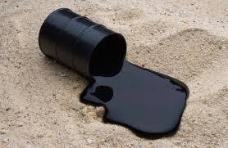
Oil

Slide 6
What is the difference between waste oil and used oil?

Slide 7
Used oil has been used previously, and as a result of that, is now contaminated by impurities, either chemical or physical. Examples of used oil are old transmission oil, motor oil, brake fluid, hydraulic oil and gearbox oil. Used oil is a recyclable commodity, and as such, can be stored for recycling, reuse or disposal. Used oil is not considered to be a waste product.
Both waste oil and used oil require proper recycling or disposal techniques which are set out by government bodies. This is to avoid illegal dumping and to help protect the environment.
Waste oil and used oil should be labelled clearly on airtight tanks or containers.

Slide 8
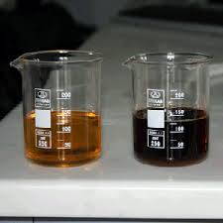

Slide 9
Regulations regarding disposal of waste oil and used oil

Slide 10
Used oil falls under ‘regulated waste products’, whereas waste oil is considered to be a hazardous waste. As such, disposing of waste oil has far more legal implications and must be handled in accordance with the Dangerous Waste Regulations.
Most motor garages will have used oil on their premises, as it is a by-product of their services, however, it is unusual to have waste oil onsite. Nearly all plants have used oil, while very few will ever have waste oil.
Waste oil is considered to be a dangerous substance, and requires speedy and proper disposal. Waste oil must be handled using licenced disposal and storage facilities with permitted treatments.

Slide 11
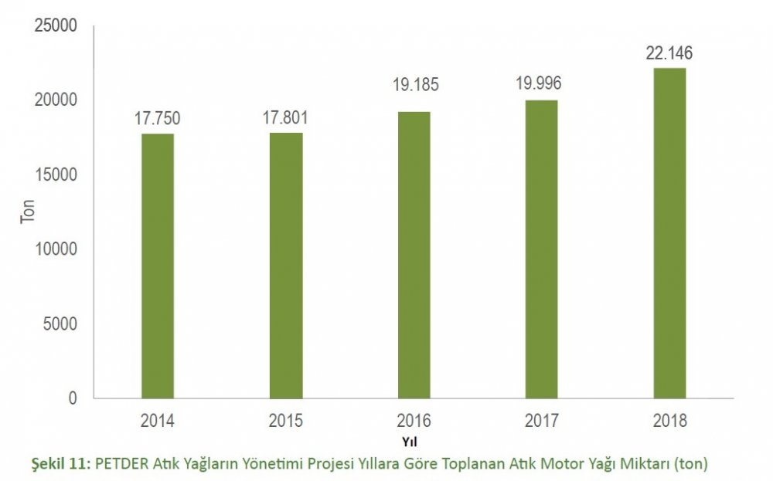
PETDER (Petroleum Industry Association) Waste Motor Oils Management Project Amount of Waste Oil Collected by Years (ton)

Slide 12
Disposal of waste oil

Slide 13
As waste oil may contain hazardous materials, and could be toxic, it has to be disposed of correctly. Previously, waste oil was dumped in landfills, but after the effects on the environment became apparent, this practise was stopped. Now there are far more regulations regarding the disposal of waste oil.
There are different ways in which waste oil can be disposed of, but there are many restrictions regarding disposal.
Waste oil cannot be discharged into a public sewer, it cannot be tipped into drains or onto land, and you must have a legal licence and a permitted hazardous waste incinerator if you want to burn it.
The best way to dispose of waste oil is to contact a specialist company that deal with proper disposal techniques for hazardous waste. These companies use techniques that do not harm the environment or cause additional pollution that could endanger human health.

Slide 14
did you know that?

Slide 15

we can recycle used oils by making detergent or wax.

Slide 16
NEWS

Slide 17
PETDER (Petroleum Industry Association) Waste Engine Oil Management Project 2018 Annual Report has been published. According to the data in the report, the amount of waste engine oil collected by PETDER in 2018 and delivered to licensed enterprises from the Ministry of Environment and Urbanization increased by 10.75% compared to 2017, reaching 22,146 tons.

Slide 18
With the "Waste Oil Management Regulation", which covers mineral waste oils and will take effect on January 1, a certificate requirement has been made for enterprises whose engine oil changes are made. (12.21.2019)

Slide 19
References
https://www.petro-online.com/news/fuel-for-thought/13/breaking-news/what-is-waste-oil/34144
https://translate.google.com/?hl=tr#view=home&op=translate&sl=en&tl=tr&text=What%20is%20the%20difference%20between%20waste%20oil%20and%20used%20oil%3F https://www.istac.istanbul/en/our-services/istanbul-medical-waste-management
https://www.google.com/search?q=waste+oils+Statistics+In+Istanbul&rlz=1C1SQJL_trTR818TR818&sxsrf=ALeKk01m7l8U5Xy6Z0suiRwK1Lz6IOgi0A:1583771170779&source=lnms&tbm=isch&sa=X&ved=2ahUKEwijr6iw543oAhWtSBUIHb4lDcgQ_AUoAXoECAwQAw&biw=1242&bih=597#imgrc=V_4mEQuCY1EYPM
https://www.ekovitrin.com/otovitrin/petder-2018de-22146-ton-atik-yag-topladi-h76681.html
http://rcrcommodities.com/?page_id=1274
https://www.dunya.com/gundem/45-bin-ton-atik-yag-toplandi-haberi-205535
https://www.aktuelbilgiler.com/kullanilmis-yaglar-nasil-degerlendirilir/

Slide 20


