Slide 1
Radioactive wasteS

Slide 2
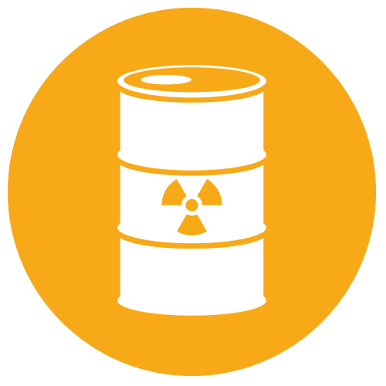
WHAT IS RADIOACTIVE WASTE?
ÇM344 Hazardous Waste Management – Radioactive Waste
Radioactive waste is waste that contains radioactive material. Radioactive waste is usually a by-product of nuclear power generation and other applications of nuclear fission or nuclear technology, such as research and medicine. Radioactive waste is hazardous to all forms of life and the environment and is regulated by government agencies in order to protect human health and the environment.

Slide 3
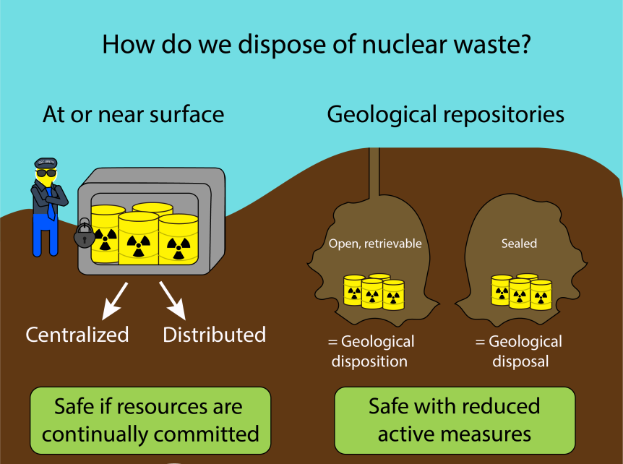
RADIOACTIVE WASTE MANAGEMENT
ÇM344 Hazardous Waste Management – Radioactive Waste
Like all industries, the generation of electricity produces waste. Whatever fuel is used, the waste produced in generating electricity must be managed in ways that safeguard human health and minimise the impact on the environment.For radioactive waste, this means isolating or diluting it such that the rate or concentration of any radionuclides returned to the biosphere is harmless. To achieve this, practically all radioactive waste is contained and managed, with some clearly needing deep and permanent burial. From nuclear power generation, unlike all other forms of thermal electricity generation, all waste is regulated – none is allowed to cause pollution.

Slide 4
ÇM344 Hazardous Waste Management – Radioactive Waste
Nuclear power is characterised by the very large amount of energy produced from a very small amount of fuel, and the amount of waste produced during this process is also relatively small.However, much of the waste produced is radioactive and therefore must be carefully managed as hazardous material.
All parts of the nuclear fuel cycle produce some radioactive waste and the cost of managing and disposing of this is part of the electricity cost (i.e. it is internalised and paid for by the electricity consumers).All toxic waste needs be dealt with safely – not just radioactive waste – and in countries with nuclear power, radioactive waste comprises a very small proportion of total industrial hazardous waste generated.Radioactive waste is not unique to the nuclear fuel cycle. Radioactive materials are used extensively in medicine, agriculture, research, manufacturing, non-destructive testing, and minerals exploration. Unlike other hazardous industrial materials, however, the level of hazard of all radioactive waste – its radioactivity – diminishes with time.

Slide 5
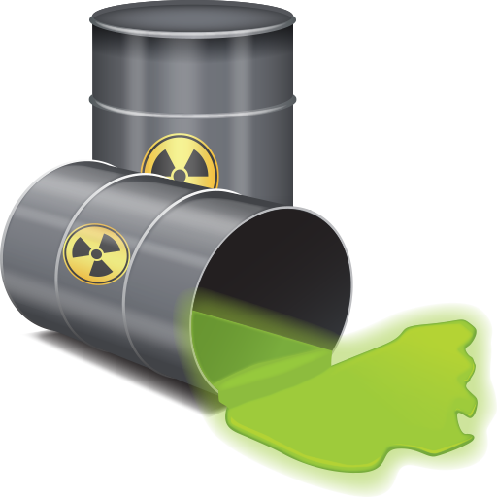
Types of Radioactive Waste
ÇM344 Hazardous Waste Management – Radioactive Waste
Radioactive waste includes any material that is either intrinsically radioactive, or has been contaminated by radioactivity, and that is deemed to have no further use. Government policy dictates whether certain materials – such as used nuclear fuel and plutonium – are categorised as waste.
Every radionuclide has a half-life – the time taken for half of its atoms to decay, and thus for it to lose half of its radioactivity. Radionuclides with long half-lives tend to be alpha and beta emitters – making their handling easier – while those with short half-lives tend to emit the more penetrating gamma rays. Eventually all radioactive waste decays into non-radioactive elements. The more radioactive an isotope is, the faster it decays.
Radioactive waste is typically classified as either low-level (LLW), intermediate-level (ILW), or high-level (HLW), dependent, primarily, on its level of radioactivity.

Slide 6
ÇM344 Hazardous Waste Management – Radioactive Waste
Low-level waste
Low-level waste (LLW) has a radioactive content not exceeding four giga-becquerels per tonne (GBq/t) of alpha activity or 12 GBq/t beta-gamma activity. LLW does not require shielding during handling and transport, and is suitable for disposal in near surface facilities.
Intermediate-level waste
Intermediate-level waste (ILW) is more radioactive than Low-Level Waste, but the heat it generates (less than 2 kW/m³) is not sufficient to be taken into account in the design or selection of storage and disposal facilities. Due to its higher levels of radioactivity, ILW requires some shielding.

Slide 7
ÇM344 Hazardous Waste Management – Radioactive Waste
High-level waste
High-level waste (HLW) is sufficiently radioactive for its decay heat (less than 2kW/m³) to increase its temperature, and the temperature of its surroundings, significantly. As a result, HLW requires cooling and shielding.
Very low-level waste
Exempt waste and very low-level waste (VLLW) contains radioactive materials at a level which is not considered harmful to people or the surrounding environment.

Slide 8
ÇM344 Hazardous Waste Management – Radioactive Waste
Storage and disposal
Storage of waste may take place at any stage during the management process. Storage involves maintaining the waste in a manner such that it is retrievable, whilst ensuring it is isolated from the external environment. Waste may be stored to make the next stage of management easier (for example, by allowing its natural radioactivity to decay). Storage facilities are commonly onsite at the power plant, but may be also be separate from the facility where it was produced.
Disposal of waste takes place when there is no further foreseeable use for it, and in the case of HLW, when radioactivity has decayed to relatively low levels after about 40-50 years.

Slide 9
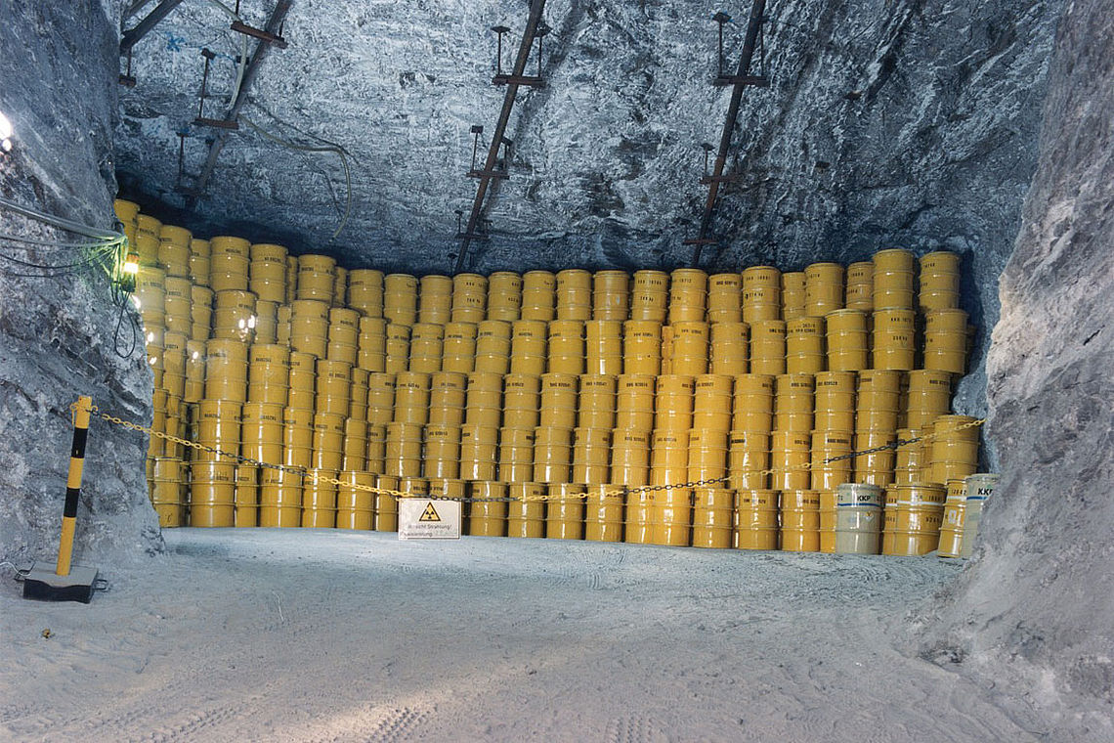
Fig. Drums of radioactive waste storage

Slide 10
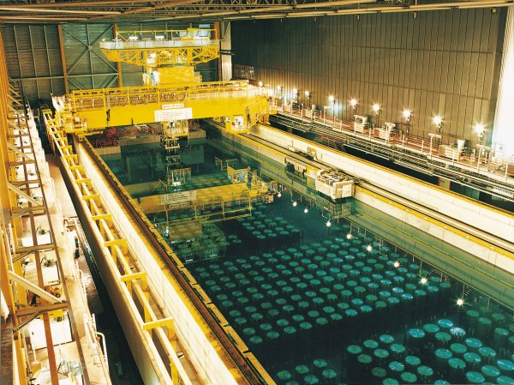
Fig. Storage of Spent Nuclear Fuel

Slide 11
ÇM344 Hazardous Waste Management – Radioactive Waste
Wastes generated at nuclear power plants
Low- and intermediate-level radioactive waste (LILW) at nuclear power plants is produced by contamination of various materials with the radionuclides generated by fission and activation in the reactor or released from the fuel or cladding surfaces. The radionuclides are primarily released and collected in the reactor coolant system and, to a lesser extent, in the spent fuel storage pool.
The main wastes arising during the operation of a nuclear power plant are components which are removed during refuelling or maintenance (mainly activated solids, e.g. stainless steel containing cobalt-60 and nickel-63) or operational wastes such as radioactive liquids, filters, and ion-exchange resins which are contaminated with fission products from circuits containing liquid coolant.

Slide 12
ÇM344 Hazardous Waste Management – Radioactive Waste
In order to reduce the quantities of waste for interim storage and to minimize disposal cost, all countries are pursuing or intend to implement measures to reduce the volume of waste arising where practicable. Volume reduction is particularly attractive for low-level waste which is generally of high volume but low radiation activity. Significant improvements can be made through administrative measures, e.g. replacement of paper towels by hot air driers, introduction of reusable long lasting protective clothing, etc., and through general improvements of operational implementation or "housekeeping".

Slide 13
ÇM344 Hazardous Waste Management – Radioactive Waste
Liquid wastes and wet solid wastes
According to the different types of reactors now operating commercially all over the world, different waste streams arise. These streams are different both in activity content and in the amount of liquid waste generated. Reactors cooled and moderated by water generate more liquid waste than those cooled by gas. The volumes of liquid waste generated at boiling-water reactors (BWRs) are significantly higher than at pressurized water reactors (PWRs). Because the cleanup system of heavy-water reactors (HWRs) works mainly with once through ion-exchange techniques to recycle heavy water, virtually no liquid concentrates are generated at them

Slide 14
ÇM344 Hazardous Waste Management – Radioactive Waste
Active liquid wastes are generated by the cleanup of primary coolants (PWR, BWR), cleanup of the spent fuel storage pond, drains, wash water, and leakage waters. Decontamination operations at reactors also generate liquid wastes resulting from maintenance activities on plant piping and equipment. Decontamination wastes can include crud (corrosion products) and a wide variety of organics, such as oxalic and citric acids.
Wet solids are another category of waste generated at nuclear power plants. They include different kinds of spent ion-exchange resins, filter media, and sludges. Spent resins constitute the most significant fraction of the wet solid waste produced at power reactors. Bead resins are used in deep demineralizers and are common in nuclear power plants. Powdered resins are seldom used in PWRs, but are commonly used in BWRs with pre-coated filter demineralizers. In many BWRs, a large source of powdered resin wastes are the "condensate polishers" used for additional cleaning of condensed water after evaporation of liquid wastes

Slide 15
ÇM344 Hazardous Waste Management – Radioactive Waste
Pre-coated filters used at nuclear power plants to process liquid waste produce another type of wet solid waste-filter sludges. The filter aids — usually diatomaccous earth or cellulose fibres — and the crud that is removed from the liquid waste together form the filter sludges. Some filtration systems do not require filter aid materials. The sludges arising from such units therefore do not contain other materials.

Slide 16
ÇM344 Hazardous Waste Management – Radioactive Waste
Treatment and conditioning of liquid/solid waste
Liquid radioactive waste generated at nuclear power plants usually contains soluble and insoluble radioactive components (fission and corrosion products) and non-radioactive substances. The general objective of waste treatment methods is to decontaminate liquid waste to such an extent that the decontaminated bulk volume of aqueous waste can be either released to the environment or recycled. Waste concentrate is subject to further conditioning, storage, and disposal. Because nuclear power plants generate almost all categories of liquid waste, nearly all processes are applied to treat radioactive effluents. Standard techniques are routinely used to decontaminate liquid waste streams. Each process has a particular effect on the radioactive content of the liquid. The extent to which these are used in combination depends on the amount and source of contamination. Four main technical processes are available for treatment of liquid waste: evaporation; chemical precipitation/flocculation; solid-phase separation; and ion exchange.

Slide 17
ÇM344 Hazardous Waste Management – Radioactive Waste
Treatment of gaseous effluents
It is common practice at all nuclear power plants for contaminated gases and building ventilation air to be first passed through filters to remove paniculate activity before discharge to the atmosphere via stacks. Ventilation and air cleaning system usually employ coarse pre-filters followed by high-efficiency-particulate-air (HEPA) filters. These have typical particle removal efficiencies of 99.9% or better for 0.3 mm particles. Radioactive iodine arising from power plant operation is routinely removed by impregnated charcoal filters, used in combination with paniculate filters. Impregnation is required to trap the organic iodine compounds from gas effluents.

Slide 18
ÇM344 Hazardous Waste Management – Radioactive Waste
Because noble radioactive gases released from fuel elements in a small amount are mainly short-lived, delaying their release will allow radioactive decay processes to greatly reduce the quantities finally released to the environment. Two delay techniques are used for this purpose: storage in special tanks or passage through charcoal delay beds.

Slide 19
ÇM344 Hazardous Waste Management – Radioactive Waste
Treatment and conditioning of solid waste
During the operation of a nuclear power plant, various types of dry solid wastes containing radioactive materials are generated. The nature of these wastes vary considerably from facility to facility and can include redundant items of the reactor plant, ventilation system filters, floor coverings, contaminated tools, etc. Another source of solid waste is the accumulation of miscellaneous paper, plastic, rubber, rags, clothing, small metallic or glass objects, used during the operation and maintenance of the nuclear power plant. Depending on the physical nature and further treatment methods, dry solid waste usually is classified and segregated into four main categories: combustible, non-combustible, compactible, and non-compactible waste. However, each facility usually has its own level of classification according to the prevailing conditions.

Slide 20
ÇM344 Hazardous Waste Management – Radioactive Waste
New developments
Most treatment and conditioning processes for LILW have now reached an advanced industrial scale. Although these processes and technologies are sufficient for effective management of radioactive waste at nuclear power plants, further improvements in this technology are still possible and desirable. The increasing cost of radioactive waste disposal provides an incentive to adopt procedures and techniques to minimize waste quantities and to develop new techniques to minimize volumes at the treatment and conditioning step. It is not possible here to summarize all new developments and improvements which are being made in this direction in Member States.

Slide 21
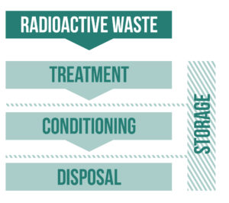
ÇM344 Hazardous Waste Management – Radioactive Waste
Some examples of such new developments include the use of specific inorganic sorbents to improve liquid waste treatment; use of membrane techniques for liquid waste treatment; dewatering and drying of bead resin and filters slurries; incineration of spent ion-exchange resins; dry cleaning of protective cloth to reduce quantity of laundry drains; use of high integrity containers for packaged dried filter sludges; vitrification of some intermediate-level waste to reduce volumes of waste to be disposed of; and supercompaction of unburnable waste

Slide 22
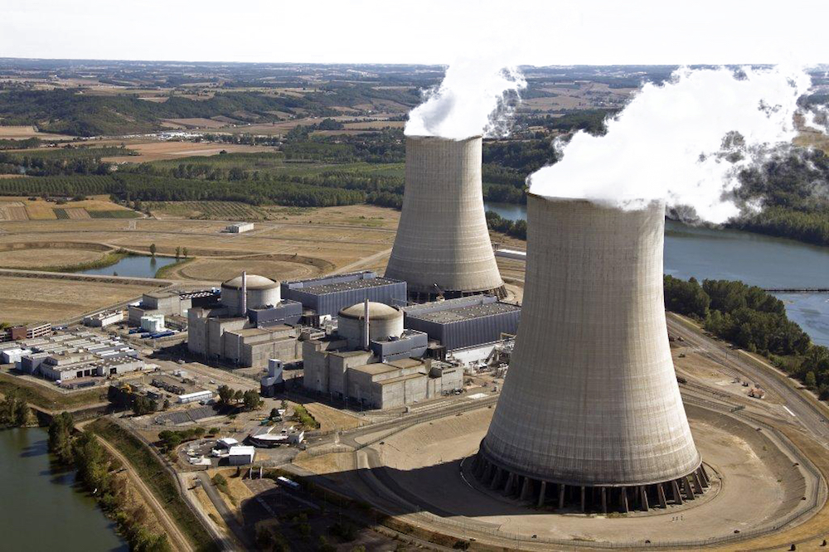
ÇM344 Hazardous Waste Management – Radioactive Waste
Perhaps not all of these new developments will find broad implementation in waste management technologies, in particular at nuclear power plants. However, the research and development reflects the fact that the nuclear industry and utilities take great care in a safe and economic management of radioactive waste at nuclear power plants, and that improvements in existing technology are forseen.

Slide 23
ÇM344 Hazardous Waste Management – Radioactive Waste
management of radIoactIve wasteS In Turkey

Slide 24
ÇM344 Hazardous Waste Management – Radioactive Waste
RADIOACTIVE WASTE MANAGEMENT FACILITY OF TURKEY
Turkey's first and only licensed radioactive waste facility "Radioactive Waste Management Facility", which was established in 1989. This property is located in Istanbul / Küçükçekmece.
The facility performs many basic services and activities.
1-Radioactive material transport and dismantling of radioactive sources
2-Receiving, processing and storage of low-medium, high-activity radioactive wastes
3-Receiving, processing and storage of radioactive wastes in consumer product class (lightning rod, smoke detector, etc.)
4-Handling, processing and storage of compressible solid wastes (contaminated gloves, galoshes, paper towels etc.) and liquid radioactive wastes (liquid sources, aqueous solutions)
Handling and storage of
5-NORM-TENORM radioactivity contaminated scrap materials
6-Temporary storage of radioactive sources (storage for a certain period of time)
7-Scrap sorting, radioactivity control in scrap
8-Radioactive waste and radioactive resources training and consultancy services
9-R & D, training, technical support and project activities to develop legislation

Slide 25
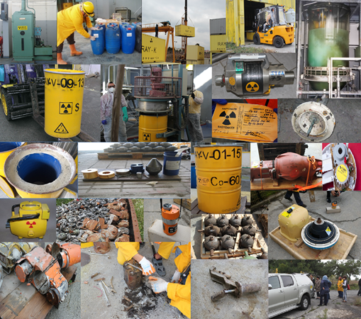
Fig. Photos from the facility.

Slide 26
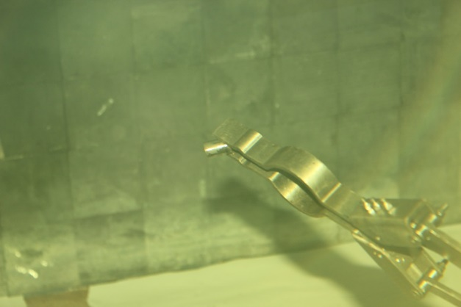
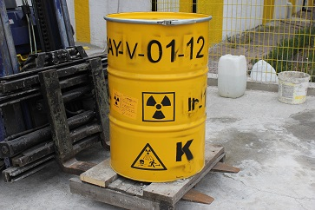
Fig. Hot cell and built-up activities and generated waste packages built for the activities of the category 3-5 devices, including closed radioactive sources.

Slide 27
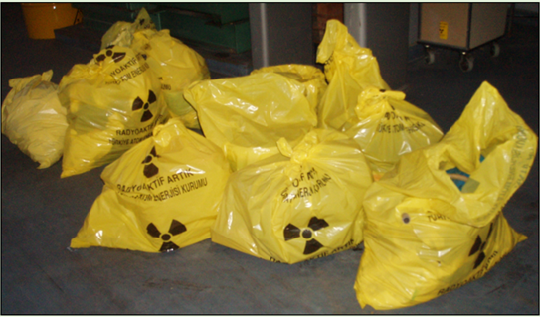
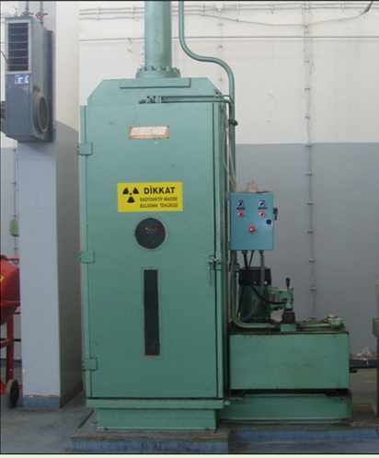
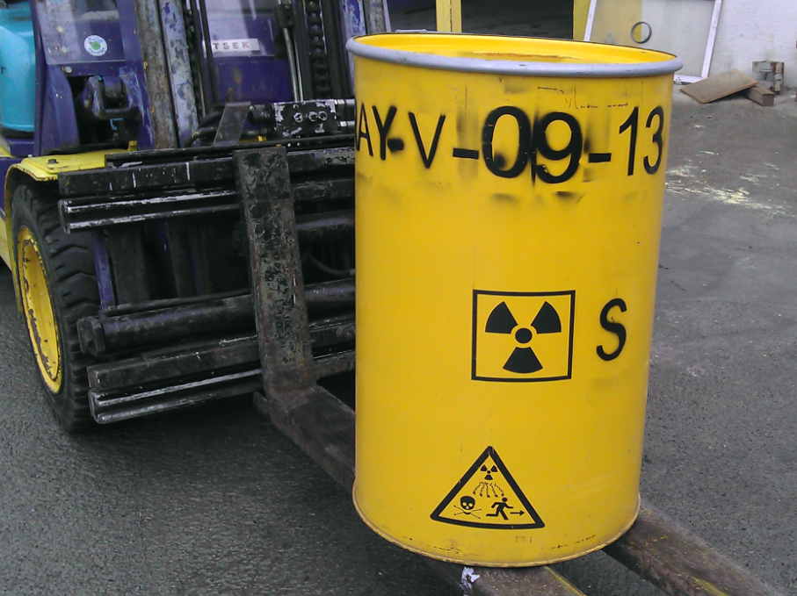
Fig. The squeezable packets of waste, the compacted compactor and the waste package created for storage.
From the left to the right, respectively.

Slide 28
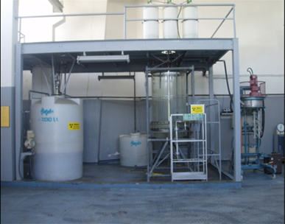
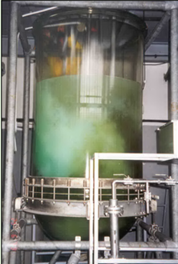
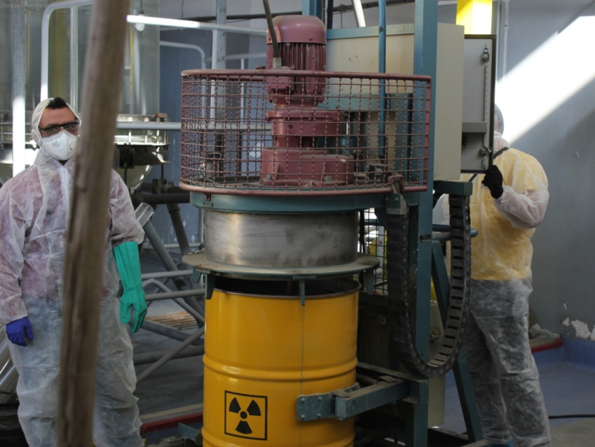
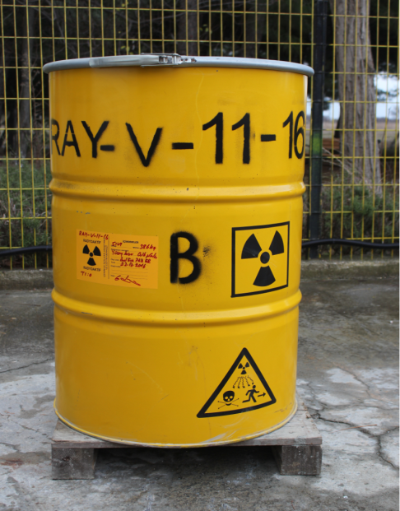
Fig. From left to right is the liquid waste treatment plant where the liquid wastes received are processed respectively, the sedimentation process in the wastes, the concrete bundling of the sediment as a result of the precipitation and the waste package created for storage.

Slide 29
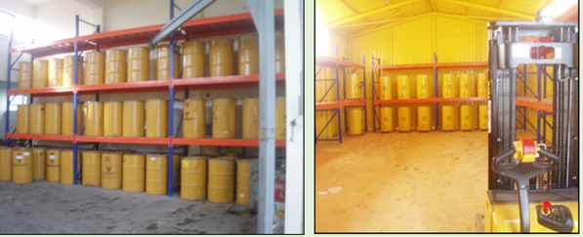
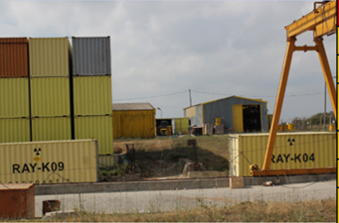
Fig. Storage activities according to the class of radioactive waste.

Slide 30
ÇM344 Hazardous Waste Management – Radioactive Waste
Turkish Standard for Waste Management
Authority: Turkish Atomic Energy Authority (TAEK),
Statute: Radiation Safety Statute put into force with cabinet decision on 24/7/1985 and with no. 85/9727, Radiation
Safety Regulation: Regulation issued in the Official Gazette dd. 24/3/2000 and no. 23999, Regulation on Control of the
Radioactive Waste: Every kind of radioactive material which are not to be reused or other equipment contaminated with radioactive materials,(official definiton)
License holder: Official or private person or institutions who has acquired a license from Authority in order to store and use radioactive materials in accordance with the provisions of Radiation Safety Regulation,

Slide 31
ÇM344 Hazardous Waste Management – Radioactive Waste
Sealed Radioactive Source: Radioactive material that is sealed in a capsule or coated with a coating material in order to provide imperviousness under normal usage and possible accident conditions. (official definiton)
ALI: Intake limit of radioactive materials to the body annually in Becquerel (Bq) units, (ALI is initials of “Annual Limits on Intake”) (SI unit system ,radioactivity units)
ALI min: Two different ALI values are determined by accepting that radioactive material scan be taken into body from digestive and/or respiratory system. ALI min values given in this regulation are the lowest values of the said two values,
Half Life: The time passed for the initial activity value of a radioactive material fall down at half value.
Discharge to the Environment: Discharge of liquid wastes into the sewer system, solid wastes to the medical waste disposal facilities, wastes in gas form such as vapor, aerosol and dust particles to the atmosphere in the forms explained and in quantities not exceeding the limits indicated in this regulation.

Slide 32
ÇM344 Hazardous Waste Management – Radioactive Waste
Limitations on Discharge of the Wastes Generated from the Use of Radioactive Material to the Environment
Limitations on Discharge of Liquid Wastes to the Sewer System
Liquid wastes can only be given to the sewer system in the limitations given below, under the responsibility of the license holder, provided that fulfillment of the provisions designated in the Authority law and following the concentration values being found acceptable after Authority’s evaluation of the information relevant with the waste system of body provided by the organization.
Total quantity of radioactivity in the waste which can be discharged to the sewer system by one organization at once cannot be more than 2.5 times of the ALI min value given in Table 13.1 and cannot exceed 100 MBq.

Slide 33
ÇM344 Hazardous Waste Management – Radioactive Waste
Scintillation solvents for laboratories and liquid wastes with similar organic solvent contents cannot have alpha radioactivity. Concentration of solvents with beta and gamma radioactivity content do not exceed 3.7 Bq value in millimeter, radioactivity concentration ofsolvents with H-3 and C-14 contents do not exceed 37 Bq value in millimeter. For the wastes exceeding those values, the provisions in paragraph (a) of Article 7 of this Regulation are applied.
Radioactivity quantity that can be discharged to the sewer system in one month for one organization cannot be more than 25 times of the ALI min value given in Table 13.1. Wastes exceeding those values are subject to paragraph (a) of Article 7 of this Regulation.

Slide 34
ÇM344 Hazardous Waste Management – Radioactive Waste
If waste includes more than one radioisotope, ratio of each radioisotope activity to its own ALI min value calculated then the sum of those ratios is taken. In order to discharge those wastes to the sewer system, that sum cannot be greater than 2.5 for each discharge and cannot be greater than 25 for monthly total discharge.
Liquid wastes with the urine and feces of patients who are under I-131 treatment, shall be connected to the sewer system out of the hospital at one point, a radiation warning sign shall be put up and regular measurements shall be made. At this point I-131 concentration value cannot exceed 10 Bq value.

Slide 35
ÇM344 Hazardous Waste Management – Radioactive Waste
Limitations on the Discharge of Solid Wastes to the Environment
Equipment contaminated during the usage of radioactive materials and solid radioactive materials which cannot be used are classified as waste and can be discharged to the environment under the responsibility of the license holder within the limitations given below.
Radiation dose rate on the surface of radioactive waste bags which will be sent to the medical waste disposal facilities shall not exceed 1 μSv/hour in anyway. Measurements shall be made by an appropriate detection device that can measure the emission of radiation of the radioactive material.
Alpha-releasing solid wastes cannot be discharged to the environment. For those wastes application must be made to the Authority.

Slide 36
ÇM344 Hazardous Waste Management – Radioactive Waste
Limitations On The Discharge Of Gas Wastes To The Atmosphere
Wastes in gas form are discharged to the atmosphere under responsibility of the license holder under the conditions determined in the licensing and facility projecting phase.

Slide 37
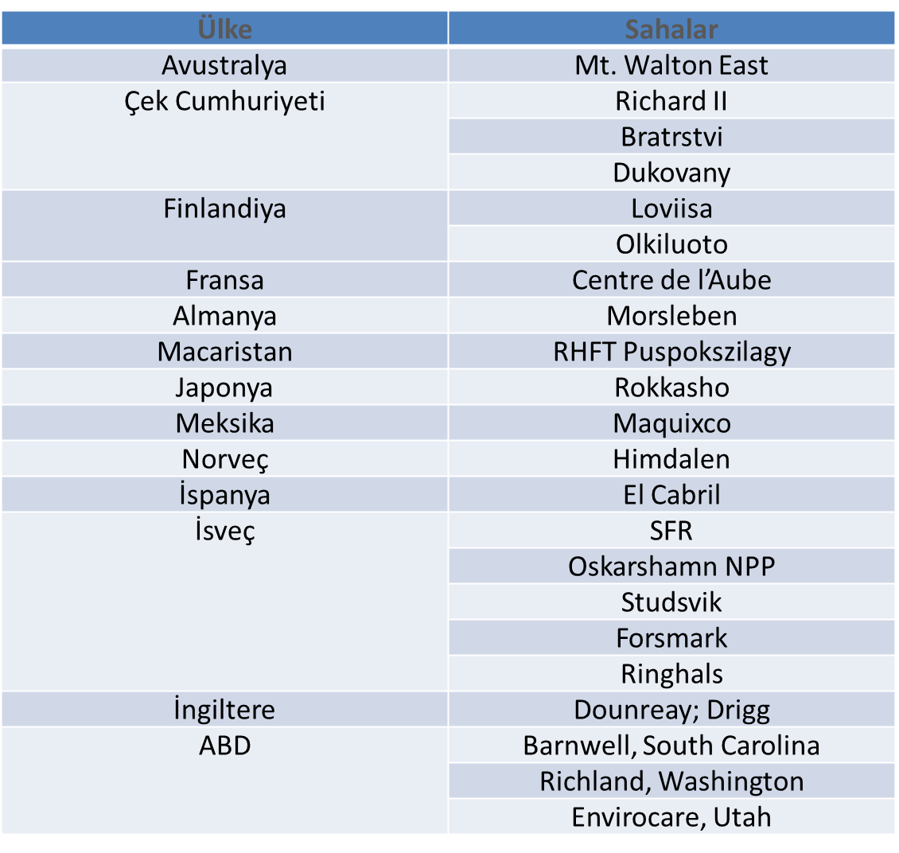
ÇM344 Hazardous Waste Management – Radioactive Waste
Radioactive waste storage areas of countries

Slide 38
SON

