Slide 1
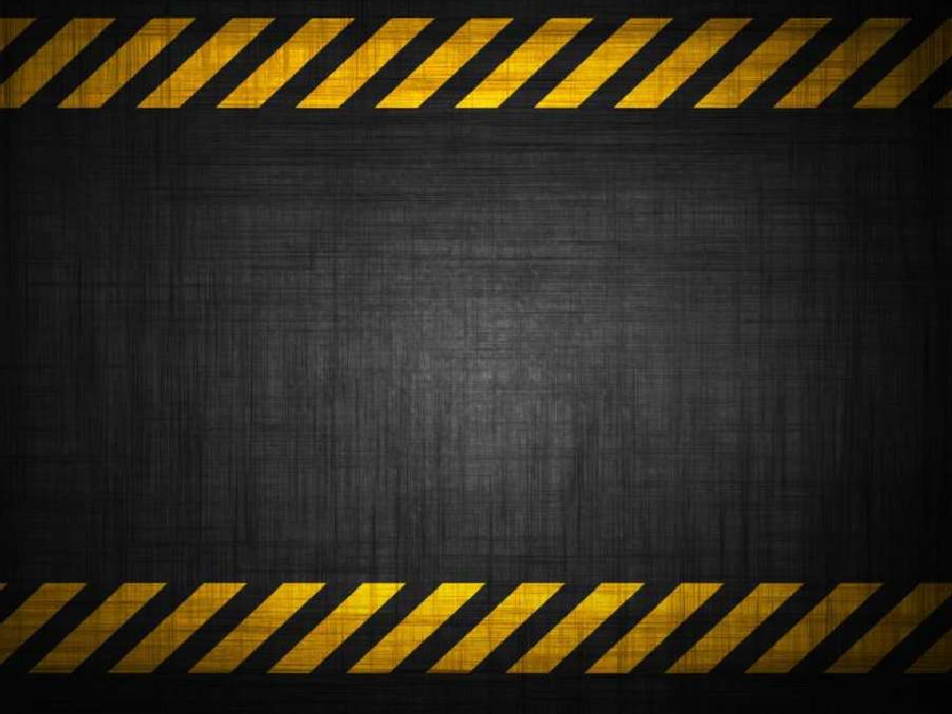
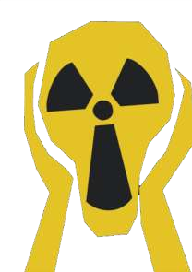
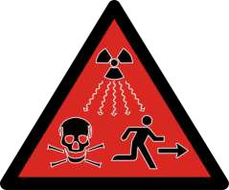
Radioactive Waste
HAZARDOUS WASTE MANAGEMENT

Slide 2

T.C ERCIYES UNIVERSITY
DEPARTMENT OF ENVIRONMENTAL ENGINEERING
RADIOACTIVE WASTE AND WASTE MANAGEMENT DISPOSAL
HATICE ELBIR
1030910548@erciyes.edu.tr
2020

Slide 3
INDUSTRIAL HAZARDOUS WASTE MANAGEMENT IN TURKEY
CONTENST
Introduction
What Is Radioactive Waste
Types of Radiaactive Waste
Source of Radioactive Waste
Effects and Dangers
Storage
Radioactive Disposal and Managenment
Conclusions
References

Slide 4
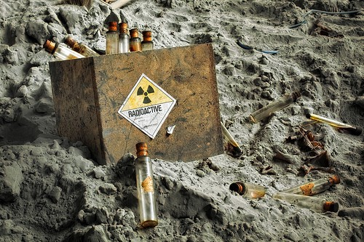
RADIOACTIVE WASTE MANAGEMENT
Introduction
Radioactive waste is nuclear fuel that is produced after being used inside of a nuclear reactor. Although it looks the same as it did before it went inside of the nuclear producer it has changed compounds and is nothing like the same. What is left is considered radioactive material and is very dangerous to anyone. This is very dangerous and remains this way for not just a few years but for thousands of years.

Slide 5

RADIOACTIVE WASTE MANAGEMENT
WHAT IS RADIOACTIVE WASTE?
According to Wikipedia, “Radioactive wastes are wastes that contain radioactive material. Radioactive wastes are usually by-products of nuclear power generation and other applications of nuclear fission or nuclear technology, such as research and medicine. Radioactive waste is hazardous to most forms of life and the environment,and is regulated by government agencies in order to protect human health and the environment.”

Slide 6
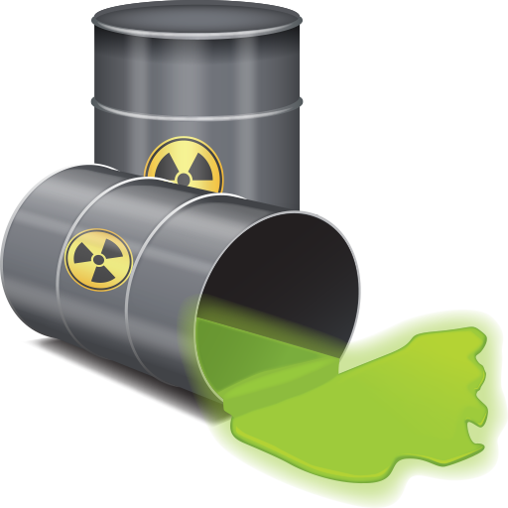
RADIOACTIVE WASTE MANAGEMENT
Types of Radioactive Waste
According to the United States Nuclear Regulatory Commission more than 104 licensed nuclear facilities are located inside of the United States. These reactors total 20% of the energy consumption being used. All types of nuclear wastes have their own separate storage and clean-up procedures.
Low-level waste (LLW)
Intermediate-level waste (ILW)
High-level waste (HLW)

Slide 7
RADIOACTİVE WASTE MANAGEMENT

Slide 8
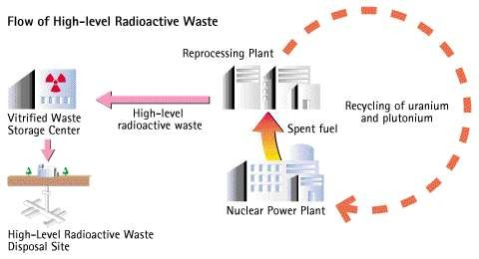
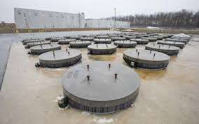
RADIOACTIVE WASTE MANAGEMENT
High-level Waste
HLW is produced by nuclear reactors.
HLW worldwide is currently increasing by about 12,000 metric tons every year
In 2010, there was very roughly estimated to be stored some 250,000 tons of nuclear HLW
that the main proposed long-term solution is deep geological burial, either in a mine or a deep borehole.

Slide 9
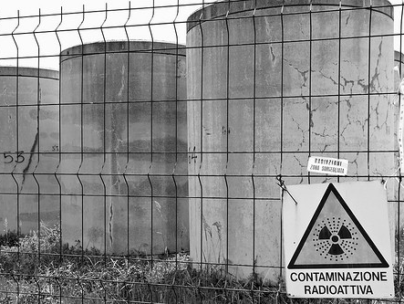

Slide 10
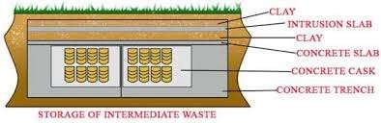
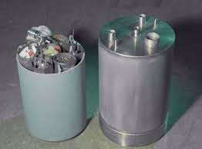
RADIOACTIVE WASTE MANAGEMENT
Intermediate-level Waste
Contains higher amounts of radioactivity and in general require shielding, but not cooling
Includes resins, chemical sludge and metal nuclear
fuel cladding, as well as contaminated materials from reactor decommissioning.
It may be solidified in concrete or bitumen for disposal.

Slide 11
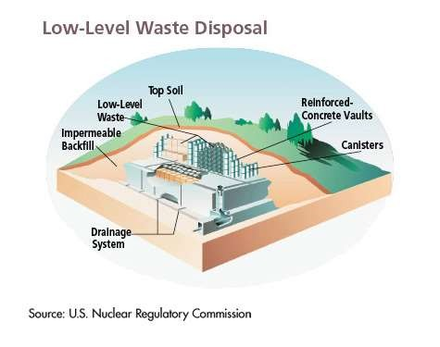
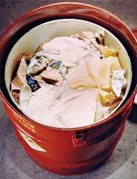
RADIOACTIVE WASTE MANAGEMENT
Low-level Waste
Most of the radioactive waste that is around today is considered to be low level. In fact, about 90% of all nuclear waste is low level. Nuclear reactors, hospitals, dental offices, and similar types of facilities often use low-level nuclear waste materials on a daily basis and it is needed in order to provide the services that are offered within these facilities.

Slide 12
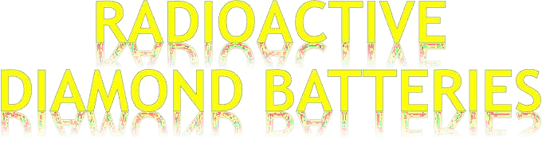


RADIOACTIVE WASTE MANAGEMENT

Slide 13

Developed by University of Bristol
Diamond is made from carbon- 14 (radioactive) extracted from nuclear waste
-Generates a small magnetic current when subjected to
radiation field

Slide 14

No moving parts involved
No emissions generated
No maintenance required
Continuous power output
- Low power and extremely long life
- Cost to produce diamond
Cost to dispose nuclear waste
- Can be used where batteries could not be replaced such as pacemakers, in spacecrafts and satellites

Slide 15
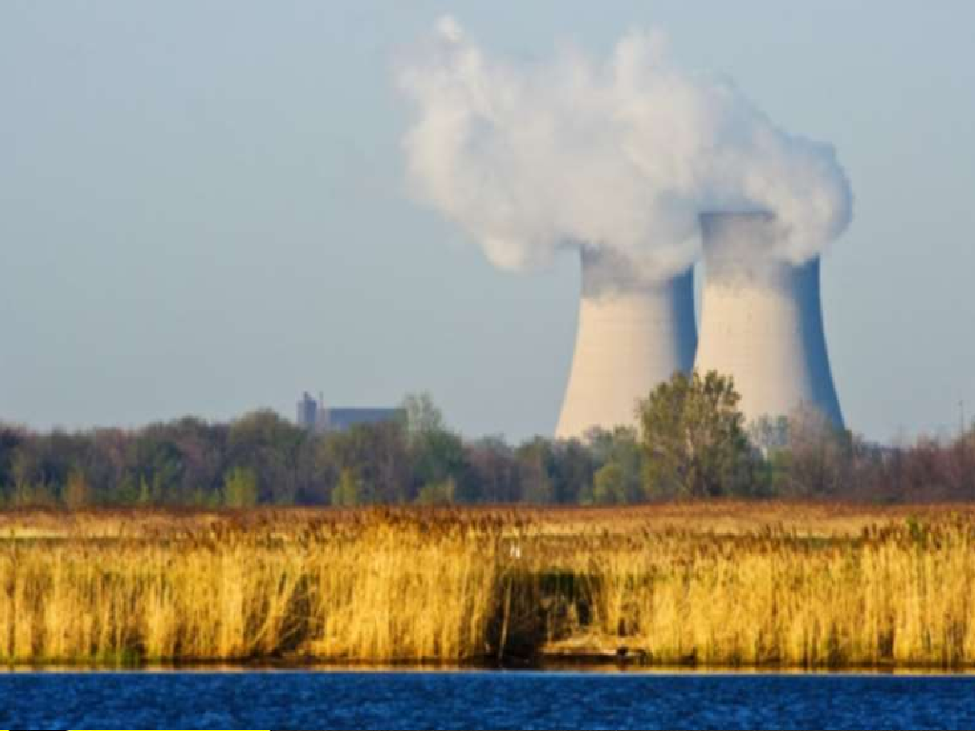
SOURCES OF RADIOACTIVE WASTE

Slide 16
SOURCES
Nuclear fuel cycle
Nuclear weapons decommissioning
Legacy waste
Medical
Industrial
Naturally occurring radioactive material (NORM)
Coal ,gas and oil

Slide 17
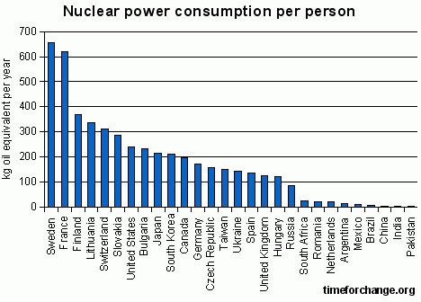
NUCLEAR FUEL CYCLE
It often contains radium and its decay products.
Uranium is used to make fuel from the reprocessing of used fuel.

Slide 18
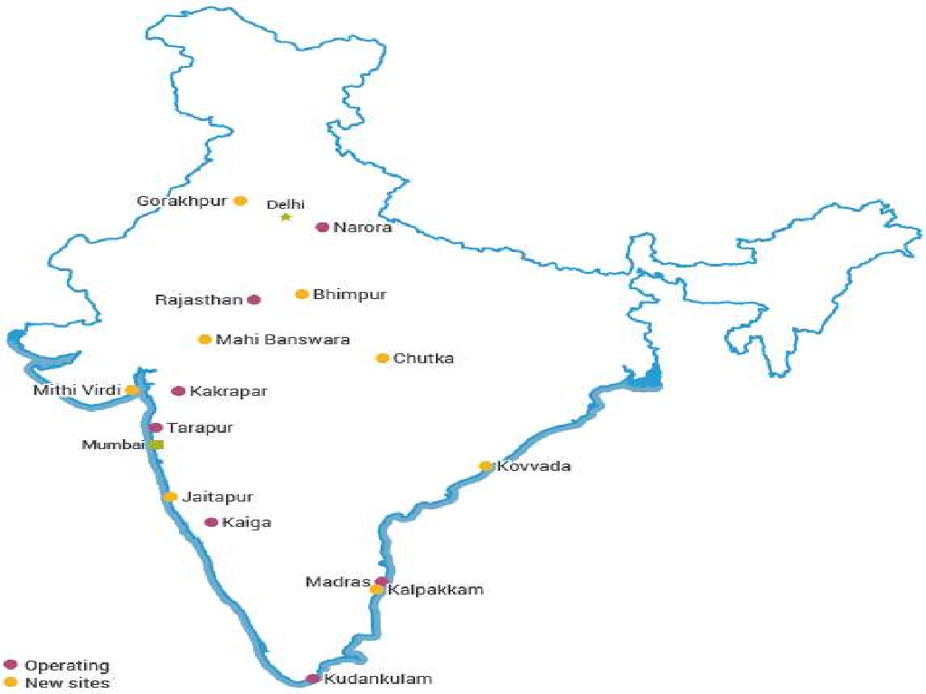
Nuclear Plants in India

Slide 19
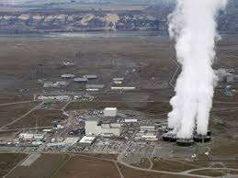
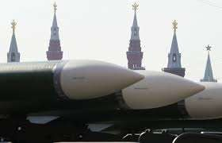
NUCLEAR WEAPONS DECOMMISSIONING
Waste from nuclear weapons decommissioning is unlikely to contain much beta or gamma activity other than tritium and americium.
It is more likely to contain alpha-emitting actinides such as Pu-239 which is a fissile material used in bombs, plus some material with much higher specific activities, such as Pu-238 or Po.

Slide 20
LEGACY
Due to historic activities typically related to radium industry, uranium mining, and military programs, there are numerous sites that contain or are contaminated with radioactivity.
In the United States alone,
the Department of Energy states there are "millions of gallons of radioactive waste" as well as "thousands of tons
of spent nuclear fuel and material" and also "huge quantities of contaminated soil and water”.

Slide 21
MEDICAL
Radioactive medical waste tends to contain beta particle and gamma ray emitters
Y-90, used for treating lymphoma (2.7 days)
I-131, used for thyroid function tests and for treating thyroid cancer (8.0 days)
Sr-89, used for treating bone
cancer, intravenous injection (52 days)

Slide 22
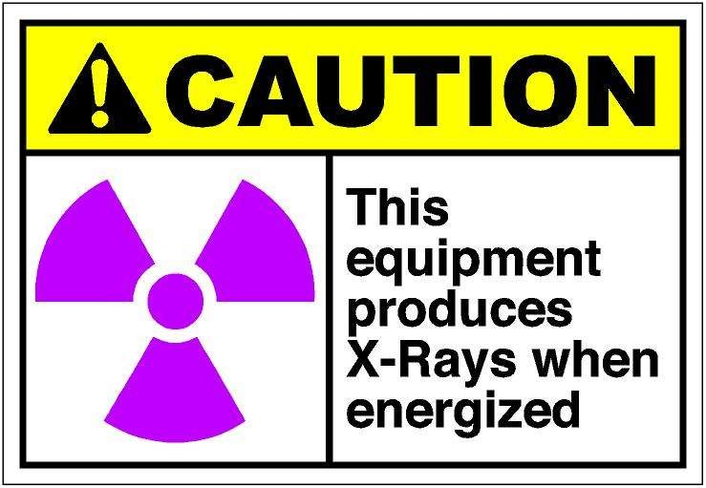
Man-Made Sources
Exposure is mostly through medical procedures like X-ray diagnostics.
Radiation therapy is usually targeted only to the affected tissues.

Slide 23
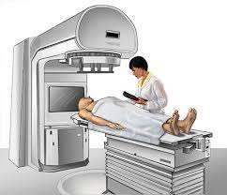
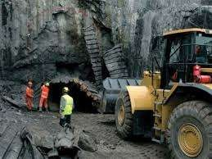
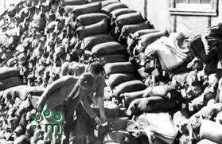

Slide 24
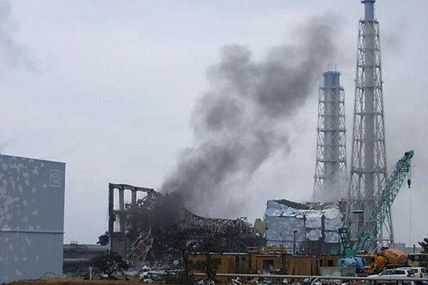
INDUSTRIAL
Industrial source waste can
contain alpha, beta, neutron or gamma emitters. Gamma emitters are used
in radiography while neutron emitting
sources are used in a range of applications, such as oil well logging.

Slide 25
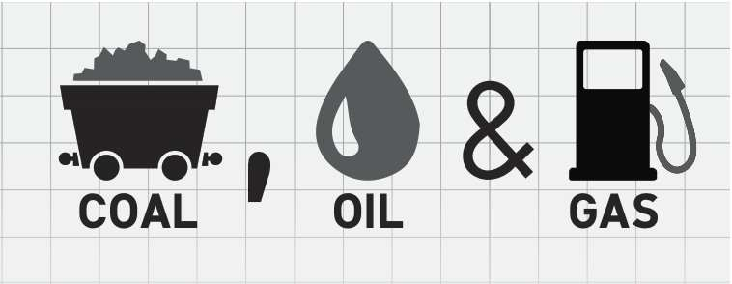
COAL,OIL AND GAS
Coal contains a small amount of radioactive uranium, barium, thorium and potassium, but, in the case of pure coal, this is significantly less than the average concentration of those elements in the Earth's crust.
Residues from the oil and gas industry often contain radium and its decay products.

Slide 26
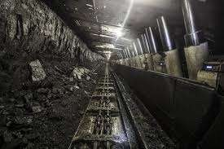
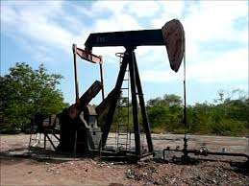
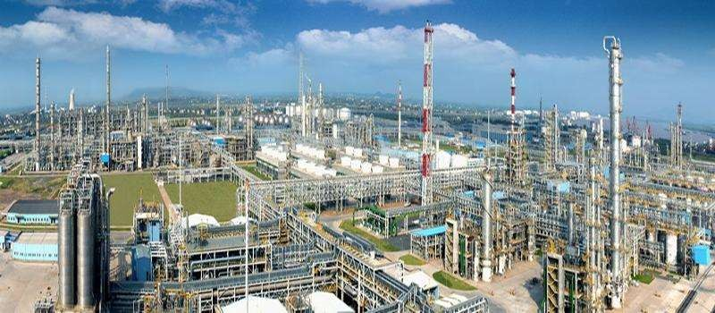

Slide 27
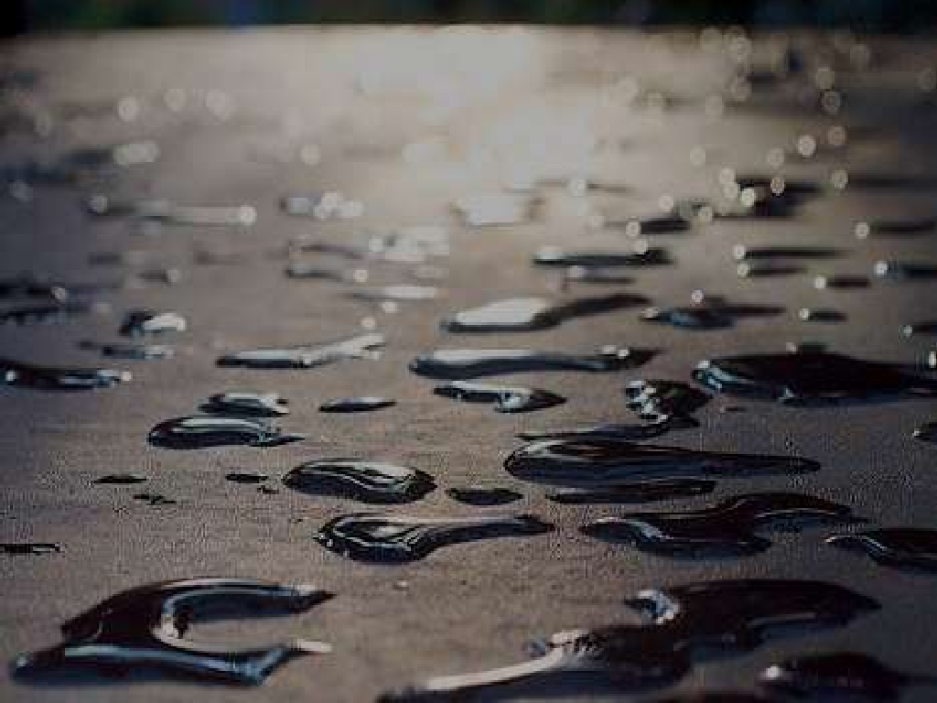
Effects & Dangers
of Radioactive Waste

Slide 28
Effects
Accidents
Scavenging
Transportation
Health Effects
Expense
Somatic Effects
Genetic effects
Naturally occuring Ionizing

Slide 29
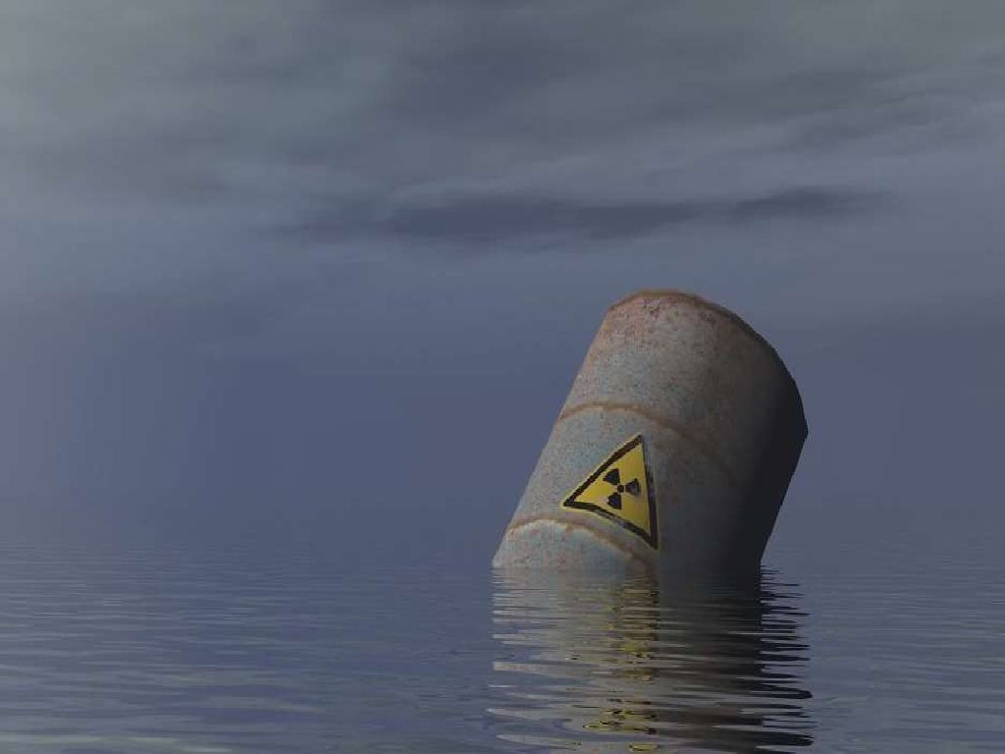
Accidents
Disastrous situations like nuclear waste being spread by dust storms into areas that were populated by humans and animals and contaminated of water, whether ponds, rivers or even the sea.

Slide 30
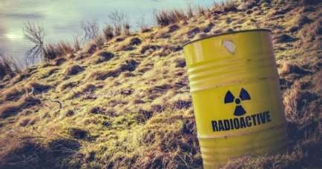
Scavenging
People often go scavenging for abandoned nuclear waste that is still radioactive.
People will willingly expose themselves to dangerous levels of radiation in order to make money.

Slide 31

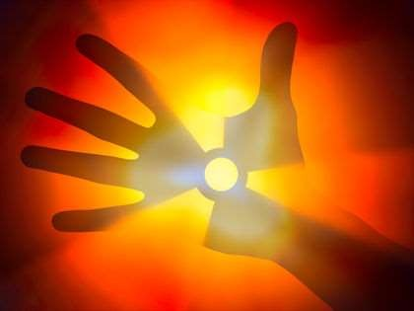
Health Effects
Long term effects to radiation can even cause cancer.
Radiation can cause changes in ‘DNA’ that ensures cell repair.

Slide 32
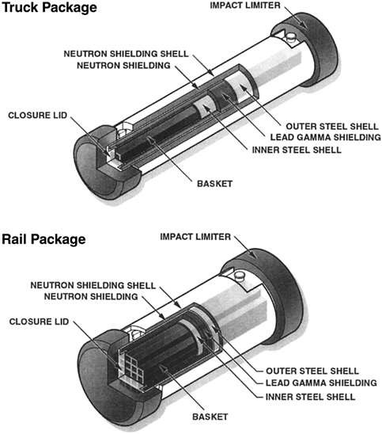
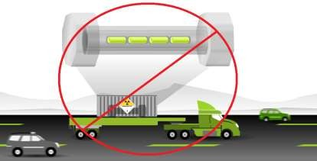
Transportation
Transporting nuclear waste from power plants can result in problems.
Use of poor shipping casks,then even a slight bump can cause contents to spill.

Slide 33

Expense
If accidents does occur, the cost of cleaning everything up and making everything safe once again for people, animals and plants is very high.

Slide 34
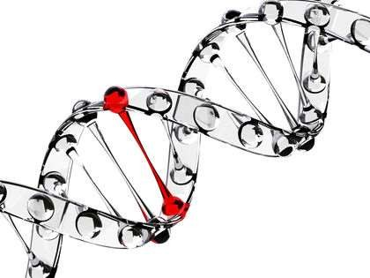
Genetic or Heritable Effects
Appears in the future generations of the exposed person as a result of radiation damage to the reproductive cells, but risks from genetic effects in humans are seen to be considerably smaller than the risks for somatic effects.

Slide 35
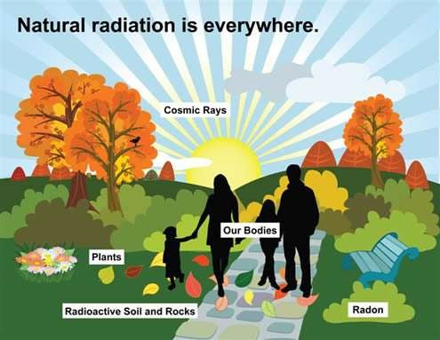
Naturally Occurring Ionizing
Also called background radiation.
Sources of background radiation include cosmic rays from the Sun and stars, naturally occurring radioactive materials in rocks and soil, radionuclide normally incorporated into our body’s tissues, and radon and its
products, which
we inhale.

Slide 36

Dangers
Long half life
Storage
Affects on Nature

Slide 37
Long Half Life
The products of nuclear fission have long half lives.
They will continue to be radioactive for many thousands of years.
Stored nuclear waste can be extremely volatile and dangerous for many years to come.

Slide 38
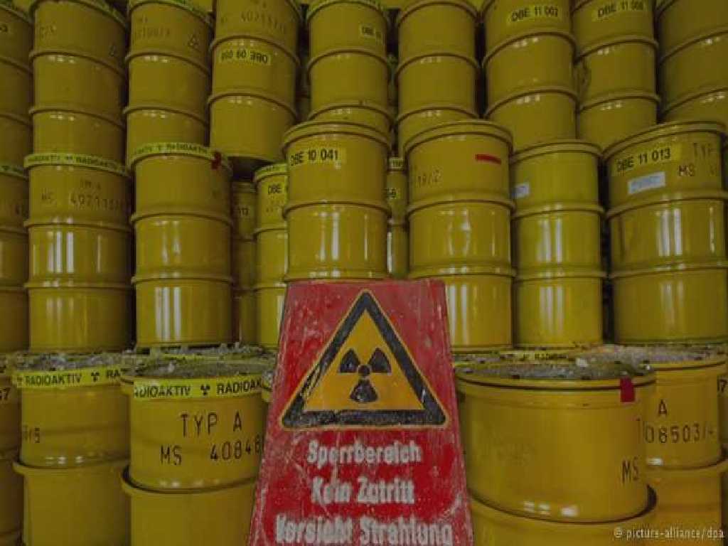
Storage
One of the major issue is storage
Can be stored in ground, ejected in space, disposed in ocean or disposed in ice sheets.

Slide 39
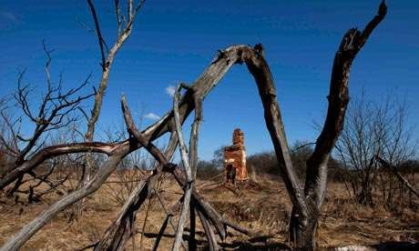
Affects on Nature
Have huge environmental impacts on plant and animal species.
Can cause cancerous growths, for instance, or causing genetic problems.

Slide 40
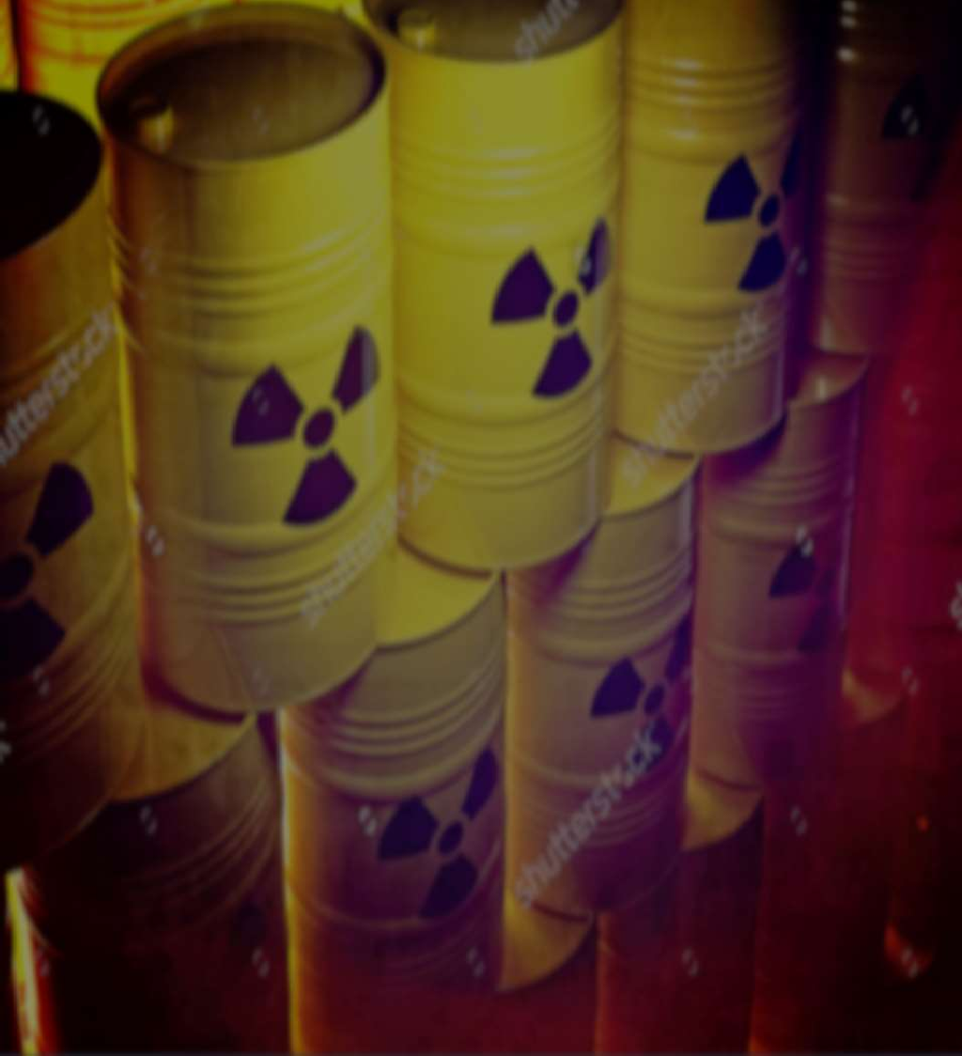
Storage
of Radioactive Waste

Slide 41
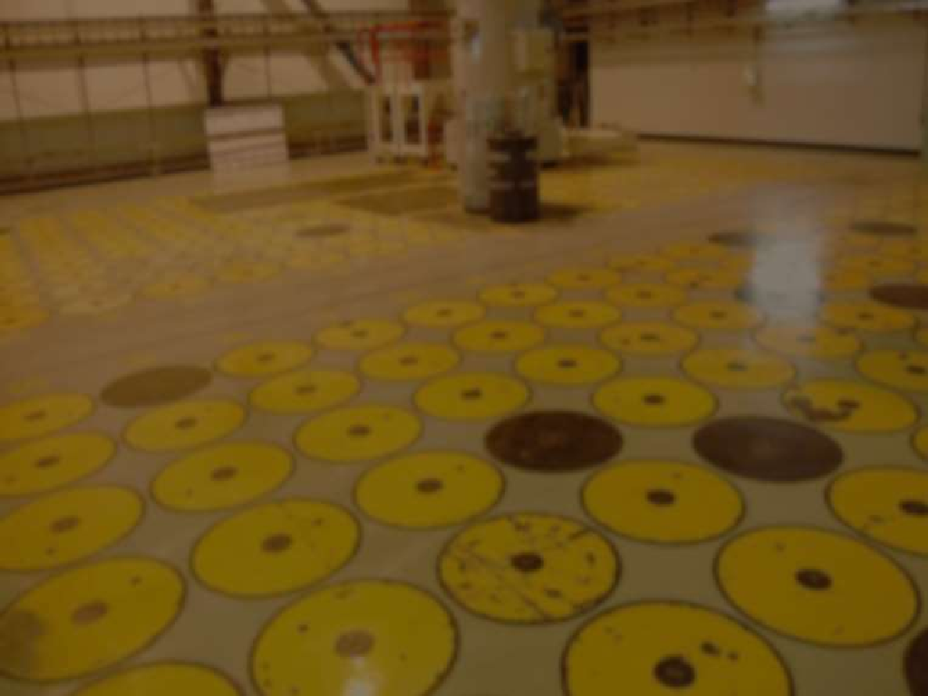
Storage of Spent Fuel
Two different strategies are used for spent nuclear fuel:
  Reprocessing for new fuel
  Storing for future needs
France, China, India, Japan, Russia reprocesses the fuel.
USA, Finland, Sweden, Canada have opted for direct disposal.

Slide 42






Storage
Dry Storage
Wet Storage
Spent Fuel Ponds
Virtification
Underground Storages

Slide 43
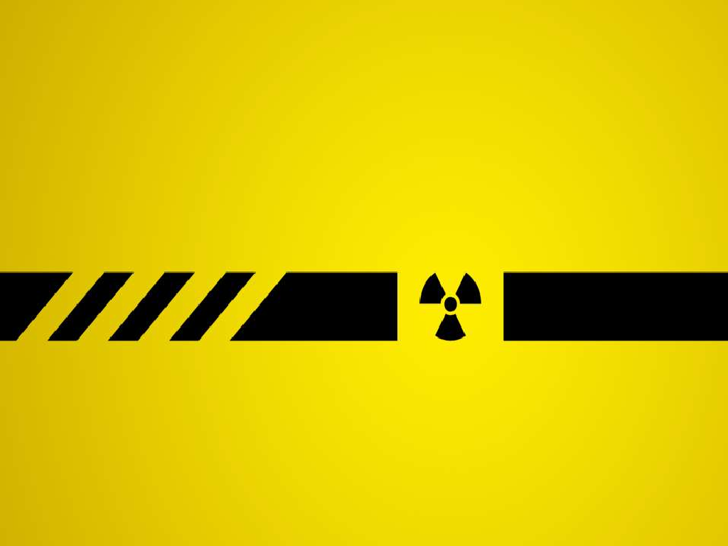
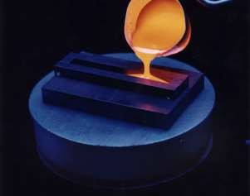
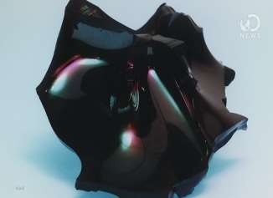
Vitrification
It is a technique for the transformation of a substance into a glass (non-crystalline amorphous solid).
Principle aims are:
1)Minimise the volume of waste
2)Reduce potential hazard by conditioning it into solid form

Slide 44
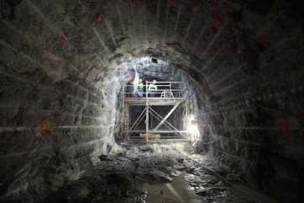
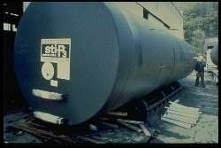
Underground Storage
A Storage tank, not including any underground piping connected to the tank.
Having 10% of its volume underground

Slide 45
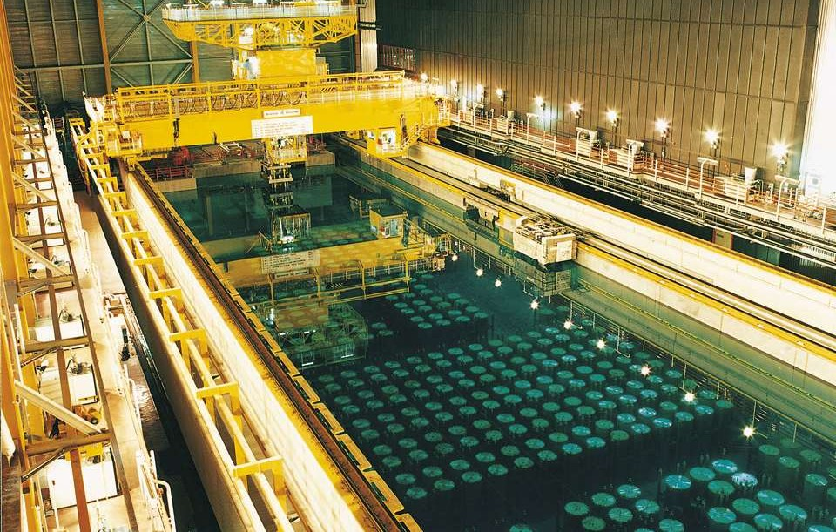
SPENT FUEL POOLS
Spent fuel pools (SFP) are storage pools for spent fuel
from nuclear reactor.
The nuclear waste is stored at least 20 feet under the
water.

Slide 46
Storage of Spent Fuel
Store waste in only approved bags and container.
Bags – Yellow with Radiation label
Boxes – Line with Yellow bag
Bottles – Attach Radiation label
DO NOT use anything that can be mistaken for a ordinary trash container
DO NOT use coke bottles , milk bottles and etc. for liquid waste.

Slide 47
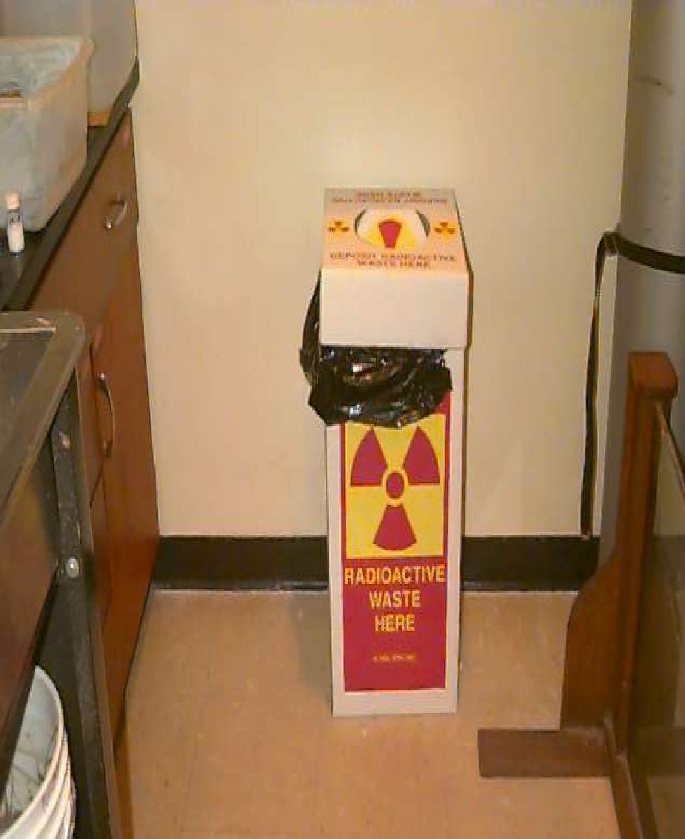
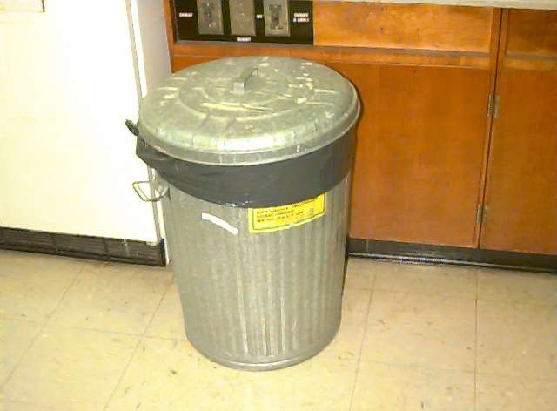
Waste Containers
Do’s
Don’ts

Slide 48
RADIOACTIVE DISPOSAL AND MANAGEMENT

Slide 49

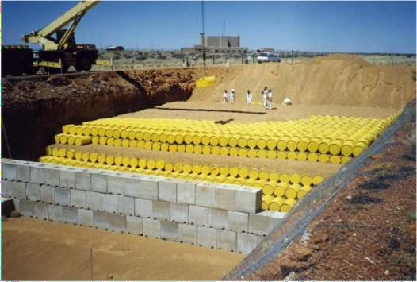
Disposal & Management
Waste disposal is discarding waste with no intention of retrieval.
Waste management means the entire sequence of operations starting with generation of waste and ending with disposal.

Slide 50
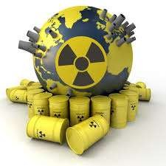
Methods
Deep geological repositories Ocean dumping
Seabed burial
Sub-seabed disposal
Subductive waste disposal method
Transforming radioactive waste to non-radioactive stable waste
Dispatching to the Sun
Legal methods of waste disposal

Slide 51

























Geological Disposal
Other ways
Ocean Dumping
Methods
Transmutation Method
Subductive Method

Slide 52
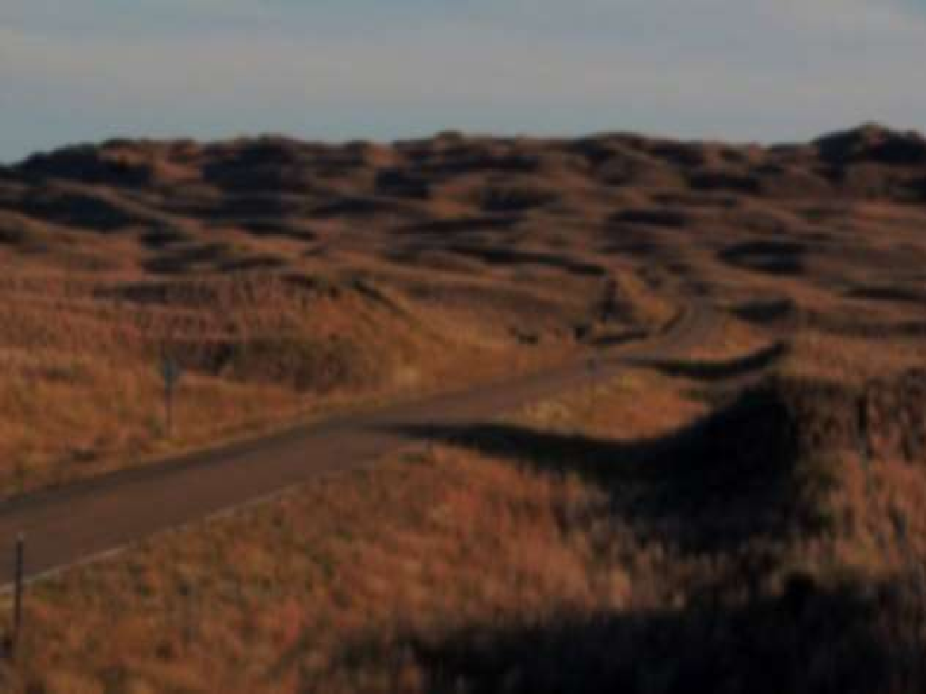
GEOLOGICAL DUMPING
Disposal in a facility constructed in tunnel, vaults or silos in a particular geological formation at least a few hundred meters below ground level.
Such a facility could be designed to accept high level radioactive waste (HLW), including spent fuels if it is to be treated as waste.
Yucca Mountain in USA is the recent of geological dumping.

Slide 53


GEOLOGICAL DUMPING
Geological dumping means disposal of nuclear waste under continental crust or under seabed.
It provides natural isolation system that is stable over thousands of years to contain long lived radioactive waste.
Low level radioactive waste (in near surface facilities or old mines)
High level radioactive waste (in host rocks that are crystalline or argillaceous)

Slide 54

OCEAN DUMPING
OCEAN DUMPING is the dumping or placing of material in the ocean , often on the continental shelf.
A wide range of materials is involved, including garbage, construction and demolition debris, sewage sludge, dredge material, waste chemicals, nuclear waste.
Sometimes hazardous and nuclear waste are also disposed but these are highly dangerous for aquatic life and human life also.

Slide 55



OCEAN DUMPING
Ocean dumping (good alternative and least expensive method)
In this method nuclear waste is dumped into the ocean.
For many years the countries like U.S.A.
,U.K.,FRANCE etc. Adopted this method.
Banned by most of the countries due to
scientific proof of bad effects on ocean and marine life.
But Russia continue to dispose of its waste
into ocean. Because it has no other alternative method.

Slide 56

SUB SEABED DISPOSAL
Seabed disposal is different from sea dumping. The floor of deep oceans is a part of tectonic plates covered by hundreds of meters of thick sedimentary soft clay.
The high level radioactive waste contained in canisters,would be lowered into these holes and stacked vertically one above the other interspersed by 20 m or more of mud pumped in.

Slide 57

Subductive waste disposal method
It is one of the single viable disposal method which ensures NON RETURN of regulated material to biosphere

Slide 58






