Slide 1
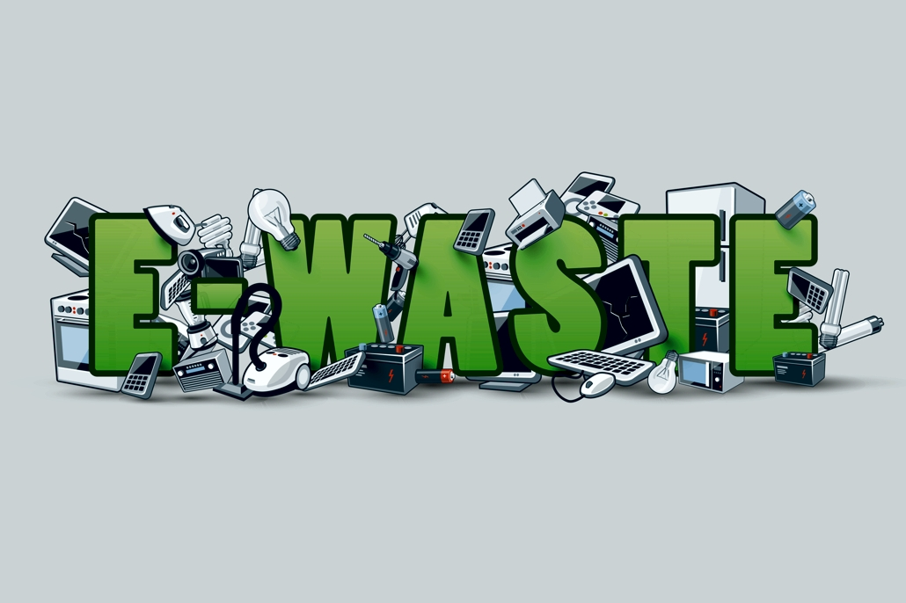
T.C.
ERCİYES UNİVERSTY
ENVİRONMENTAL ENGINEERING
HAZARDOUS WASTE MANAGEMENT
ELECTRONIC WASTE
M.RAŞİT DARICI
1030920131

Slide 2
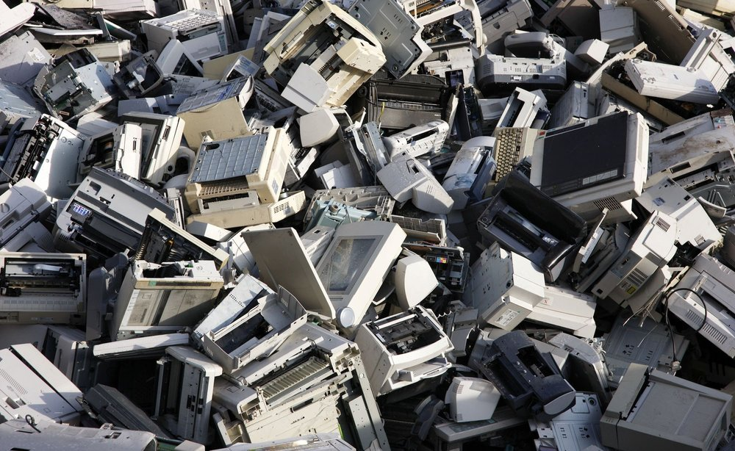
TODAY’S ELECTRONIC GADGETS..
TOMORROWS ELECTRONIC WASTE!!!!

Slide 3
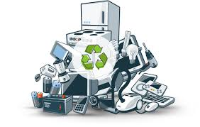
CONTENTS
WHAT IS THE E-WASTE ?
SOURCES OF E-WASTE.
TYPES OF E-WASTES.
EFFECTS OF E-WASTE ON ENVIRONMENT.
EFFECTS OF E-WASTE ON HUMANS BODY.
HOW THESE BECOME E-WASTE.
METHODS OF DISPOSAL OF E-WASTE.
WHY E-WASTE MANAGEMENT ?
STATISTICS.
CONCLUSION.

Slide 4
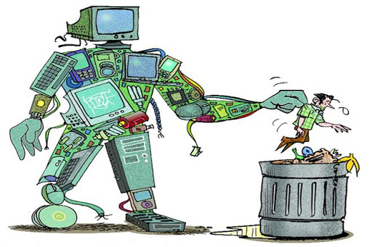
WHAT IS THE E-WASTE ?
Electronic waste or e-waste describes discarded electrical or electronic devices. Used electronics which are destined for refurbishment, reuse, resale, salvage recycling through material recovery, or disposal are also considered e-waste. Informal processing of e-waste in developing countries can lead to adverse human health effects and environmental pollution.

Slide 5
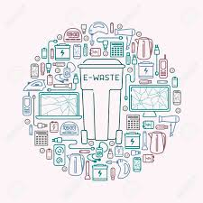
SOURCES OF E-WASTE.
Waste generated from the products used for data processing such as computer, computer devices like monitor, speakers, keybords,printer etc.
Electronic devices use for entertaiment like TV, DVDs and CD players.
Equipment or devices used for communication like phones, landline phones, fax etc.
Household equipment’s like vacuum cleaner, microwave ovens, washing machine, air conditioners etc.
Audio, visual components such as VCRs, stereo equipment etc.

Slide 6
TYPES OF E-WASTES.

Slide 7
EFFECTS OF E-WASTE ON ENVIRONMENT.
Emissions from E-waste create environmentol damage.
Toxis chemical from E-waste enter “soil-crop-food pathway”.
These are non-biodegrable and cause soil pollition.
E-waste dumping yards nearby places are polluted and cause health hazards.

Slide 8
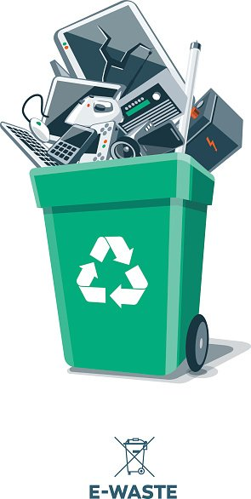
EFFECTS OF E-WASTE ON HUMANS BODY.

Slide 9
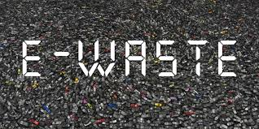
HOW THESE BECOME E-WASTE.
Reasons:
Advancement in technology.
Changes in style fashion and status
Nearing the end of their useful life.
Not talking precautions while handling them.

Slide 10
METHODS OF DISPOSAL OF E-WASTE.
Why we should ensure safe disposal of these
Land fill disposal allows heavy metals to leach into ground water.
Inciraneration makes hazardous material airborne.
Acid baths are dangerous and cause water and soil contamination.
To ensure exported materials are handled properly.

Slide 11
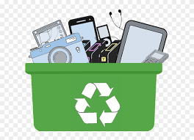
Methods

Slide 12
Advantages of recycling E-waste

Slide 13
WHY E-WASTE MANAGEMENT ?
Pollution of grand water.
Acidification of soil.
Emission of toxic fumes and gases.
It is the fastest growing portion of municipal waste.
Releases harmful gases into the air.

Slide 14
STATISTICS.
Fifty million metric tonnes of e-waste is generated every year, equalling the weight of nearly 4,500 Eiffel towers. Much of it is incinerated or placed in landfill, causing pollution, human health hazards and the loss of valuable finite resources.

Slide 15
CONCLUSION.
E-waste has emerged as one of the fastest growing waste streams world wide today.
Electronic gadgets, without proper disposal can cause environmental harm.
Reuse and recycle are more beneficial than simple disposal.
Designing of products using environment friendly raw items can make a change.
Awaneress of e-waste should be given.
Govrment shall take steps to reduce e-waste disposal

Slide 16
References
https://www.omurgokkus.com
https://tcocertified.com/e-waste/?gclid=EAIaIQobChMIzO-f0e2N6AIVC1PTCh1lTAzjEAAYASAAEgL1wfD_BwE
https://mybarc.org/e-waste-problems/?gclid=EAIaIQobChMI-5XKi6yN6AIVTsjeCh2WDAxSEAAYASAAEgIZifD_BwE
https://www.who.int/ceh/risks/ewaste/en/
https://en.wikipedia.org/wiki/Electronic_waste

Slide 17
Thank you ☺

