Slide 1
HAZARDOUS WASTE IDENTIFICATION AND CLASSIFICATION
Seyyid Aliosman BİLGİNER
1030910553
Erciyes University Environmental Engineering

Slide 2
Table of Contents
1) What is Hazardous Waste?
a) Criteria based on deciding whether a waste is dangerous.
2) Classification of Hazardous Wastes.
a) What is AYGEİY?
b) Hazardous Waste List.

Slide 3
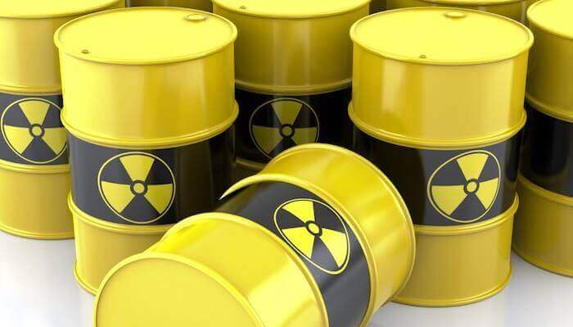
What is Hazardous Waste?
Carcinogenic, toxic, explosive, flammable, corrosive, irritant etc. wastes that pose a risk to human health and the environment due to their properties are called hazardous waste.

Slide 4
Criteria based on deciding whether a waste is dangerous:
Composition of waste,
Amount of waste components,
Chemical reagents of waste components,
Physical state of waste,
Environmental impacts and persistence of waste can be summarized as.

Slide 5
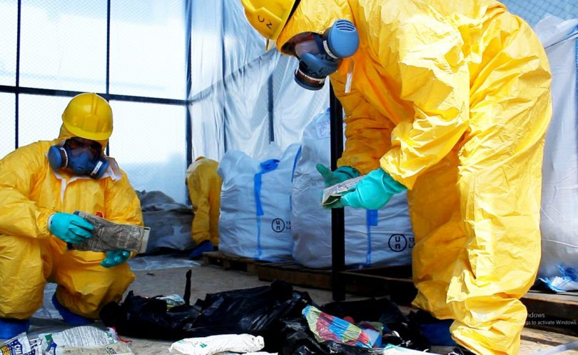
Classification of Hazardous Wastes
Classification of hazardous wastes; the degree of danger, according to source, flammable, corrosive, reactive, toxic properties are classified according to.
Wastes can be classified as solid, sludge, dust, liquid, gas, flammable and non-flammable depending on their physical condition.

Slide 6
What is AYGEİY?
AYGEİY: Regulation on General Principles of Waste Management
AYGEİY consists of 4 sections in total.
Ek-I
A list of substances that have been released or disposed of in the environment as a result of any activity is given. This list defines waste categories.

Slide 7
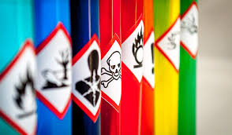
Ek-II/A:
Ek-I describes the disposal procedures for wastes.
Ek-III/A
Limit concentrations should be checked in order to determine whether the waste classified as potentially hazardous waste is dangerous.
Ek-IV
Waste list is given and encodings are made.

Slide 8
Ek-IV wastes are divided into 20 main categories.
Sections 1 - 12, 17 - 19; resource based
Sections 6 to 7; detailing based on processing.
Sections 13 - 15; based on matter and material
Sections 16; wastes not otherwise specified in the list
Section 20; There are 20 main headings, namely municipal waste.

Slide 9
Hazardous Waste List
The waste list is given with AYGEİY Ek-IV. This list is made of waste classification and there is a waste code for each waste identification.
There are 839 waste code entries for waste in the list.

Slide 10
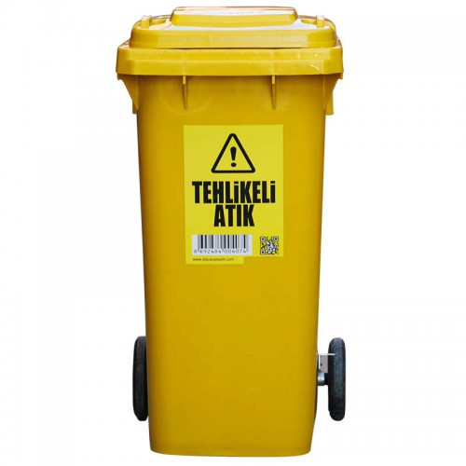
Waste codes use a 6-digit code system. The first two steps of this coding system show the industry where waste is sourced. The second double step details the sub-title of this sector and the last two digits gives the code of waste. Waste codes must be used as 6 digits.

Slide 12
In addition, these wastes are divided into two categories: dangerous and non-hazardous. There is a * sign beside the labeling of hazardous wastes and there is no sign for hazardous wastes. hazardous wastes marked with * are divided into two groups within themselves:
A: certain hazardous waste
M: possible hazardous waste

Slide 13
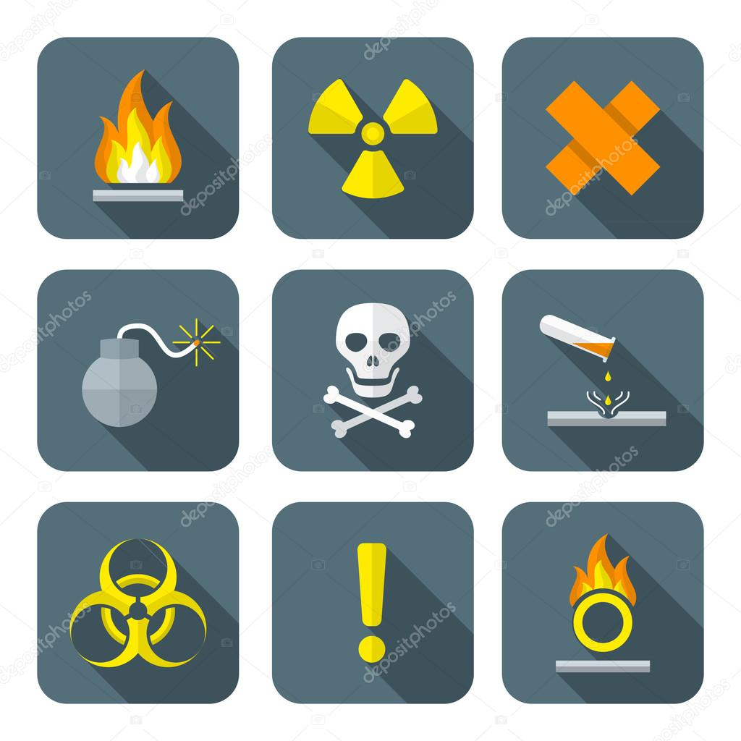
Waste marked with A is hazardous waste without any analysis and should be evaluated within this framework.
Waste marked with M is potentially hazardous waste and it is necessary to analyze it in order to determine whether it is dangerous.

Slide 15
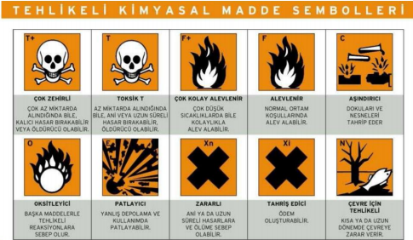
There are a total of 408 hazardous waste codes, 241 (m) marked. Classification of hazardous wastes is mainly carried out with two different approaches according to the content characteristics and source.

Slide 16
References:
https://webdosya.csb.gov.tr/db/destek/editordosya/Siniflandirma_Kilavuzu_Cilt%20I.pdf
https://webdosya.csb.gov.tr/db/destek/editordosya/Siniflandirma_Kilavuzu_Cilt%20I.pdf

Slide 17
Thank you for listening to me …

