Slide 1
HOSPITAL WASTE MANAGEMENT
Submitted By :
Hatice Nur ÇELİK

Slide 2
What is Medical Waste?
Hospital Waste is the waste produced in the course of health care activities during treating, diagnosing and immunizing human beings or animals or while doing study/research activities. 75- 90% Non hazardous or General waste 10-15% Hazardous or harmful waste.

Slide 3
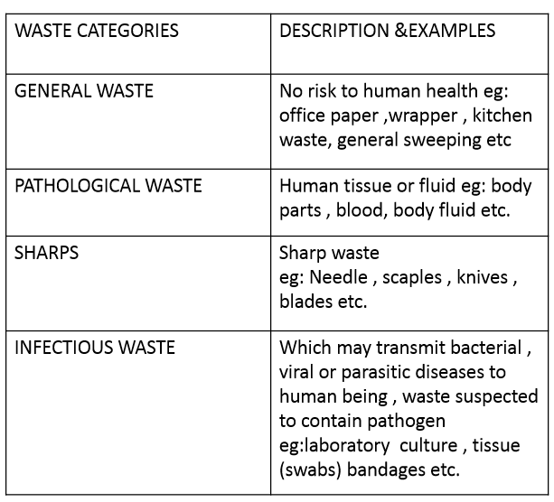
WHO Classification

Slide 4
WHO Classification

Slide 5
SOURCE OF HEALTH CARE WASTE
Governmental Hospitals
Private Hospitals
Nursing Homes
Physician’s office
Dentist office
Dispensaries
Blood bank &collection center
Animal houses
Research organizations

Slide 6
GENERATION, SEGREGATION, COLLECTION, STORAGE, TRANSPORTATION AND TREATMENT OF WASTE

Slide 7
1.GENERATION

Slide 8
2.SEGREGATION
Done at point of generation of waste and put in separate color bags . Color coding varies from nation to nation . For eg. In AIIMS hospital , New delhi , Following color code bags are practised.

Slide 9
GENERAL WASTE

Slide 10
INFECTIOUS WASTE/PATHOLOGICAL WASTE

Slide 11
SHARP & DISPOSABLE WASTE

Slide 13
3.COLLECTION OF WASTE
Centralized sanitation staffs or any other sanitation staffs should collect the waste during morning , afternoon or evening under the supervision of nursing staff and sanitation supervisior; documentation should be done in register ; Garbage should be cleaned and disinfected regularly.

Slide 14
4.STORAGE OF WASTE
Waste should not be stored in the generation area for more than a period of 4-6 hours.
It is responsibility of paramedic/sanitation staff to check for segregation.
Waste collected in various areas should be transported for disposal/treatment.

Slide 15
TRANSPORTATION
•There should be separate corridor and lift in hospital to carry and transport waste.
•General waste are deposited at municipal dumps.
•Waste for autoclaving and incineration are dumped at separate site for external waste (should have separate colored plastic bag for these waste).
•Transportation should be done in sealed container, sanitation supervisor should ensure for leakage.

Slide 16
TREATMENT & DISPOSAL
•General waste should be dumped at municipal dumping site . Sanitation officer should be responsible for proper coordination between municipal & hospital.
•Use of label/symbol is useful in identifying waste for treatment . Eg: risk of corrosion ,danger of infection, toxic hazards, glass hazards, radioactive material

Slide 17
LABEL FOR BIO-MEDICAL WASTE CONTAINERS/BAGS

Slide 18
TREATMENT &DISPOSAL TECHNOLOGIES
IncIneratIon
ChemIcal DIsInfectIon
Wet &dry thermal treatment
MIcrowave IrradIatIon
Land dIsposal
InertIzatIon

Slide 19
INCINERATION
High temperature dry oxidation process that reduce organic and combustible waste into incombustible matter.
Resulting into significant reduction in waste volume and weight.
This process is selected to treat waste that cannot be recycled, reused or can be disposed in land.

Slide 20
TYPES OF INCINERATORS
Double Chambered(for infectious waste)
Single Chambered
Rotatory Kilns(for genotoxic waste)

Slide 21
CHEMICAL DISINFECTION
Commonly used for treatment of liquid infectious waste eg. Blood, urine, stool and hospital sewage.
Chemicals are added to waste to kill or inactivate the pathogen it contains

Slide 22
WET & DRY THERMAL TREATMENT
•Wet thermal treatment/steam disinfection is based on exposure if infectious waste to high temperature and high pressure steam similar to process of autoclaving, inappropriate for treating anatomical waste, chemical and pharmaceutical waste.
•Screw feed technology: Dry thermal treatment which waste is shredded and heated in rotating auger. 80% volume and 20-35 weight is reduced, suitable for infectious waste and sharps.

Slide 23
MICROWAVE IRRADIATION
Microwave of frequency 2450MHZ and wave length 12.24cm used to destroy the microorganism . Water contained in the waste is rapidly heated by microwave and infectious component are destroyed by heat conduction.

Slide 24
LAND DISPOSAL
1.Open Dumps : risk for public health
2.Sanitary landfills: designed and constructed to prevent contamination of soil , surface, ground water and direct contact with public.

Slide 25
INERTIZATION
•Process of mixing waste with cement and other substances before disposal in order to minimize the risk of toxic substance migrating in to surface water or ground water and to prevent scavenging
•Proportion of 65% waste, 15% lime, 15%cement and 5% water is used

Slide 27
REFERENCES
http://www.hastaneinfeksiyonlarıdergisi.org/managete/fu_folder/2004-02/html.htm
http://www.istanbulsaglik.gov.tr/w/sb/egt/pdf/ftas.pdf
https://www.youtube.com/watch?v=J18QQBYrCjo
https://www.youtube.com/watch?v=cpnOWcYqUEk

Slide 28
THANK YOU

