Slide 1
COLLECTION OF WASTE BATTERIES AND DISPOSAL
PREPARED
Tuğba TANRIKULU
1030910580

Slide 2
CONTENTS
WHAT IS A BATTERY? WHERE TO USE ?
WHAT ARE THE TYPES OF BATTERIES AND WHAT ARE THEIR CONTENTS?
SIGNS ON BATTERY PACKAGING
BATTERY INDUSTRY IN TURKEY
WHAT IS A WASTE BATTERY? WHAT SHOULD WE DO?
COLLECTİON ACTİVİTİES
WHERE YOU CAN FIND WASTE BATTERY BOXES
WASTE BATTERY COLLECTION MATERIALS
WASTE BATTERY COLLECTION VEHICLES
SEPARATION BY TYPES
RECYCLING AND DISPOSAL
WASTE BATTERY RECYCLING CYCLE
REFERENCES

Slide 3
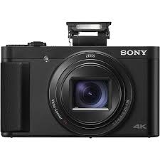
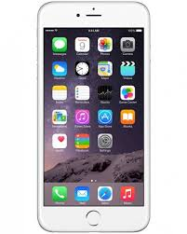
WHAT IS A BATTERY? WHERE TO USE ?
Batteries are devices of various types and sizes which can store electrical energy as a result of chemical reactions, provide the necessary electric current when the (+) and (-) terminals are connected to a device.
Batteries, in addition to those shown below, are found in many devices and are an integral part of our daily lives.

Slide 4
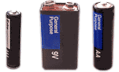
WHAT ARE THE TYPES OF BATTERIES AND WHAT ARE THEIR CONTENTS?
a) Non-rechargeable or disposable batteries,
b) Rechargeable or reusable batteries,
can be divided into two main groups.
In addition, the batteries can also be defined as cylindrical, button and rismatic.
Batteries are contain, cadmium, zinc, manganese, iron, lithium, nickel, cobalt and so on. metals, various chemical compounds, plastics and
paper / cardboard.

Slide 5
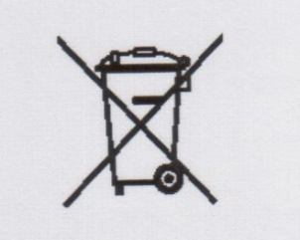
SIGNS ON BATTERY PACKAGING
Indicates that batteries should not be disposed of.
It shows that the amount of mercury in the batteries is greater than 0.0005% (5 mg / kg).
Hg
Indicates that the cadmium content in the batteries is greater than 0.025% (250mg / kg).
Cd

Slide 6
BATTERY INDUSTRY IN TURKEY
Production of batteries in portable types are not made in Turkey. All of the demand is met by imports.
Approximately 85% of the imported batteries are non-rechargeable type (zinc-carbon, alkali manganese and button) and the remainder are nickel-cadmium, nickel-metal hydride or lithium-ion batteries that can be charged.
The consumption of primary batteries varies from rural to urban. The main reason for the change is price difference.
In parallel with the increase in demand on mobile phones and laptops, there has been a large increase in the amount of imported Li-ion batteries.

Slide 7
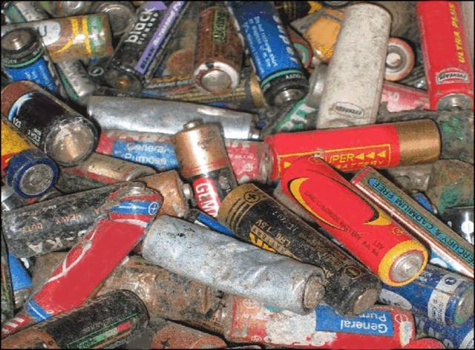
WHAT IS A WASTE BATTERY? WHAT SHOULD WE DO?
We call the batteries that have become unusable due to physical damage and / or have been expired. Recovered batteries cannot be repaired and reused.
Waste batteries should not be mixed with household waste and should never be disposed of in waste.
Waste batteries should not be thrown into the fire, water sources and buried in the ground. Otherwise, the outer container of the battery can be drilled over time and the metals and chemicals in it can be mixed with soil and water.
Waste batteries should be stored separately in your homes and disposed of in waste battery collection boxes.

Slide 8
COLLECTİON ACTİVİTİES
Various chemical substances in waste batteries can be mixed with irrigation water and soil from wild landfills, creating environmental pollution. For this reason, in order to increase the efficient use of natural resources through the recovery of waste batteries, we should either dispose of the waste batteries in nylon bags, cardboard boxes or jars, or put them in the waste battery boxes located in the collecting centers determined by the municipalities. .

Slide 9
WHERE YOU CAN FIND WASTE BATTERY BOXES
At schools and universities,
In Market
In local government,
In the mosque,
In hospitals and pharmacies,
in hotels,
In all Public, Military and Private Institutions / Organizations,
In the post office,
In Industrial Areas,
Airports,
On Protected Sites,
Prisons,

Slide 10
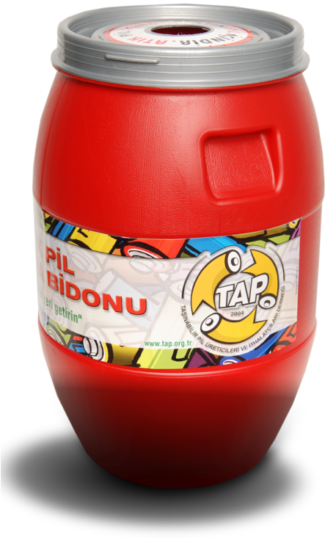
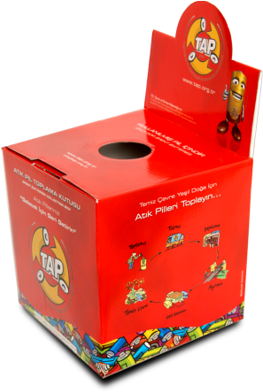
WASTE BATTERY COLLECTION MATERIALS

Slide 11
In our country, TAP is interested in waste batteries. They make announcements from their official pages by organizing various campaigns and incentives.

Slide 12
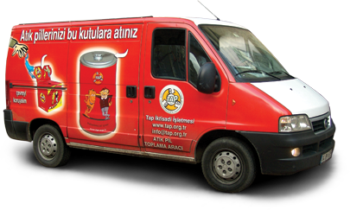
WASTE BATTERY COLLECTION VEHICLES

Slide 13
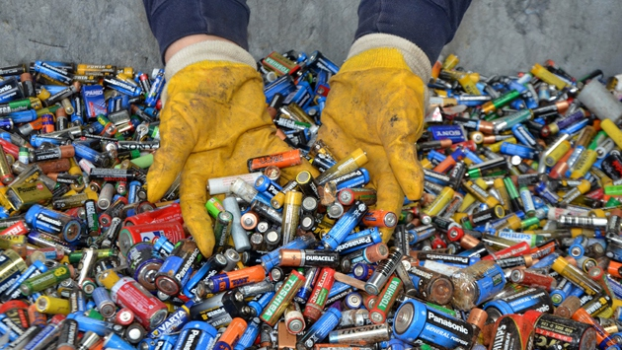
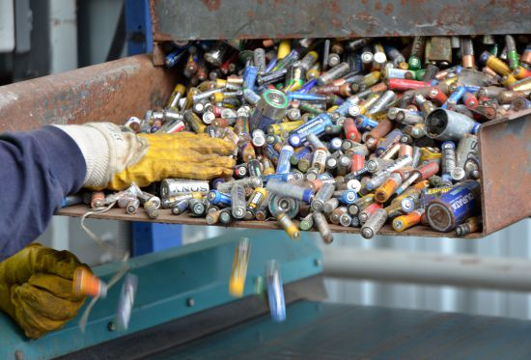
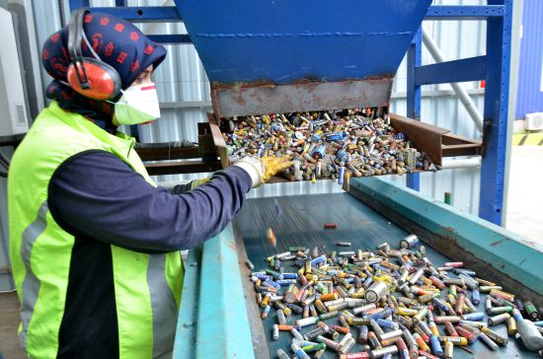
SEPARATION BY TYPES
Turkey's first "Waste Battery Recycling Plant" in Kocaeli.
The waste batteries are disposed in such a way that they do not cause environmental pollution, and the metals are supplied to the industry.
Thanks to the integrated plant, where the separation, recovery and recovery of waste batteries are carried out together, the precious metals inside the batteries are recycled and the potential harm to the environment is prevented.

Slide 14
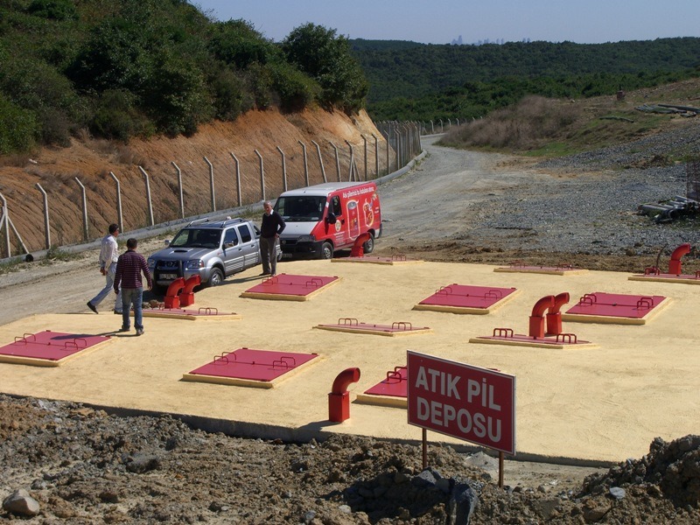
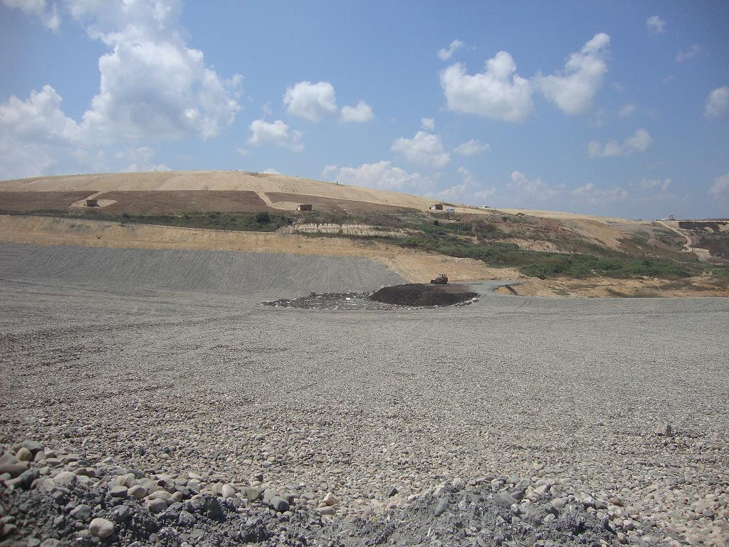
RECYCLING AND DISPOSAL
A facility capable of recycling of waste batteries in Turkey are not yet available. Therefore, the non-rechargeable type batteries collected are disposed of. Disposal is carried out in reinforced concrete storages specially constructed in underground and İSTAÇ Inc. in Şile, Istanbul, and started in 2010 at the surface storage area.

Slide 15
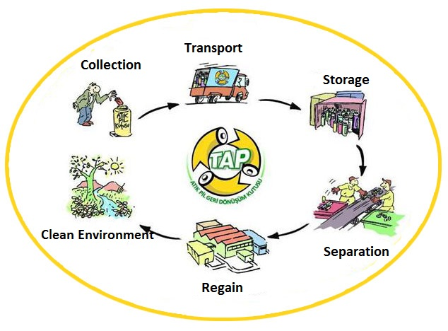
WASTE BATTERY RECYCLING CYCLE

Slide 16
REFERENCES
https://www.calrecycle.ca.gov/reducewaste/batteries
https://www.sustainability.vic.gov.au/You-and-your-home/Waste-and-recycling/Household-waste/Batteries
https://www.tap.org.tr/pil-atik-pil/sss/atik-pillerin-bertaraf-ve-geri-donusumu/
https://agtatik.com/haber/atik-piller-ekonomiye-kazandiriliyor/

